Slide 1
Walls and Barriers

Slide 2
AGENDA
Standards and Learning Objectives
Wall Graph
Paired Text
Jigsaw
Building Walls

Slide 3
STANDARDS
ONLS.6.6: Variations among physical environments within the Eastern Hemisphere influence human activities. Human activities also alter the physical environment.
CCSS.ELA-LITERACY.RH.6-8.7: Integrate visual information (e.g., in charts, graphs, photographs, videos, or maps) with other information in print and digital texts.

Slide 4
LEARNING OBJECTIVES
Students will compare a physical wall built by a country to the US-Mexico border.
Students will identify reasons why countries build walls.

Slide 5
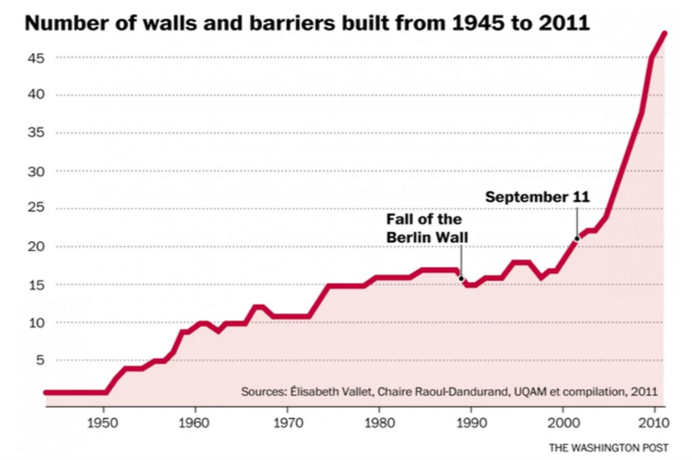

Slide 6
POLL
Based on this graph, do you believe the events of September 11, 2001 lead to the increase of the number of walls and barriers built by different countries?
YES or NO

Slide 7
PAIRED TEXT
Groups will work with a paired text to discuss similarities between their particular wall and the US-Mexico Border, how their wall influenced access to their country, and how the US-Mexico Border influences who can easily enter the US.

Slide 8
JIGSAW
Groups will trade two members to share findings from their paired text.

Slide 9
OPEN ENDED QUESTION
Write one reason as to why countries build physical walls and barriers.

