Slide 1
America Making the Grade
Infrastructure

Slide 2
Making the Grade
Standards
D2.Civ.1.6-8. Distinguish the powers and responsibilities of citizens, political parties, interest groups, and the media in a variety of governmental and nongovernmental contexts.
D2.Civ.2.6-8. Explain speciﬁc roles played by citizens (such as voters, jurors, taxpayers, members of the armed forces, petitioners, protesters, and ofﬁce-holders)

Slide 3
Making the Grade
I Can…
Define one aspect of American Infrastructure
summarize the grade given to a specific area of American Infrastructure

Slide 4
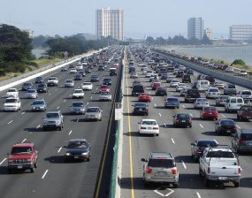
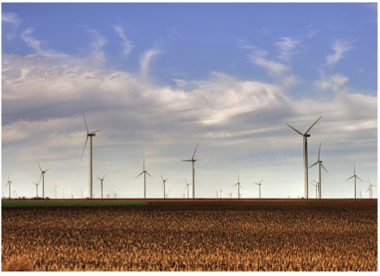
Making the Grade
Infrastructure
The basic physical and organizational structures and facilities (e.g. buildings, roads, power supplies) needed for the operation of a society or enterprise.

Slide 5
Making the Grade
Why is it important…?
Infrastructure includes…
Aviation
Dams
Energy
Inland waterways
Ports
Rail (trains)
Schools
Solid waste
Bridges
Drinking water
Hazardous waste
Levees
Public parks
Roads
Transit
Wastewater

Slide 6
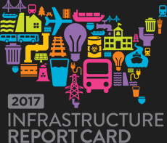
Making the Grade
Each category is graded by…
Capacity
Condition
Funding
Future need
Operation & Maintenance
Public safety
Resilience
Innovation

Slide 7
Making the Grade
What Makes the Grade?
Terms
Capacity: the maximum amount that something can contain.
- Does the infrastructure’s capacity meet current and future demands?
Condition: the state of something with regard to its appearance, quality, or working order.
- What is the infrastructure’s existing and near-future physical condition?
© 2020 ASCE's 2017 Infrastructure Report Card

Slide 8
Making the Grade
What Makes the Grade? Continued
Funding: money provided, especially by an organization or government, for a particular purpose.
- What is the current level of funding from all levels of government for the infrastructure category as compared to the estimated funding need?
Future Need: What is the cost to improve the infrastructure? Will future funding prospects address the need?

Slide 9
Making the Grade
What Makes the Grade?
Terms Continued
Operation: the fact or condition of functioning or being active.
Maintenance: the process of maintaining or preserving someone or something, or the state of being maintained
Public Safety: To what extent is the public’s safety jeopardized by the condition of the infrastructure and what could be the consequences of failure?
Resilience: the capacity to recover quickly from difficulties; toughness.
Innovation: make changes in something established, especially by introducing new methods, ideas, or products.
© 2020 ASCE's 2017 Infrastructure Report Card

Slide 10
Making the Grade
Poster Prep
In groups, prepare your summary of the report on your assigned category of the U.S. Infrastructure
Be sure each member has a role
Be prepared to share your summary with the class

Slide 11
Making the Grade
Poster Guidelines
Read the report
Highlight important phrases/stats/facts
Discuss with group what you read
Create a poster based on what you discuss
Poster should reflect what the report was and explain why it got the grade it did

