Slide 1
Karbala and the Sunni-Shia Split
Thomas Nitz

Slide 2
Early Islam
Learning Objectives:
I Can… compare and contrast religious beliefs between Sunni and Shia Islam.
I Can… analyze how the split between Sunni and Shia Islam changed into a political difference.

Slide 3
Early Islam
OH Grade 7 Social Studies Standard #5:
“Achievements in medicine, science, mathematics and geography by the Islamic civilization dominated most of the Mediterranean after the decline of the Roman Empire. These achievements were introduced into Western Europe as a result of the Muslim conquests, Crusades and trade, influencing the European Renaissance.”

Slide 4
Early Islam
Agenda:
Standards
LOs
Video
Check for Understanding
Key Vocabulary
Gallery Walk
Exit Ticket

Slide 5
Early Islam
Video:
https://www.youtube.com/watch?v=V7gim2tWgK0

Slide 6
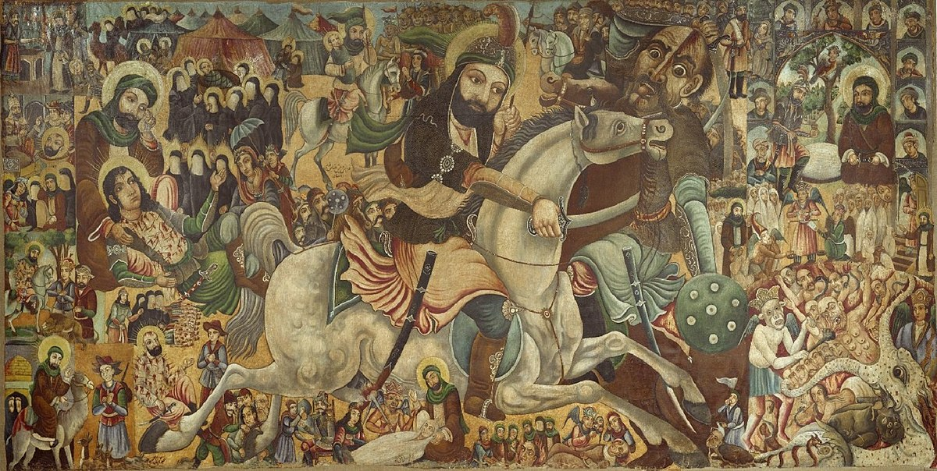
Early Islam
What happened to Hussayn ibn-Ali at the Battle of Karbala?

Slide 7
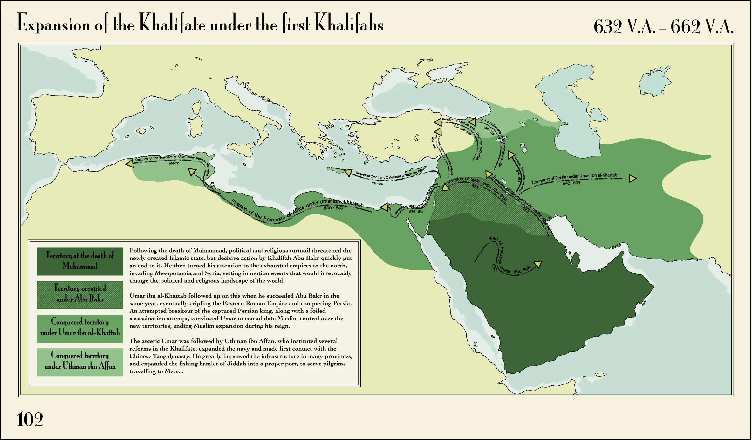
Early Islam
Vocabulary
Caliph/Caliphate: Ruler of a Muslim community, who is considered by that community to be the political and religious successor of Muhammad

Slide 8
Early Islam
Vocabulary
Ali: Son-in-Law of Muhammad
Hussayn ibn-Ali: Son of Ali

Slide 9
Early Islam
Vocabulary
Sunni: means “tradition”, Muslims who believe that the caliph doesn’t need to be from Muhammad’s family.
Shia: “The followers of Ali”, Muslims who believe that Ali should have been the caliph after Muhammad died.

Slide 10
Early Islam
Gallery Walk:
When I say to begin, move with your tablemates to the “artifact” posted on the wall that matches the number on your table.
Complete the gallery walk as directed on the handout.

Slide 11
Early Islam
Gallery Walk:
You will have 4 minutes at that station.
When time is called, move clockwise to the next station.

Slide 12
Early Islam
Exit Ticket
What is one difference between Sunni and Shia Islam?

