Slide 1
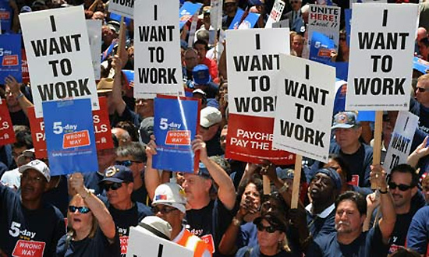
America & Unemployment
Created by: tori Siefker and Emily young

Slide 2
Opening activity
At your tables, without using technology, please guess the current unemployment rate in the United States.

Slide 3
Share out!
Share your thoughts!

Slide 4
statistics
Today's Unemployment Rate:
5.1% (as of Sep. 2015)This means about 16,426,800 people are currently unemployed in the United States.

Slide 5
agenda
Review Content Standards and LOs
Poll Everywhere Interactive
Classroom Activity Overview
Wrap Up

Slide 6
Content standards
S.S. Standard: The Great Depression was caused, in part, by the federal government's monetary policies, stock market speculation, increasing consumer debt. The role of the federal government expanded as a result of the Great Depression.
CCSS.ELA-LITERACY.WHST.9-10.1.B Develop claim(s) and counterclaims fairly, supplying data and evidence for each while pointing out the strengths and limitations of both claim(s) and counterclaims in a discipline-appropriate form and in a manner that anticipates the audience's knowledge level and concerns.

Slide 7
Learning objectives
L.O.1: Students will summarize the various courses of actions the U.S. government has taken regarding unemployment. (comprehend).L.O.2: Students will examine both historical and current perspectives on employment (analyze).
L.O.2: Students will examine both historical and current perspectives on employment (analyze).
L.O.3: Students will develop a formal piece of writing that supports their stance on a political issue (create).

Slide 8
Down and out (again)
Please take out your CELL PHONES

Slide 9
Down and out (again)
What perspective is present in this source?
What conclusions can you draw from this source?
What ideas justify the author/narrator’s opinions?

Slide 10
Voices of the unemployed

Slide 11
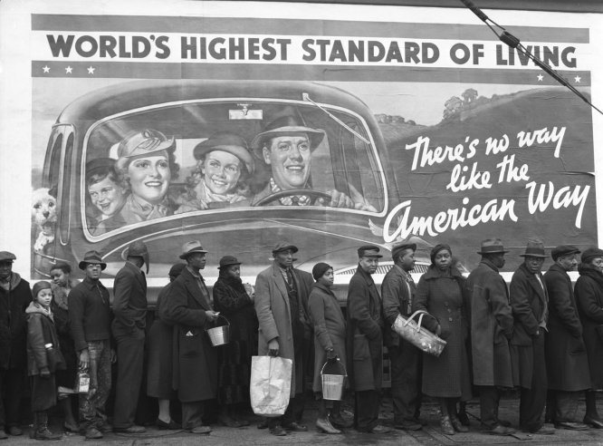
Historical Context

Slide 12
The face of unemployment

