Slide 1
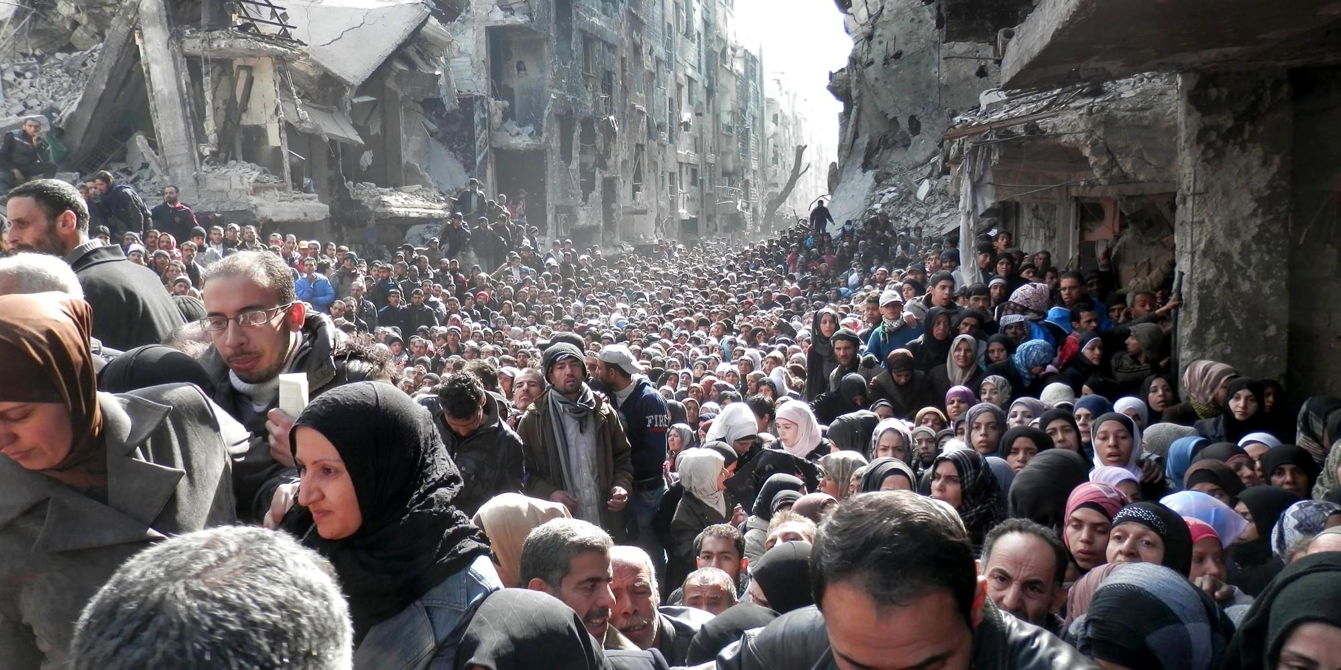
Syrian Civil War
The Syrian Crisis
Michael Reed
Joel Phillips
Andy Rhiel

Slide 2
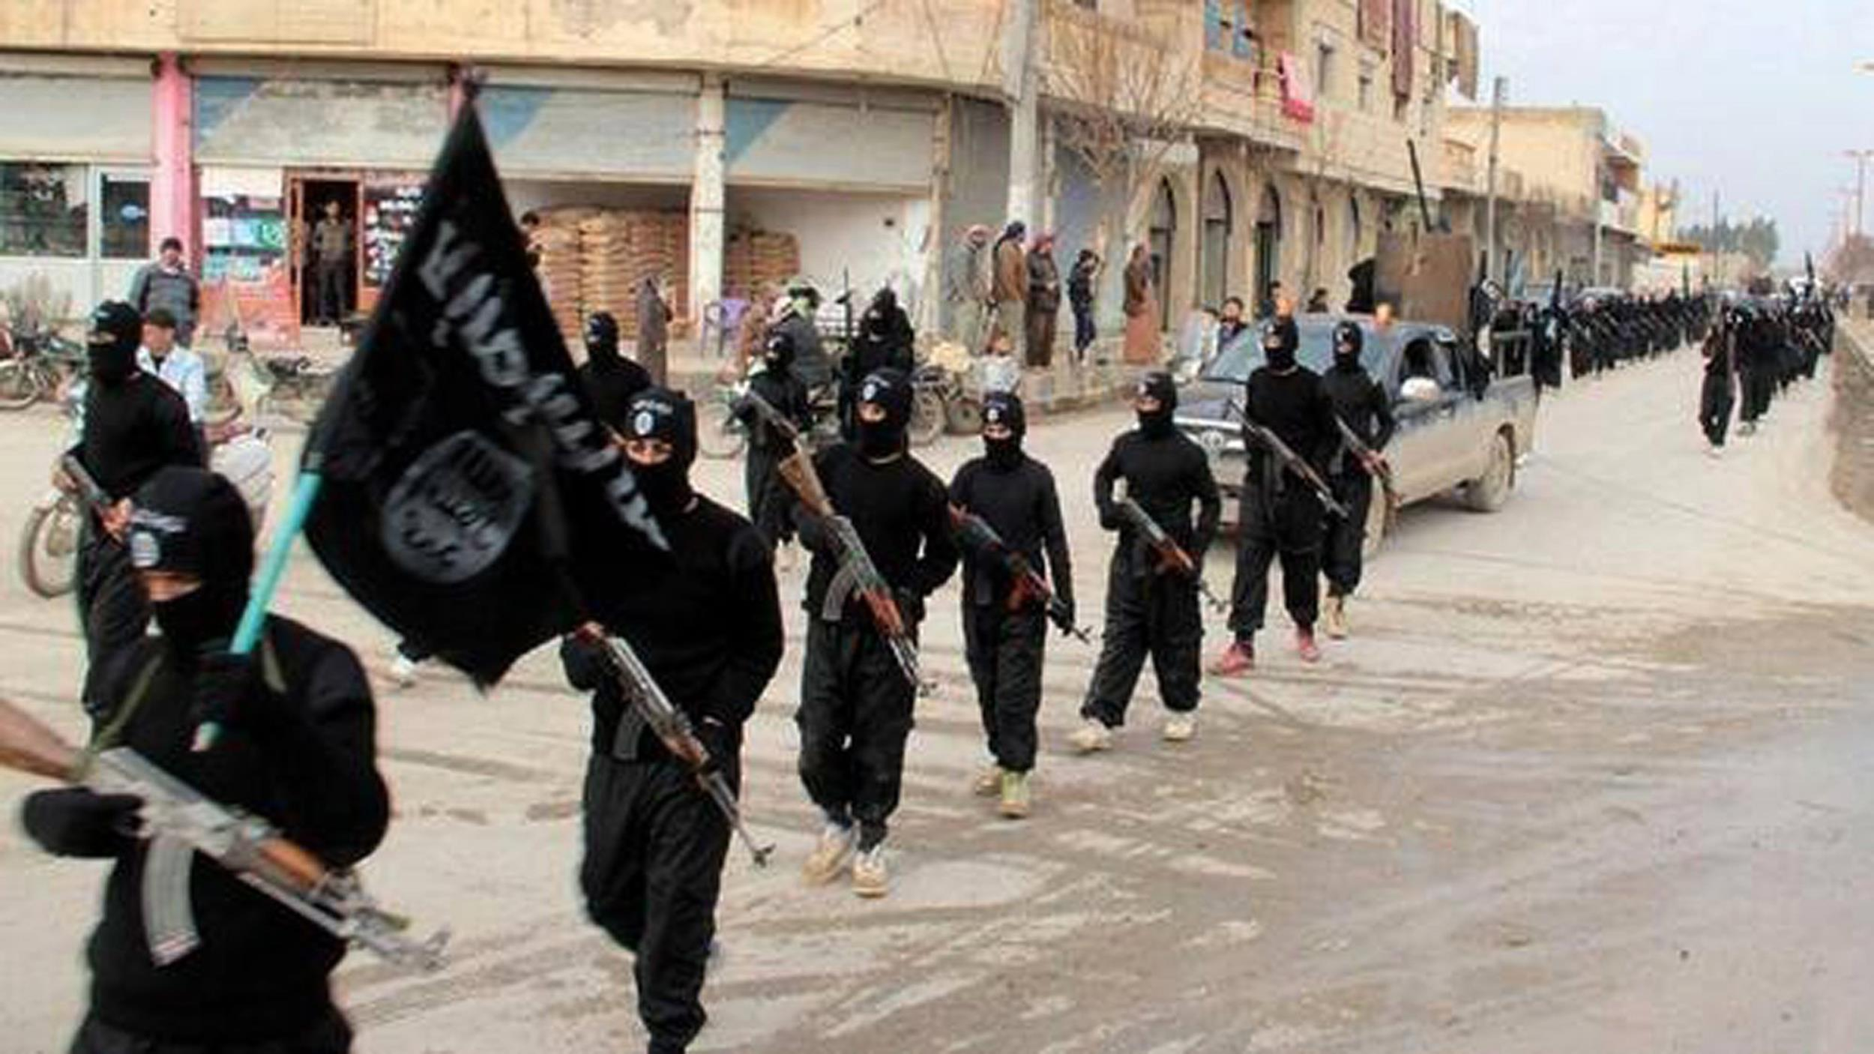

Slide 3
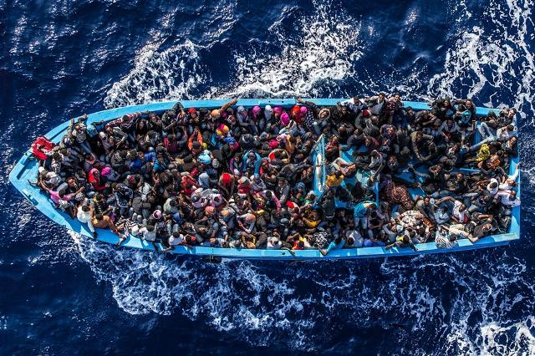

Slide 4
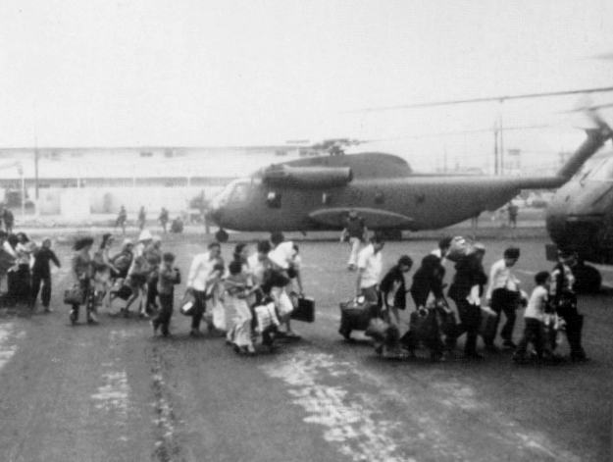

Slide 5
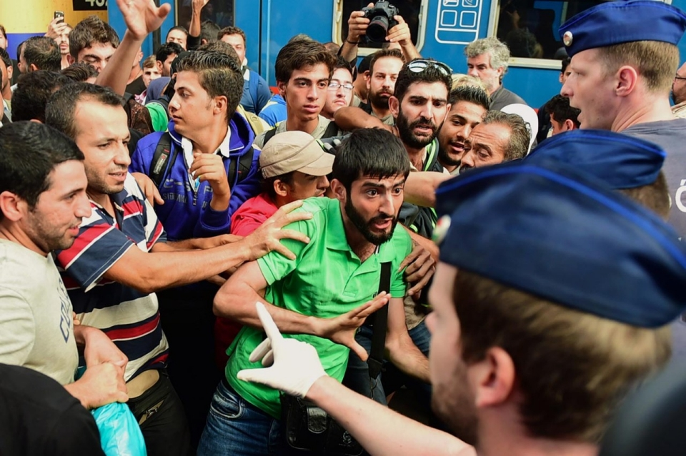

Slide 6
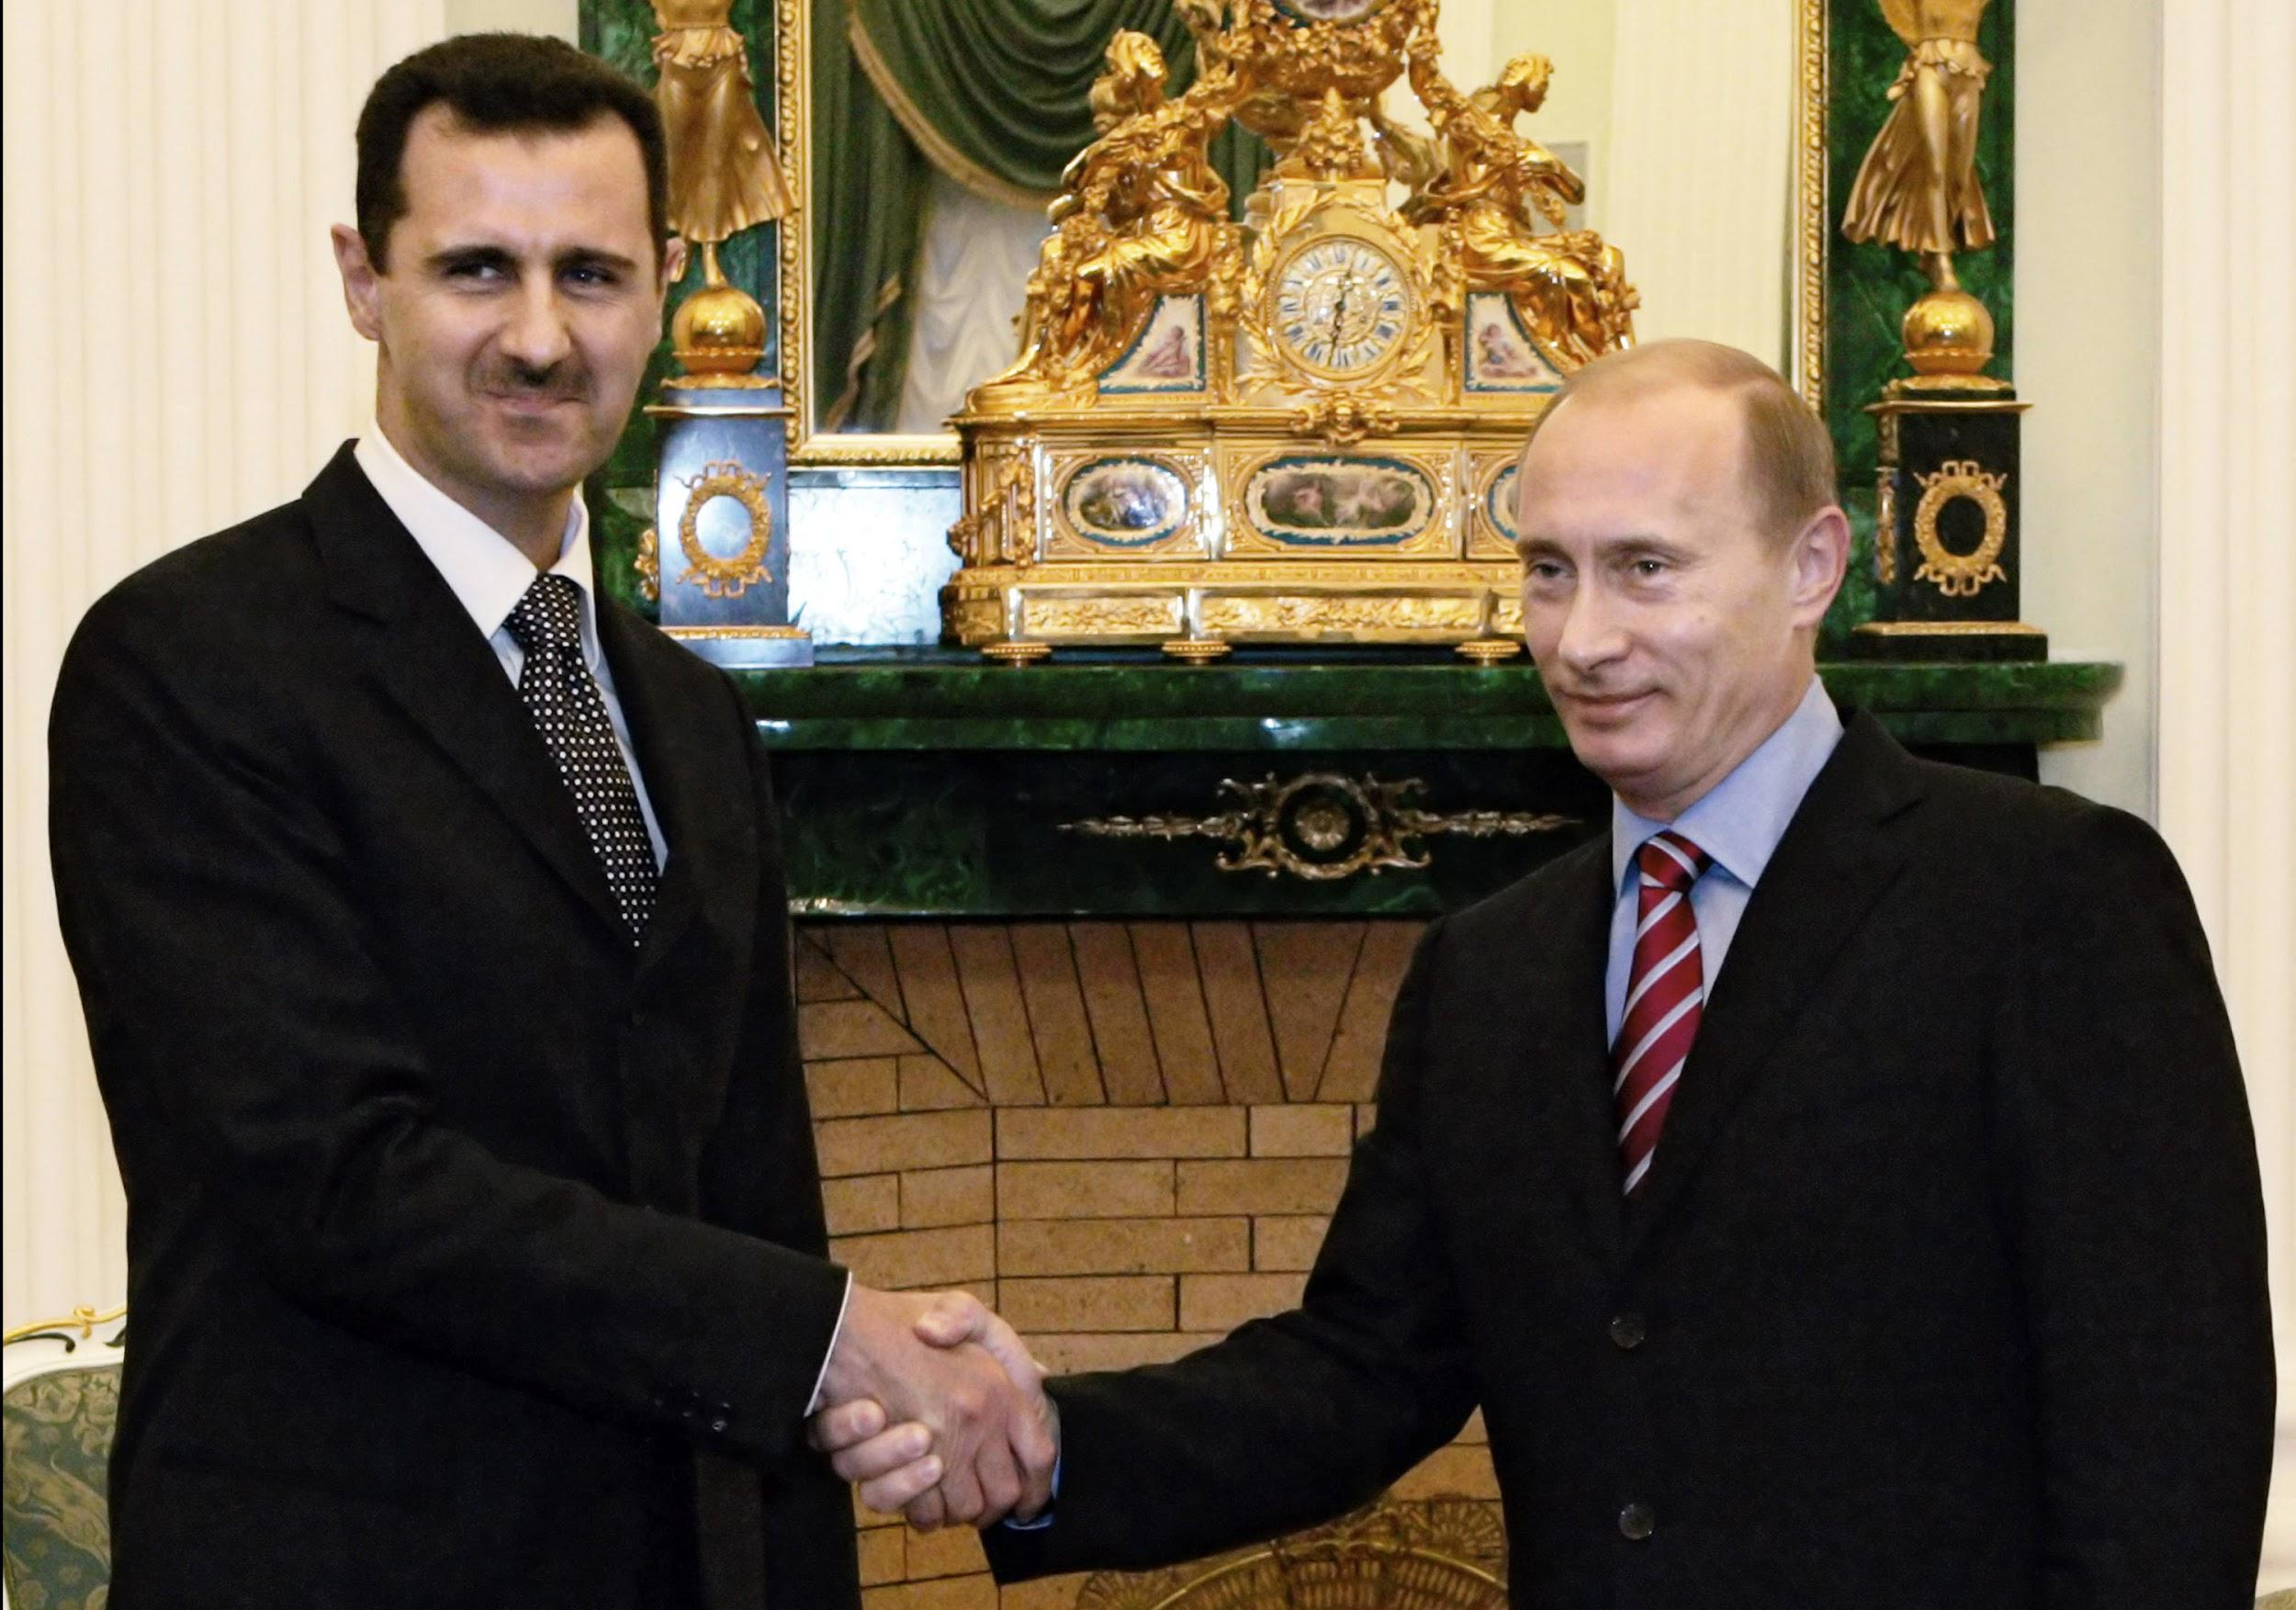

Slide 7
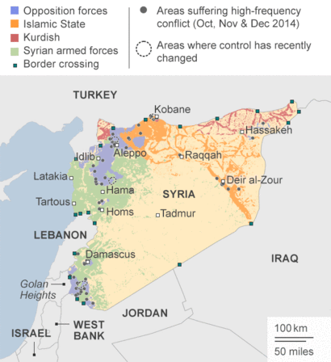
Background and Statistics
Since March 2011:
-250,000 Syrians killed
-11 million displaced Syrians
-alleged use of chemical weapons
-Rise of Jihadi groups.
-Proxy War (Russia, Iran, Saudi Arabia, U.S.A)

Slide 8
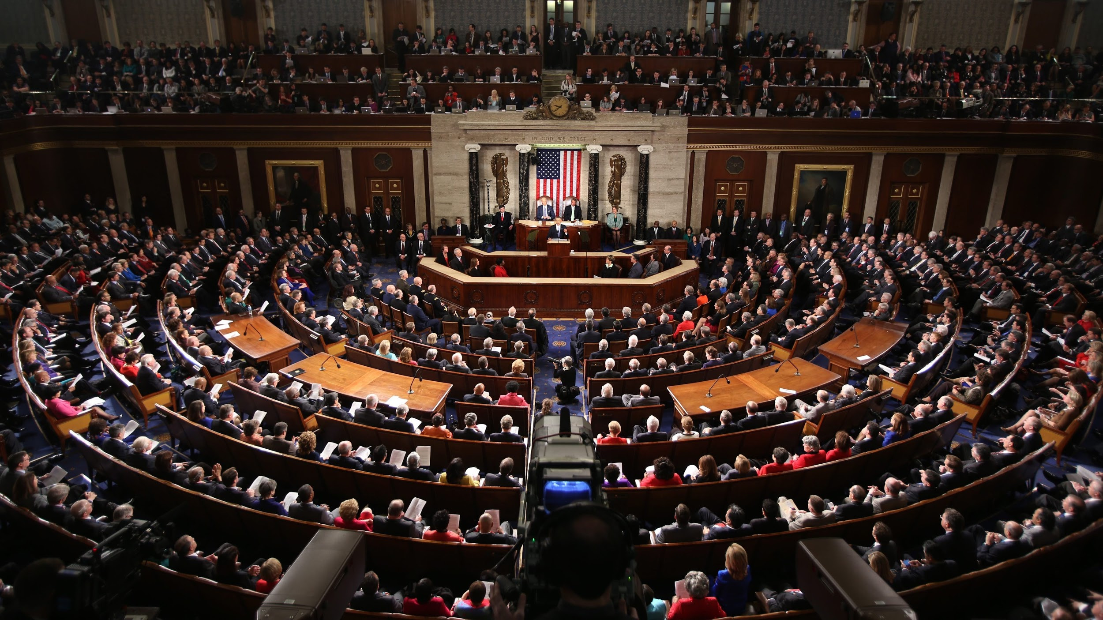
Implications for America
Refugee Crisis (Immigrants seeking asylum)
Syrian Civil War (Regional instability)
ISIS (Global Threat)
Relationships with Allies (Strained)

Slide 9
Essential Questions
American History:
What lessons can we learn from conflicts in our past to help us deal with the Syrian Civil War crises.

Slide 10
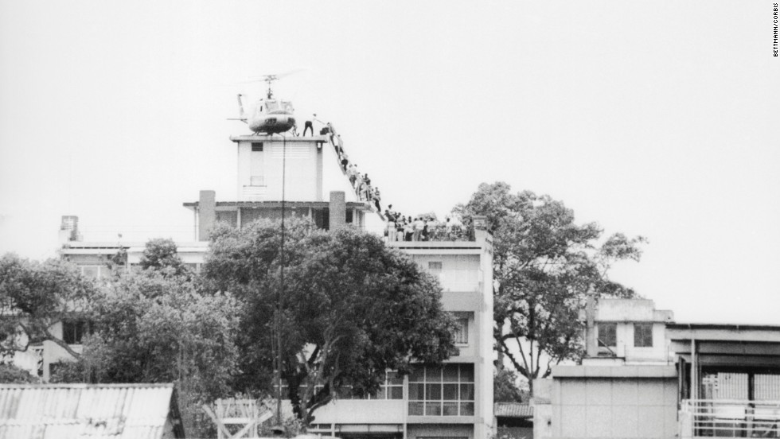
Syria’s Relation to Vietnam
LO-Students will compare and contrast the immigration issues that came out of the Vietnam War and how it relates to the current immigration issue in Syria.
Vietnamese refugee Amounts: 125,000 came to the U.S. in 1975
The U.S. coordinated the effort to evacuate the refugees

Slide 11
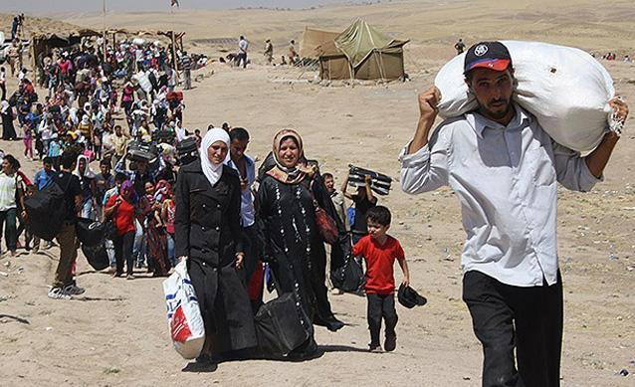
The U.S. has agreed to accept 10,000 Syrian refugees
Germany has accepted 100,000 and is expecting to accept up to 800,000
Venezuela has pledged to accept 20,000
Why isn’t the U.S. taking a more active role in helping Syrian refugees?
What kind of immigrants do we desire in this country?

Slide 12
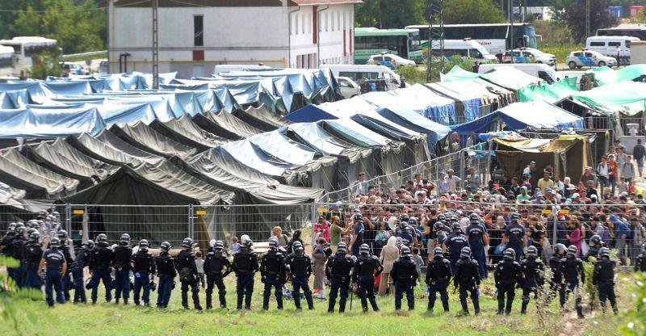
Video
http://www.cbsnews.com/news/disturbing-video-hungary-refugee-camp-europe-migrant-crisis/
http://www.bbc.com/news/world-europe-33986738
“Migrants crisis: Slovakia 'will only accept Christians’”

Slide 13
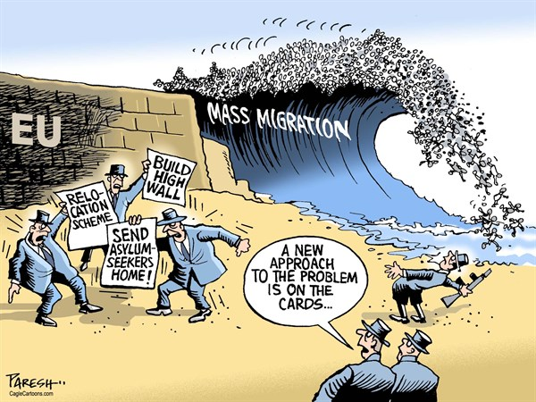

Slide 14
Where are the refugees going?
Germany-98,000
Sweden-64,000
France-6,700
UK-7,000
Denmark-11,500
Hungary-18,000
USA-1,500
Canada-10,000
Australia-12,000
UAE-250,000
Turkey-1,900,000
Lebanon-1,100,000
Jordan-629,000
Iraq-249,000
Egypt-132,000
Saudi Arabia, Kuwait, Qatar - 0
Are these numbers suprising? How so?
http://www.cnn.com/2015/09/09/world/welcome-syrian-refugees-countries/

Slide 15
Questions to consider
-What obligation do nations have to take in Syrian refugees?
-Where do morals and public policy intersect in this issue?
-Is it possible for all Syrian refugees to be provided for?
-Is it too difficult to use the channels of governments to achieve collective action in this issue?
-How will xenophobia shape the experiences of immigrants in the future? Will it be better or worse than the past?

Slide 16
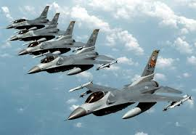
American Involvement in Foreign Conflicts
LO: Analyze a public policy issue in terms of collaboration or conflict among the levels of government involved and the branches of government involved.
Questions to Consider:
1. Who should the government consult?
2. What factors should we consider?
3. Do the branches of government usually agree on whether or not to allow immigrants into the country?

Slide 17
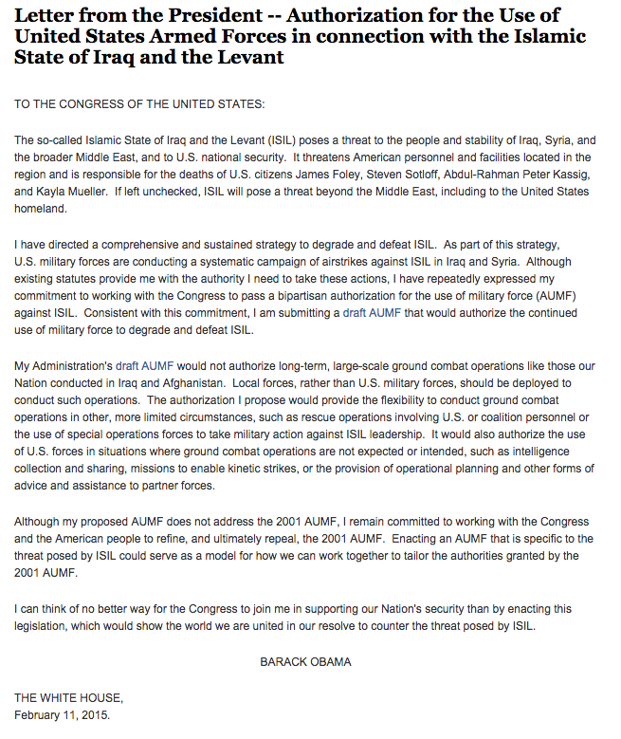
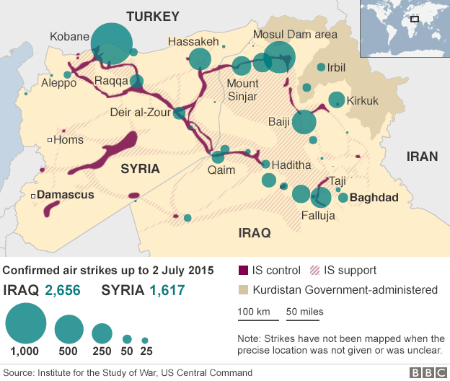
AUMF through the branches of government.
Is there a reference to dysfunctionality among the branches of government in Obama’s letter?

Slide 18
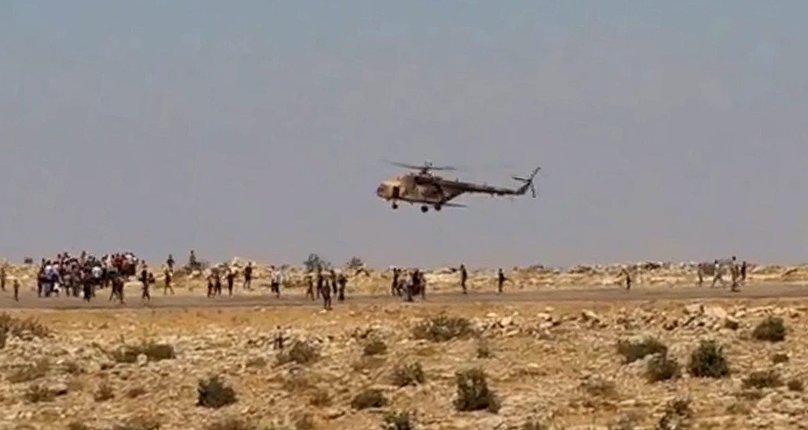
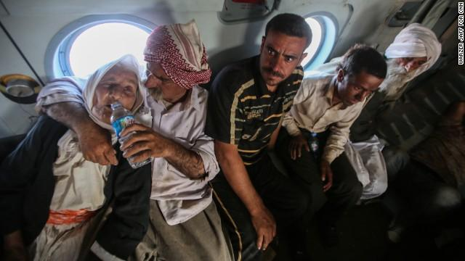
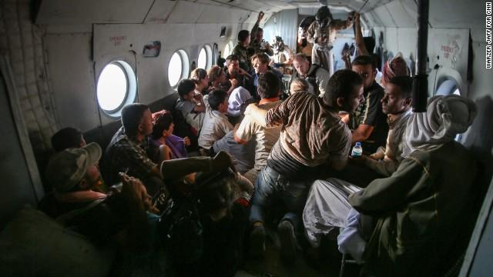
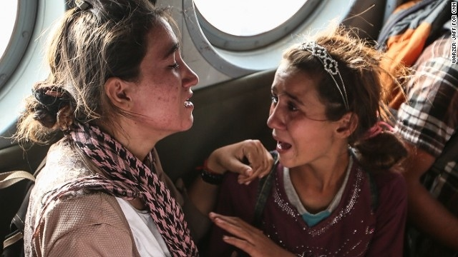
Yazidi Rescue Mission

Slide 19
Exit Slip
Please take a moment to answer the question in connection to Understanding the Middle East:
Why might we consider an historian’s perspective(s) when considering foreign policy concerning the Syrian Civil War?

