Slide 1
The FARC: A Road to Rebellion
Big Question: How do political choices lead to conflict?
Created by Trevor Barhorst & Jeff Tiedeken

Slide 2
Agenda
Timeline
Timeline Discussion
Create Intervention Plans
Intervention Plan Discussion
Exit Ticket

Slide 3

Timeline
Fill out the timeline with events from your reading.
What events are important?
Why?
Taken from http://www.st3recruitment.org.uk/recruitment-process/timeline

Slide 4
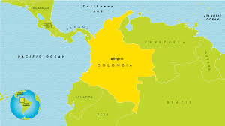
Student Learning Objectives
Students will be able to organize events from the article leading up to the formation of the FARC.
Students will be able to defend their proposed intervention using the text for support.
Taken from www.worldmapideas.com

Slide 5

Brainstorm!
How did any country you can think of resolve internal conflict?
What big social changes occurred in the United States?
Can you think of any important people who may have inspired change?
Taken from http://leadership-mantra.blogspot.com
/2016/01/8-rules-of-brainstorming.html

Slide 6
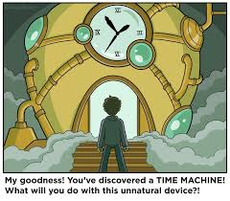
Planning the Intervention
What intervention plan would you set in place for Colombia in the 1960’s just after the establishment of FARC?
Has this plan been attempted in the past?
Why will your plan work? Use the text as evidence.
Taken from http://www.eetimes.com/author.asp
?section_id=216&doc_id=1328642

Slide 7


Discussion
Taken From http://www.weteachwelearn.org/tag/discussion/

Slide 8
Exit Ticket
After hearing class discussion on several intervention plans, what would you list as a strength of your intervention plan?
Did anything change after hearing the discussion?
If so, what?

