Slide 1
Federal System of the United States
Please come in and have a seat at the table number that matches the card you were given.

Slide 2
Learning Objectives:
Students will be able to understand the viewpoints of Federalists and Anti-Federalists.
Students will be able to analyze Federalist and Anti-Federalist ideas present in modern day political cartoons.

Slide 3

AGenda:
-Introduction
-Guided Notes (Federalist vs. Anti-Federalist)
-Big government vs. Small Government Debate
-Political Cartoon Analysis
-Exit Ticket

Slide 4
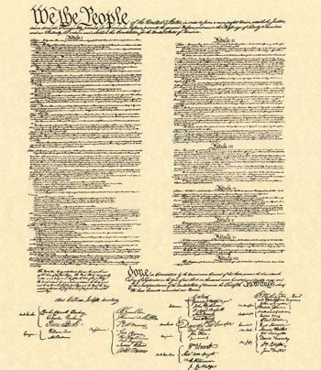
Federalists:
Supported the constitution
Believed in a stronger federal government
Saw excess freedom as a threat to security
Believed the Constitution was sufficient to protect individual rights
Notes:
Introduce the Federalists and their views on the Articles of Confederation and a new Constitution.
Photo citation: https://en.wikipedia.org/wiki/United_States_Constitution

Slide 5
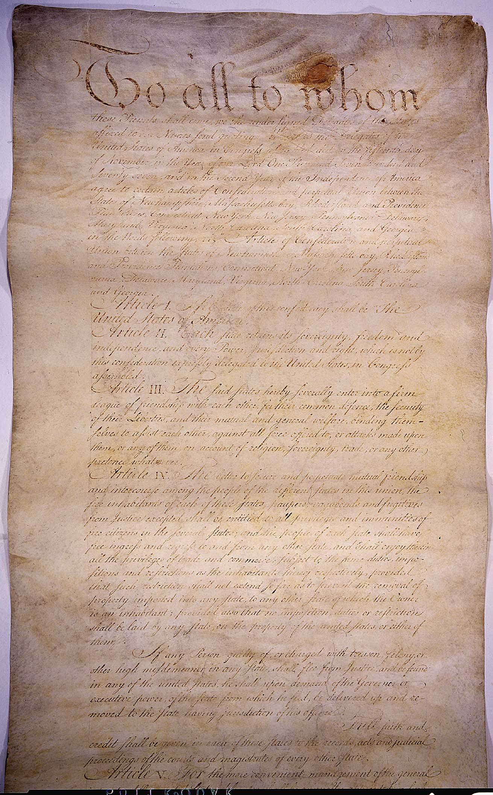
Anti-Federalists:
Supported a less powerful federal government
In favor of stronger state governments
Opposed the Constitution
Favored the Articles of Confederation
Believed the Constitution was not sufficient to protect individual rights
Notes:
Introduce the Anti-Federalists and their views on the new Constitution.
Photo Citation: https://en.wikipedia.org/wiki/Articles_of_Confederation

Slide 6
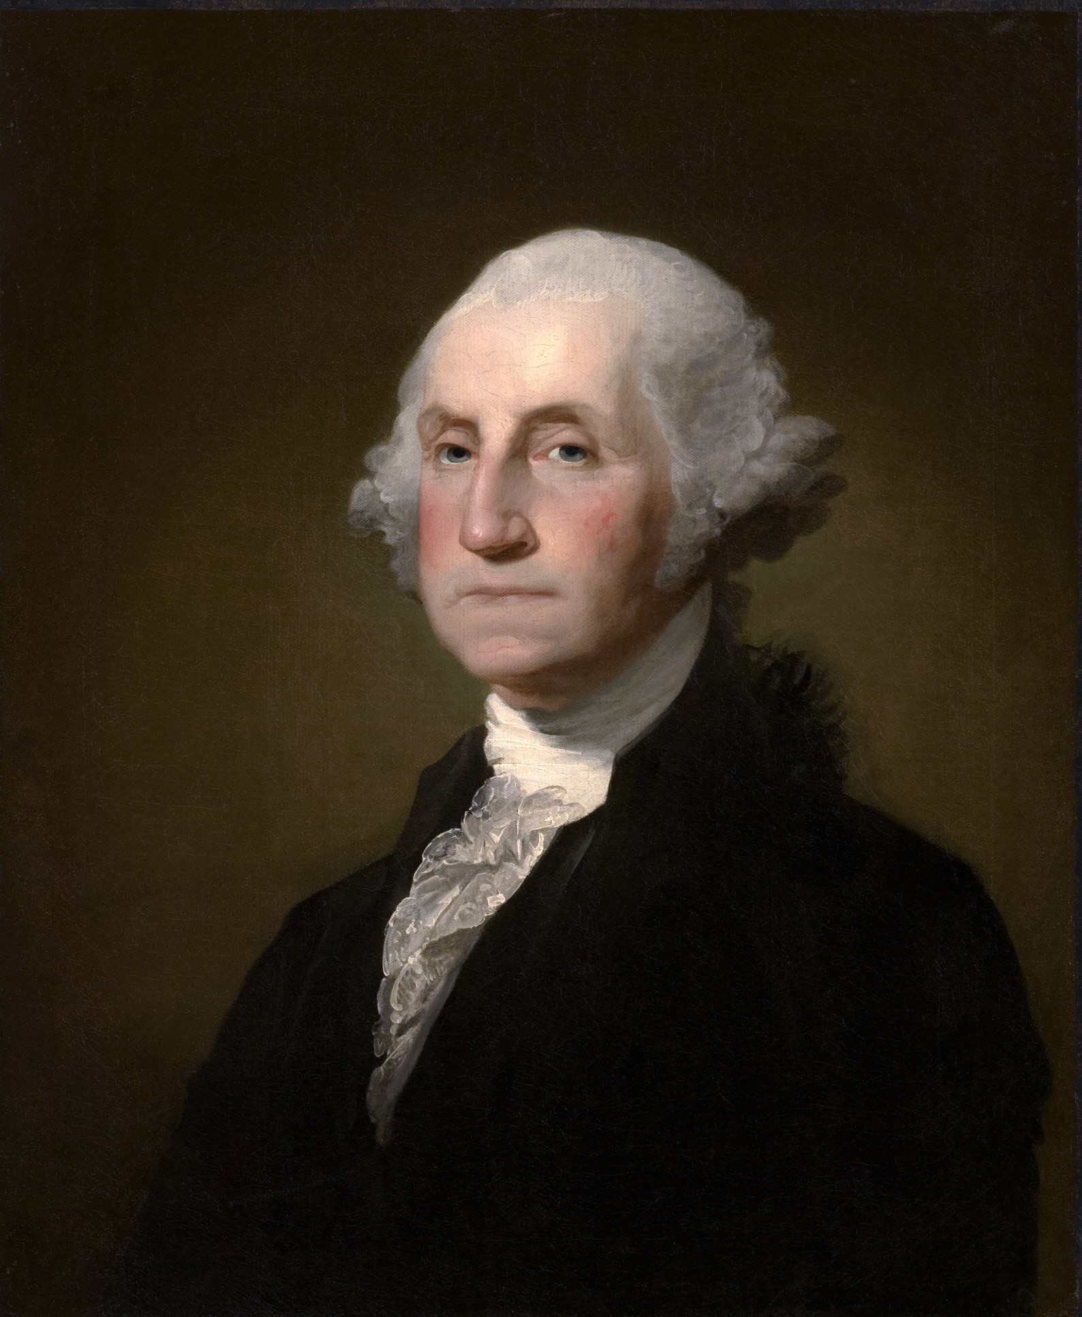
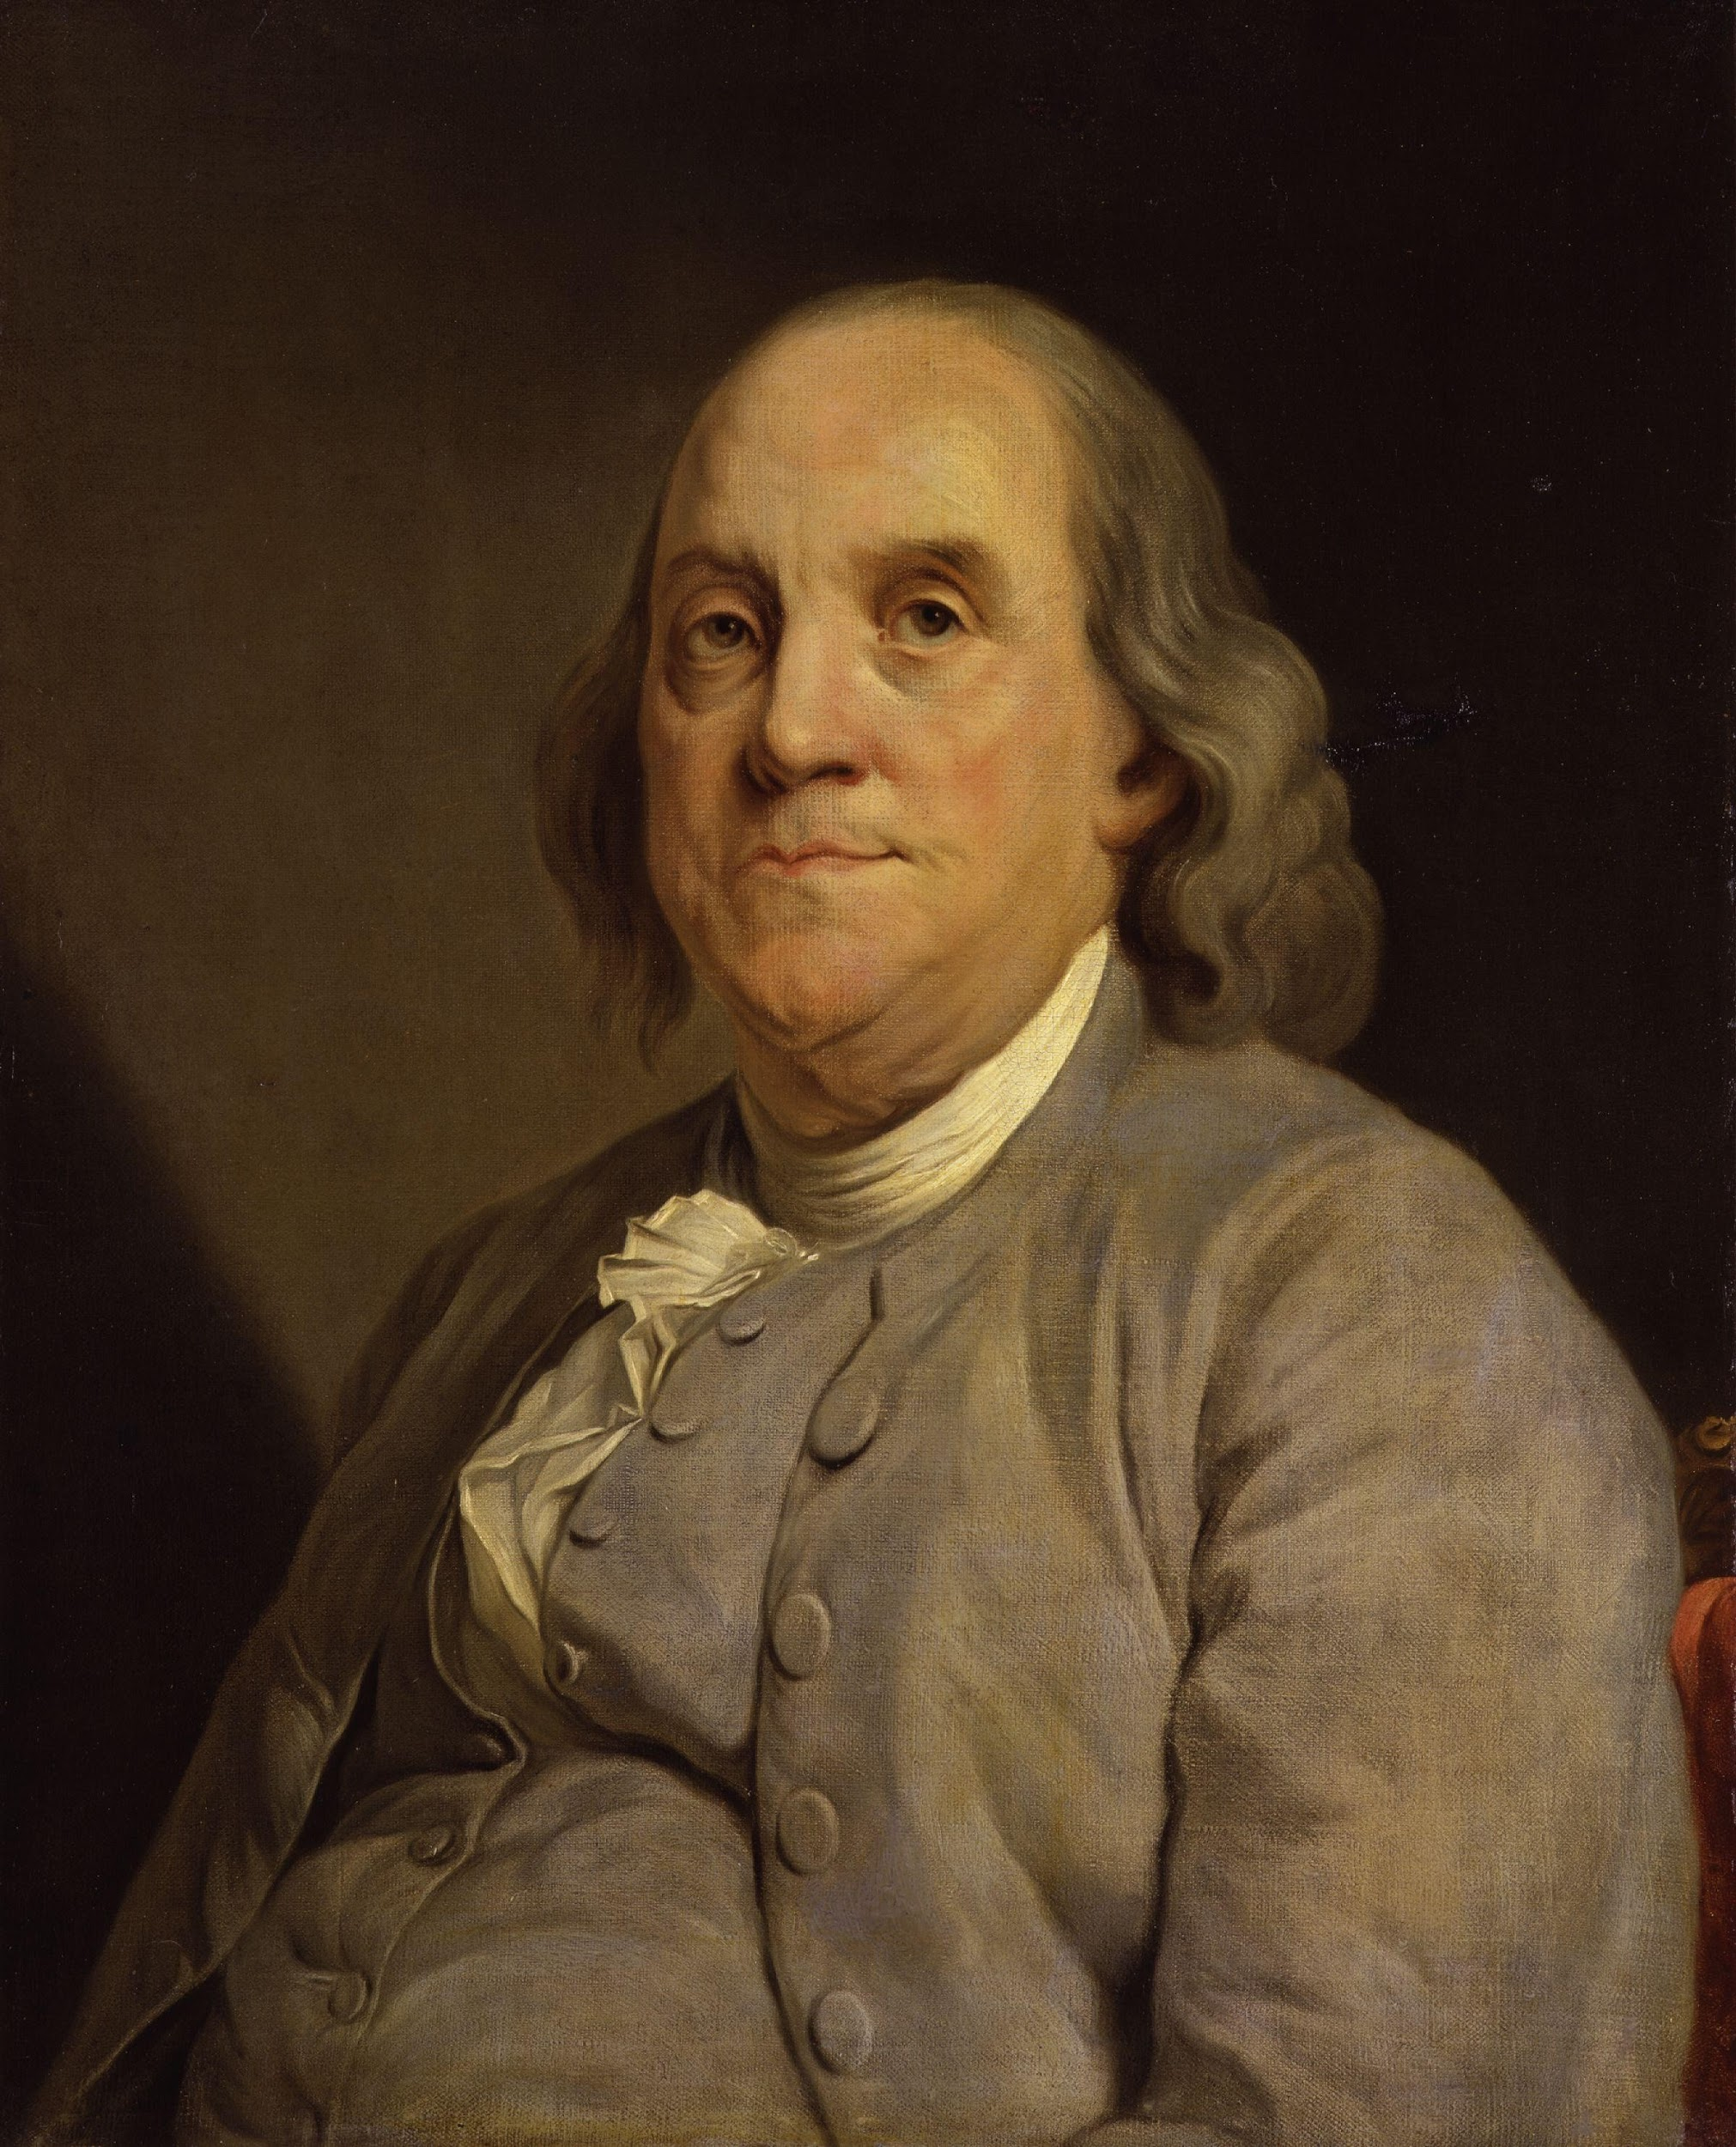
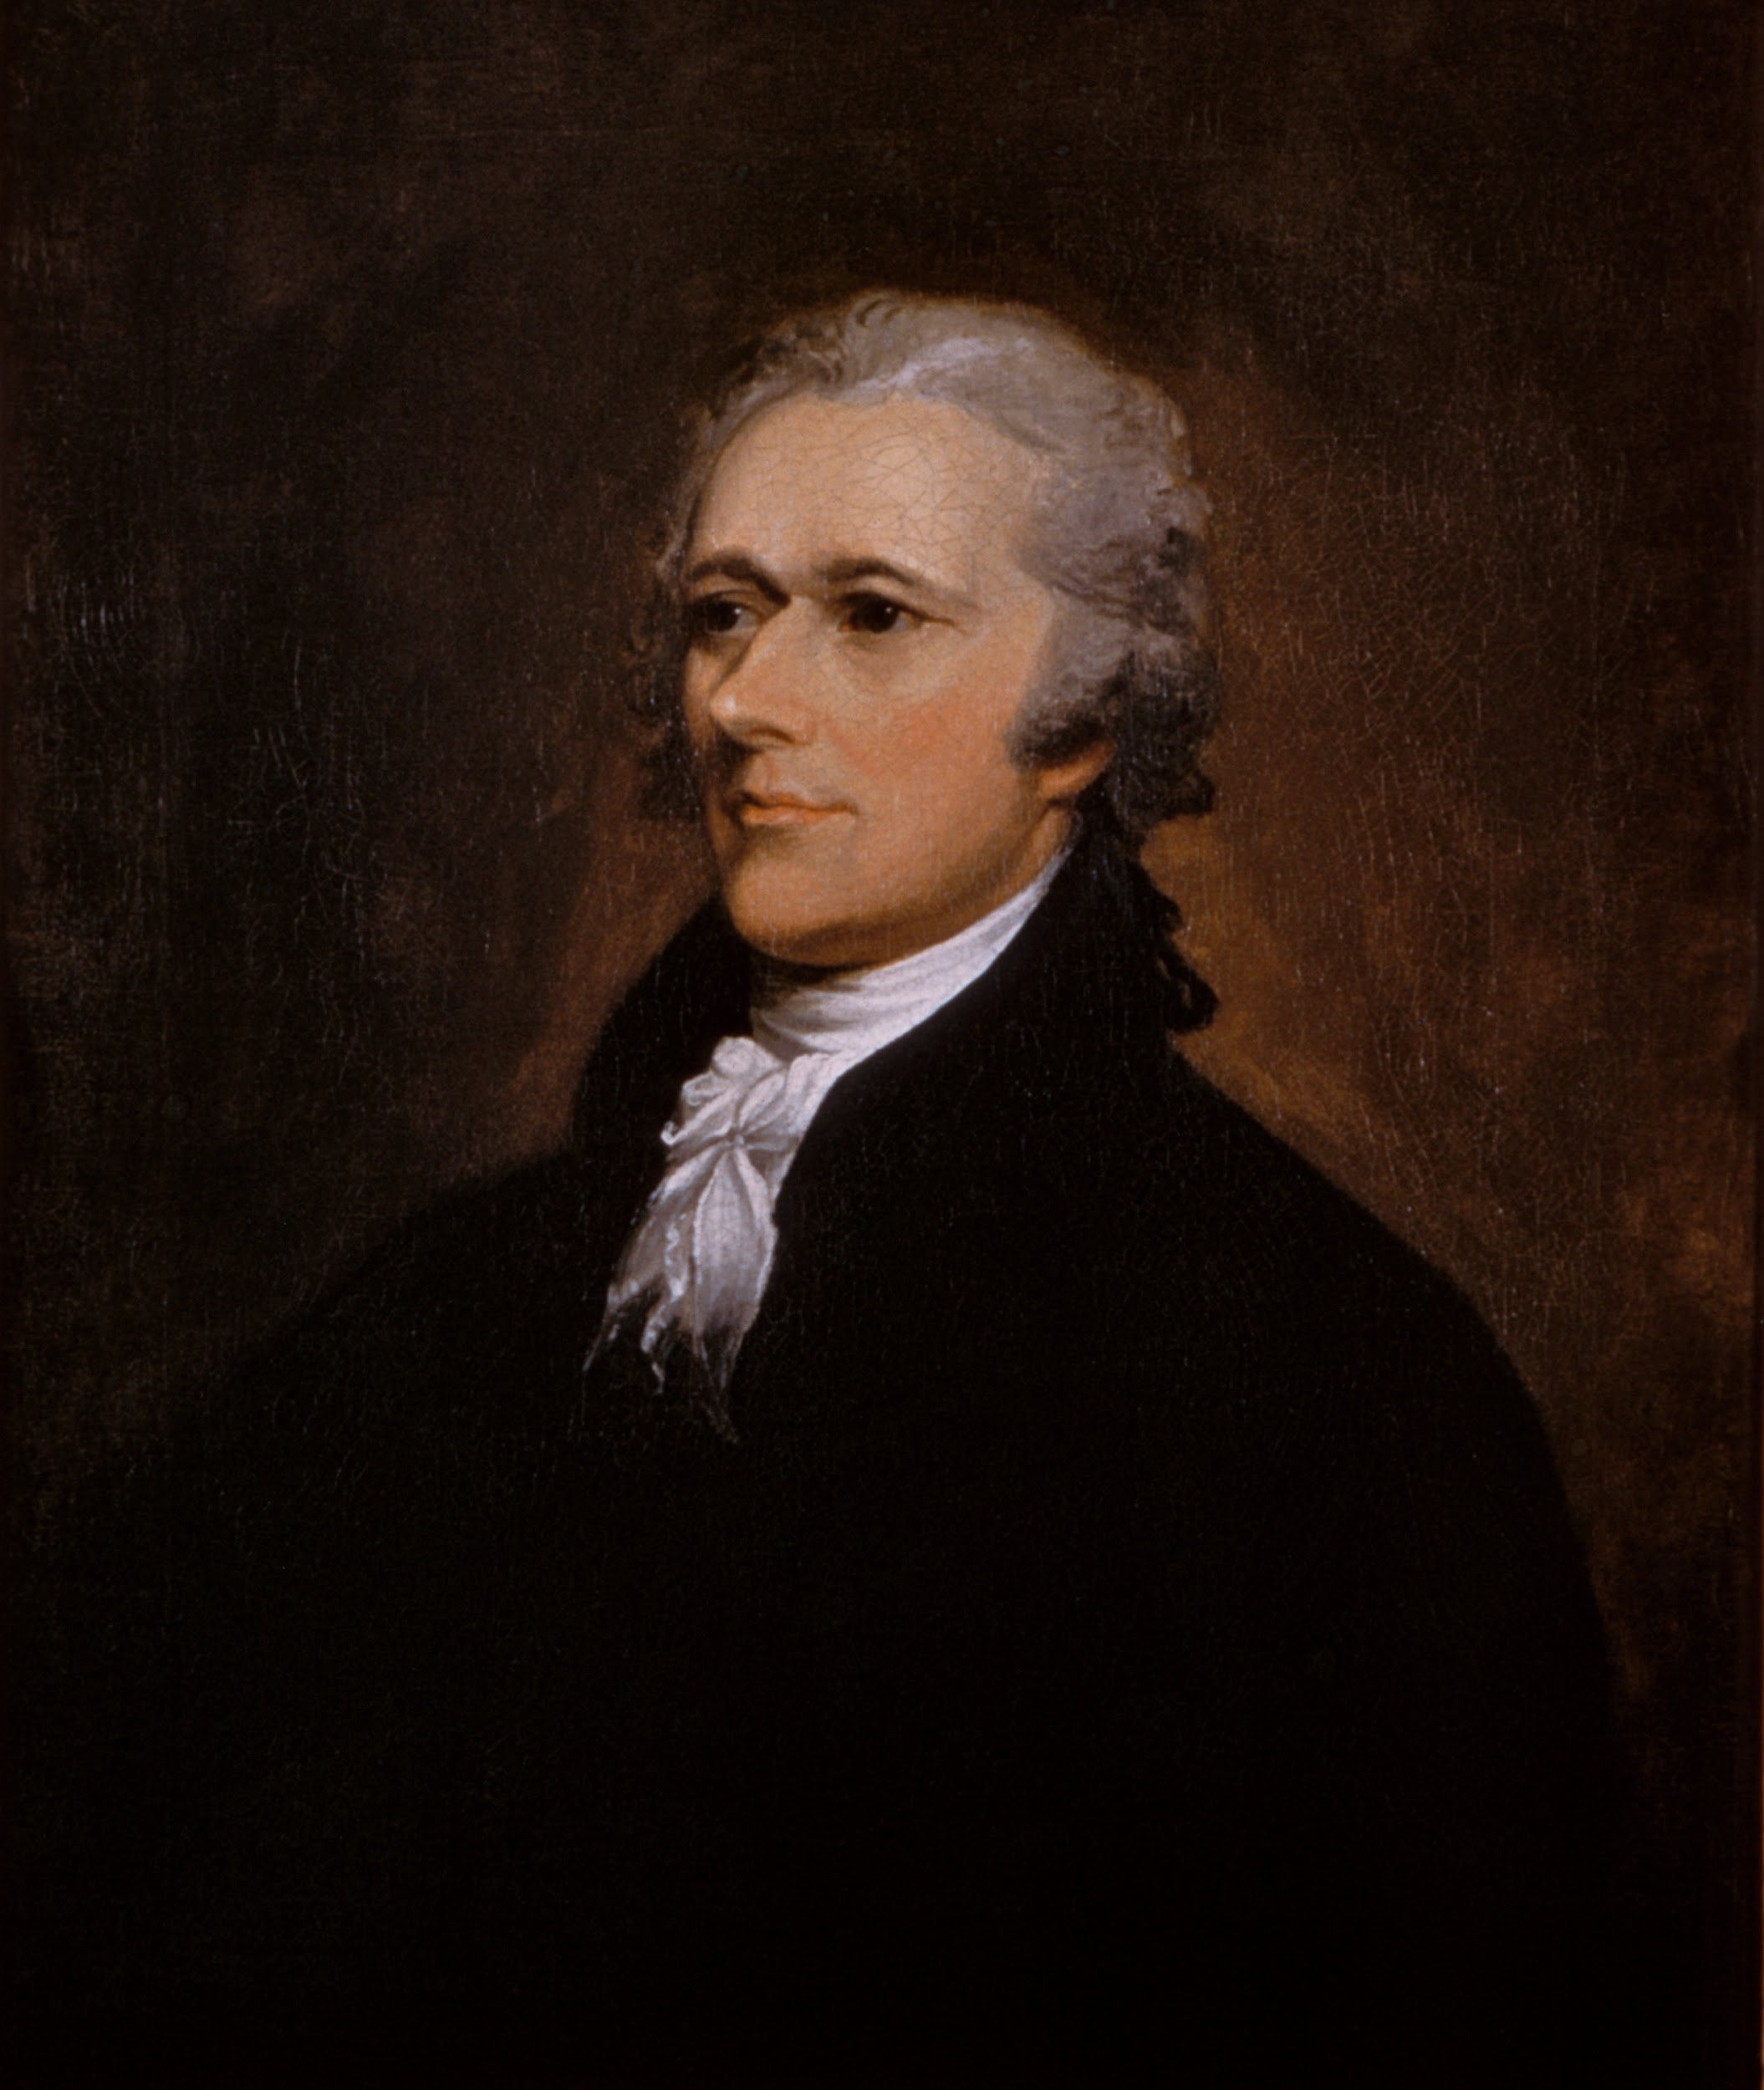
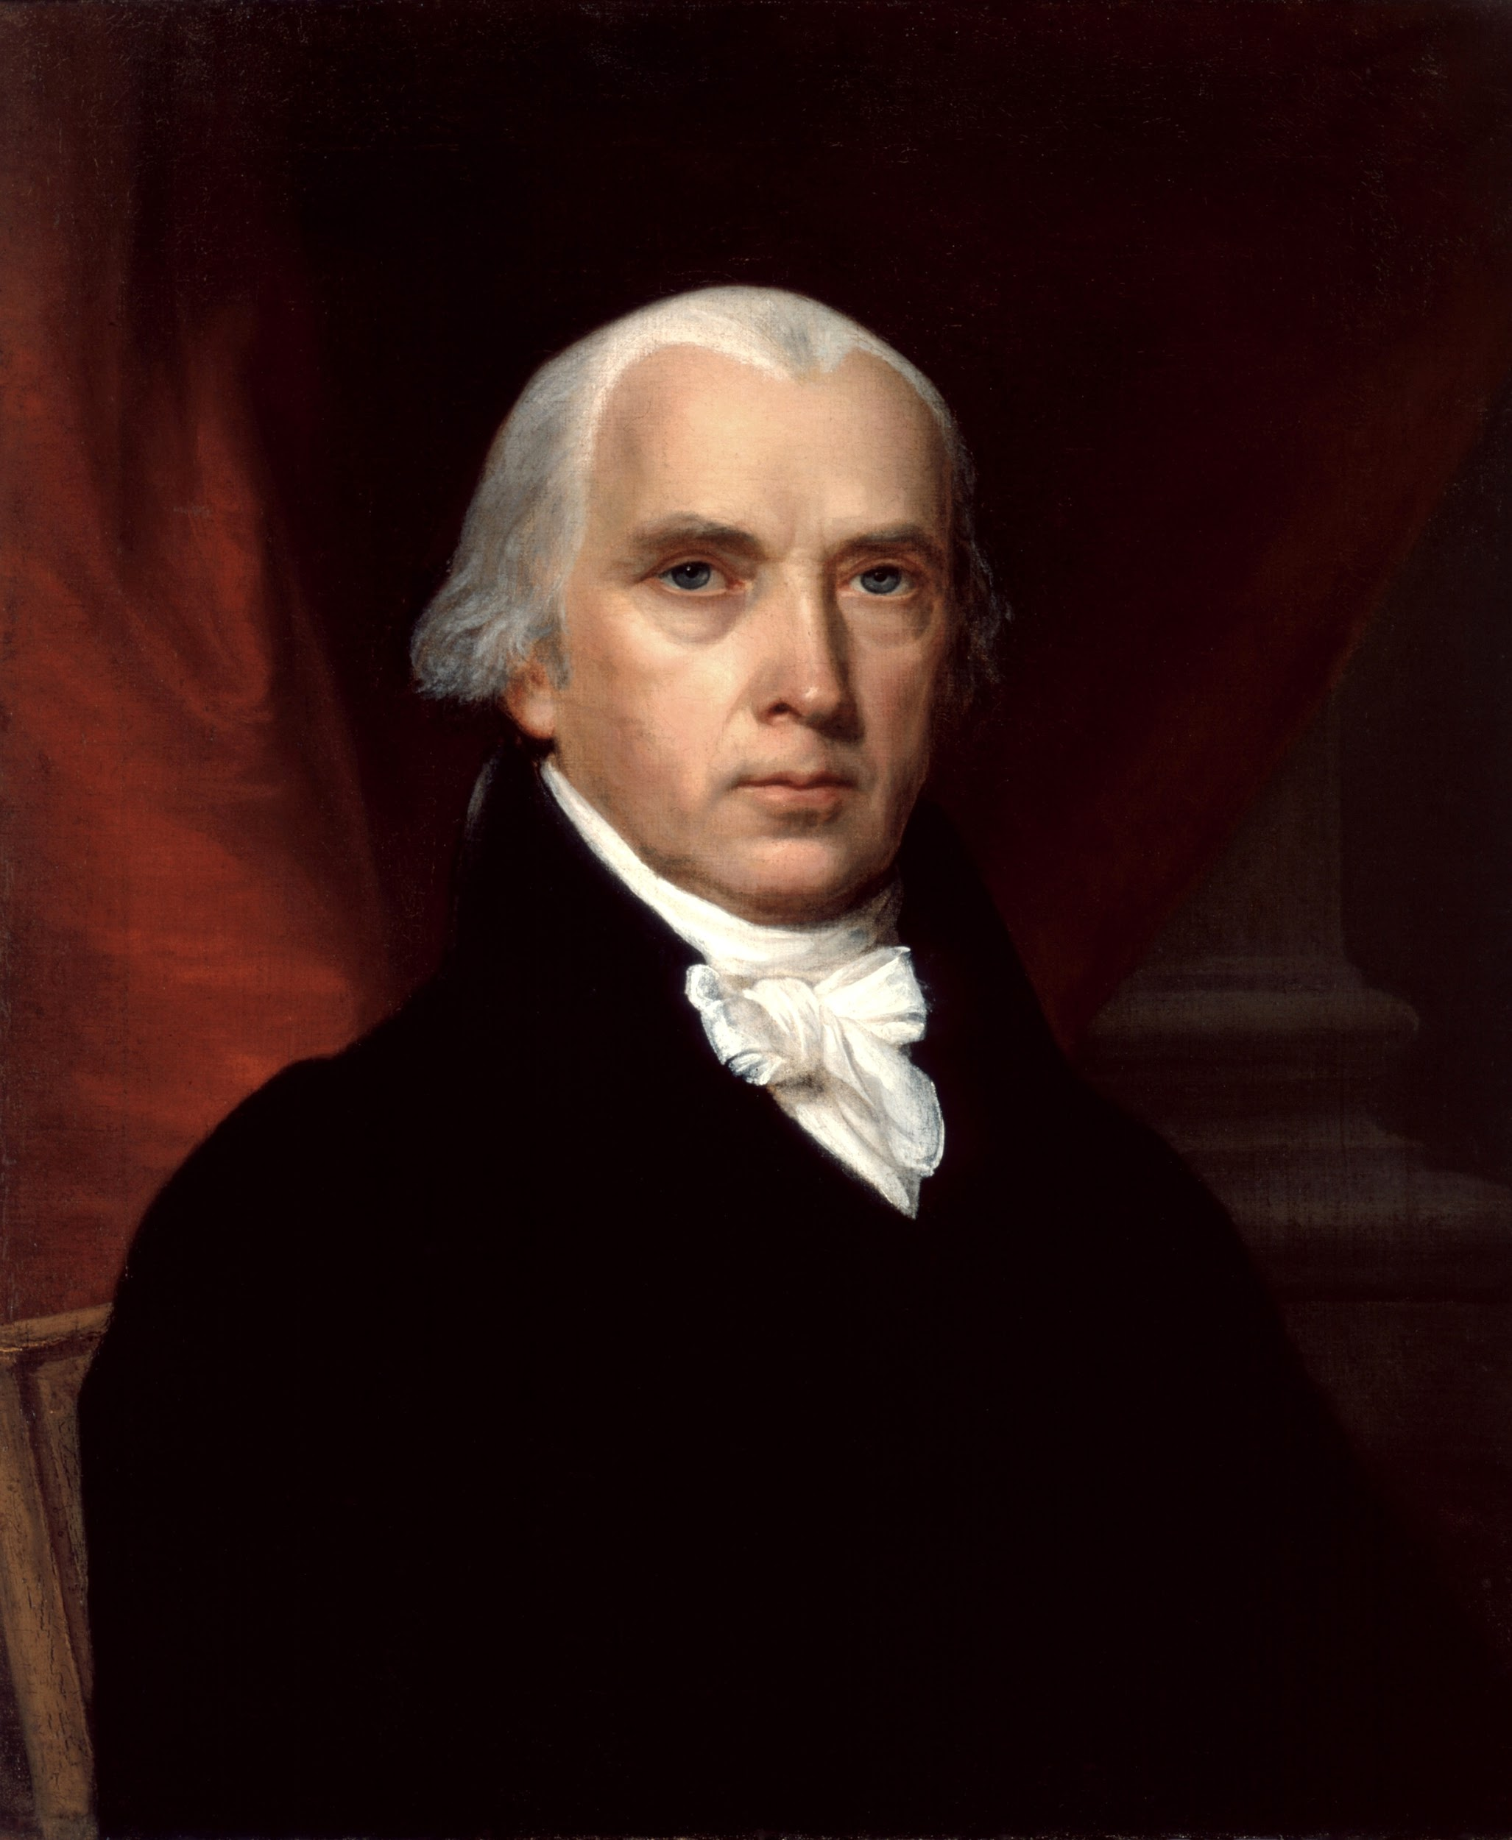
Famous Federalists:
Benjamin Franklin
Alexander Hamilton
James Madison
George Washington
Notes:
Top Left Photo Citation: https://en.wikipedia.org/wiki/George_Washington
Top Right Photo Citation: http://factfile.org/10-facts-about-benjamin-franklin
Bottom Left Photo Citation: https://en.wikipedia.org/wiki/Alexander_Hamilton
Bottom Right Photo Citation: https://en.wikipedia.org/wiki/James_Madison

Slide 7
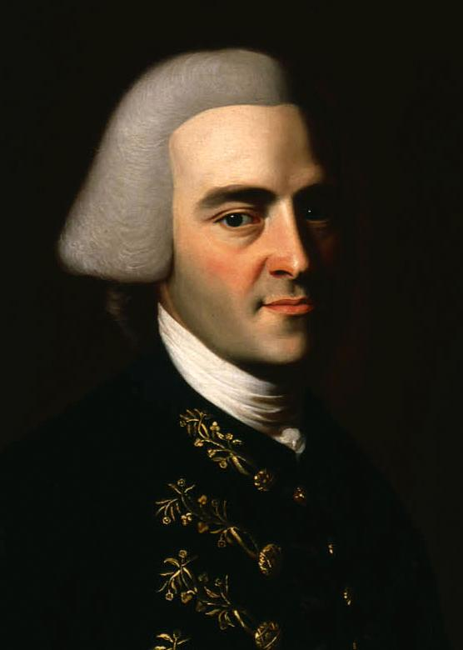
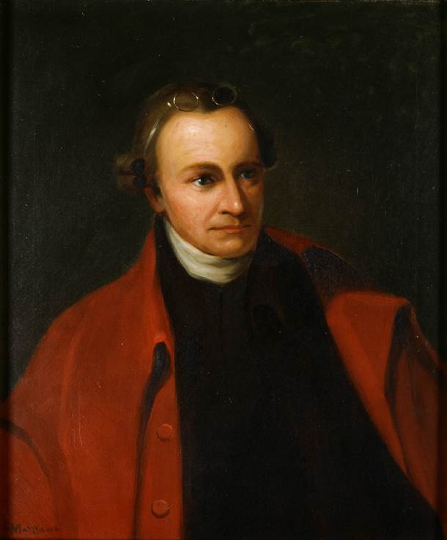
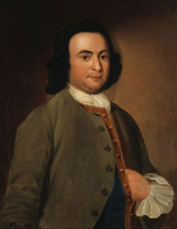
Famous Anti- Federalists:
John Hancock
Patrick Henry
George Mason
Notes:
Left Photo Citation: https://en.wikipedia.org/wiki/Patrick_Henry
Middle Photo Citation: https://en.wikipedia.org/wiki/John_Hancock
Right Photo Citation: https://no.wikipedia.org/wiki/George_Mason

Slide 8
Big government vs. small government
Federalist vs. Anti-Federalist
Today?
Notes:
Introduction to the next part of the lesson which will be an analysis of modern day political cartoons. Explain to students that even though the Federalists and the Anti-Federalists opposed each other over 200 years ago, the idea of big government vs. small government still exists today. This will make the Federalists and Anti-Federalists more relevant to students, as they will see similar issues are still debated in the present day.

Slide 9
Political cartoon analysis:
What is the main idea of the political cartoon?
What elements in the political cartoon make you think this?

Slide 10
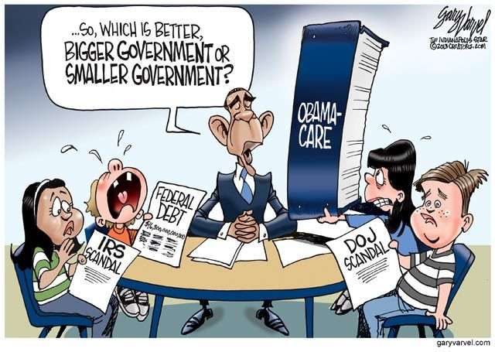
Notes:
https://texags.com/forums/16/topics/2315490

Slide 11
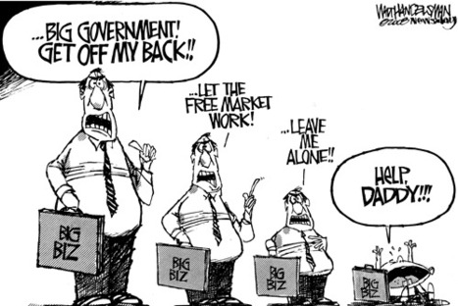
Notes:
http://www.huffingtonpost.com/dina-badie/in-defense-of-big-governm_1_b_8065306.html

Slide 12
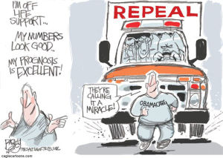
Notes:
http://www.nj.com/hudson/voices/index.ssf/2014/05/fox_news_fan_says_obamacare_sa.html

Slide 13
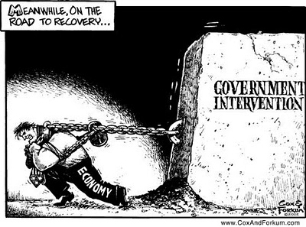
Notes:
https://www.buckeyeplanet.com/forum/threads/political-cartoons.602020/page-18

Slide 14
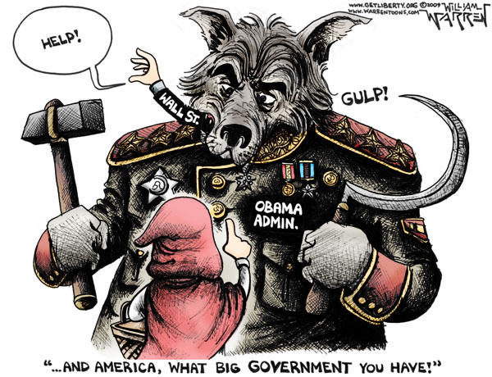
Notes:
https://standupforamerica.wordpress.com/2010/01/04/much-criticism-but-is-there-a-solution/

Slide 15
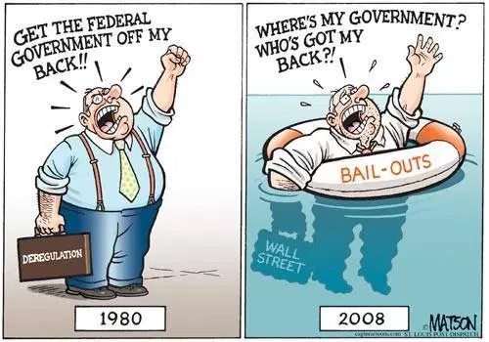
Notes:
http://markmartinezshow.blogspot.com/2011_09_01_archive.html

Slide 16
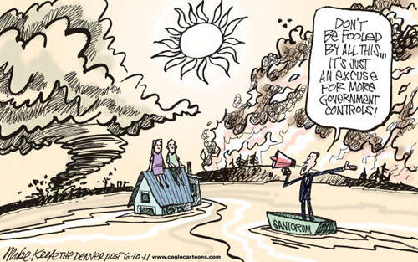
Notes:
https://goodolewoody.me/2012/03/29/small-government-or-big-government/

Slide 17
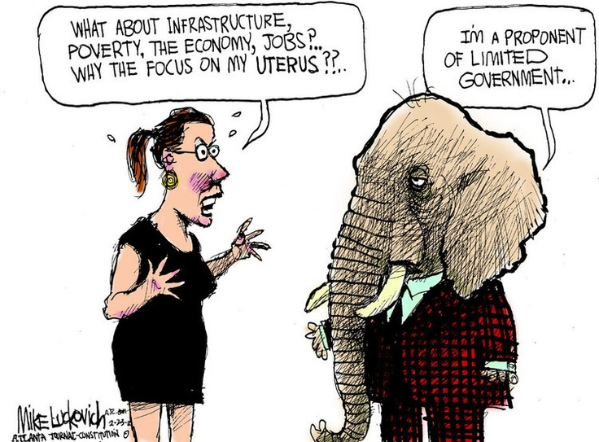
Notes:
https://theprogressivecynic.com/2013/11/06/partisan-differences-in-the-definition-of-big-government/

Slide 18
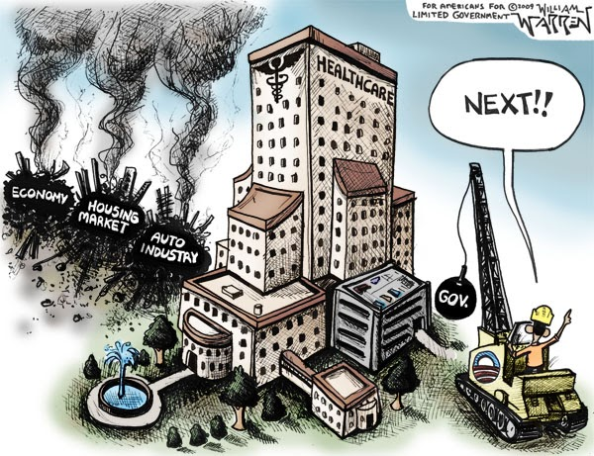
Notes:
https://juanfares.wordpress.com/2010/02/

Slide 19
Exit ticket:
In what ways does the Federalist/Anti-Federalist debate of big government vs. small government still exist today?

