Slide 1
The Creation of Student Loan Debt in the U.S.

Slide 2
The Creation of Student Loan Debt in the U.S.
Bell Ringer
What do you think the total outstanding student loan debt was in the U.S. in 2019?

Slide 3
The Creation of Student Loan Debt in the U.S.
Answer:
$1.5 trillion

Slide 4
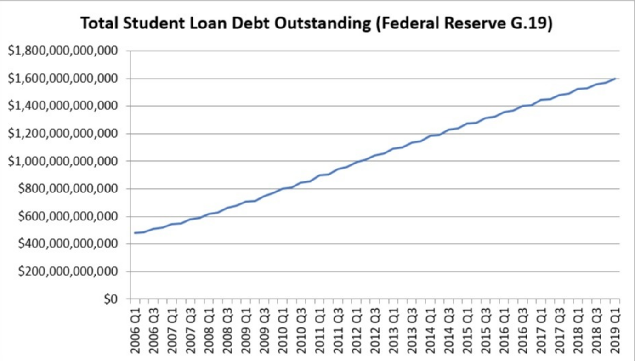
The Creation of Student Loan Debt in the U.S.
Notes:
https://www.savingforcollege.com/article/total-student-loan-debt-outstanding

Slide 5
The Creation of Student Loan Debt in the U.S.
Learning Objectives
Students will be able to analyze the reasons for the increases in the cost of college over the past century.
Students will be able to examine how the United States has handled increasing student loan debt over the past century.

Slide 6
The Creation of Student Loan Debt in the U.S.
Compelling Question
What led us to the current student crisis in the U.S.?

Slide 7
The Creation of Student Loan Debt in the U.S.
Prior to WWII, college attendance was not as widespread as it is today.
Number of people over the age of 25 with a college degree did not break 5% until after 1950. Today, it is over 30%.
What changed?

Slide 8
The Creation of Student Loan Debt in the U.S.
Federal government played a role in expansion of college education.
GI Bill: Funneled millions of federal dollars to wartime veterans for housing and education after WWII.

Slide 9
The Creation of Student Loan Debt in the U.S.
GI Bill encouraged 2 million veterans from WWII and Korean War to go to college between 1945 and 1965.
“Peacetime” GI Bill passed in 1966 helped 7 million Vietnam-era veterans go to college in 1960s and 1970s.
Cold War Era created an increase in the need for trained and skilled workers in order for the U.S. to compete globally.

Slide 10
The Creation of Student Loan Debt in the U.S.
Veterans were overwhelmingly men.
Proportion of 18-24 year old women in college doubled from 20% to 40%b between 1970 and 2000.
Amount of minority students in college grew from 2 million in 1980 to 4 million in 2000.
How might this increase college attendees affect the price?

Slide 11
The Creation of Student Loan Debt in the U.S.
Due to increases in college attendance, periods of postwar inflation, increased staffing costs, state level taxation policies, and other factors has contributed to increasing tuitions costs.
State funding of state institutions has declined over that past few decades, leading to increased costs.
Increased tuition at state institutions and fostered the creation of new types of for-profit college.

Slide 12
The Creation of Student Loan Debt in the U.S.
Students began to use loans as a principal way to pay for college.
Federal government began to build framework to protect private lenders.
1958 National Defense Education established Perkins Loans, need-based government loan system pinning interest rates at 5%.

Slide 13
The Creation of Student Loan Debt in the U.S.
1965 Higher Education Act
Established basis for federal government to offer more student financial assistance through the Federal Family Education Loan Program (FFEL).
Expanded Perkins loans.
Introduced Stafford loans and Pell Grants.

Slide 14
The Creation of Student Loan Debt in the U.S.
Stafford Loans: Federal government guaranteed and encouraged student loans by paying the interest that accrued during a student’s time in college and paid the difference between a set low rate and the market rate once the student graduated.
Pell Grant: Financial aid from federal government that does not need to be paid back.

Slide 15
The Creation of Student Loan Debt in the U.S.
Pell grants are given to students based on need, meaning that they are mostly limited to those with financial needs.
Many middle-class families do not qualify for Pell grants, and are forced to take out loans to pay for education.

Slide 16
The Creation of Student Loan Debt in the U.S.
1972: Federal government created ubiquitous student loan firm, Student Loan Marketing Association (Sallie Mae).
Sallie Mae served as agent for government backed student loans until 2004, when it privatized its operations, but continued to service government-back student loans.
2008: Sallie Mae collected $2.75 billion in interest on private loans, and $2.16 billion in interest on government-backed loans.

Slide 17
The Creation of Student Loan Debt in the U.S.
1993 Federal Direct Loan Program (FDLP): Allowed Department of Education to make loans directly.
Through 1990s, students did not use FDLP financing due to lobbying of private loan managers.
Early 2000s recession increased use of direct government loans.

Slide 18
The Creation of Student Loan Debt in the U.S.
1996: Introduction of 529 Plan, which is a college savings account that is exempt from federal taxes.
Scholarship and grants help students pay for college. (Pell Grants, Academic Scholarships, etc.)

Slide 19
The Creation of Student Loan Debt in the U.S.
Stations Debrief
  Which sources viewed student debt as negative? Which viewed it as necessary?
  Which source best supports your view on college education?
  Were there any sources that made you change your views or opinions?
  What additional information might you need in order to get a better understanding of this issue?

Slide 20
The Creation of Student Loan Debt in the U.S.
Take a Stand
Is a college education worth the cost?

Slide 21
The Creation of Student Loan Debt in the U.S.
Exit Ticket
Has the federal government helped or hurt the student loan debt crisis? Explain your stance.

