Slide 1
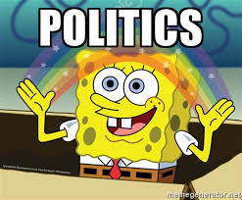
How Women of Politics are Represented in the Media
Ellie Hessler & Jessica Reynolds

Slide 2

Opening
For each word we say, please write down the first words or phrases that come to mind.

Slide 3
Today’s Agenda
Review learning objectives
Analyze various forms of media together
Small groups
Class discussion
Exit Slip

Slide 4
Learning Objectives
Students will be able to examine how women in politics are portrayed using various media formats.
Students will be able to assess the ways that media and technology influence public opinion using specific examples from class.

Slide 5
Video for modelling activity:
https://youtu.be/NdKsA4q-FFA

Slide 6
Examining the media
Who is the intended audience of this video?
What message do you think this video is trying to send about women in politics?
Is this video projecting a positive or negative perspective of the candidate? How do you know?
Do you think this video is effective in persuading public opinion?

Slide 7

Your turn!
With your group, work on answering the questions on your handout about the image that will be given to you. If you have any questions, please ask!

Slide 8


Slide 9
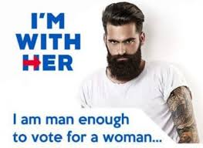

Slide 10
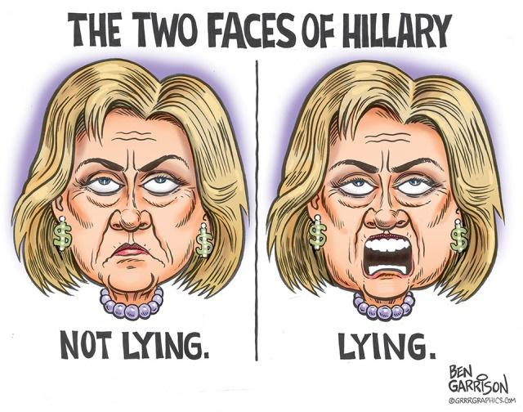

Slide 11
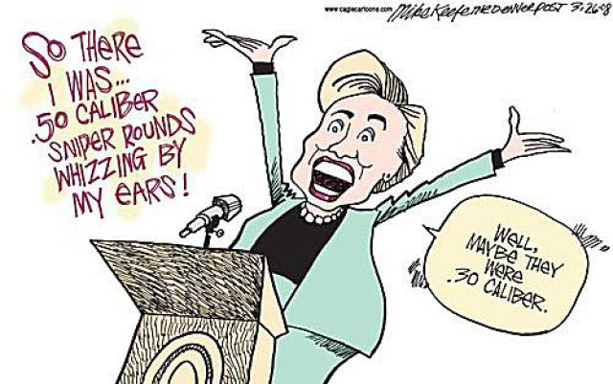

Slide 12


Slide 13
Debrief
Review today’s lesson
Connecting current events to students’ lives
Analyzing how the media and portrayal of women in the media affects us

Slide 14
Exit Slip
Reflect on the activity we did today. Answer the following questions on your exit slips and leave them on the front table before you leave.
How does the media influence public opinion?
How do you think this impacts individual decision making?

Slide 15
Citations
Donald Trump tweet about Hilary. Digital image. Http://www.washingtontimes.com/multimedia/image/clintonstarjpg/. N.p., n.d. Web.
Garrison, Ben. The Two Faces of Hilary Clinton. Digital image. N.p., n.d. Web.
Keene, Mike. Hilary in Bosnia. Digital image. N.p., n.d. Web.
NARAL Endorses Hilary Clinton. Digital image. Http://www.prochoiceamerica.org/elections/elections-press-releases/2016/hillary-endorsement-digital-ads.html. N.p., n.d. Web.
Morales, Scott. #ManEnoughForHilary. Digital image. N.p., Web,

