Slide 1
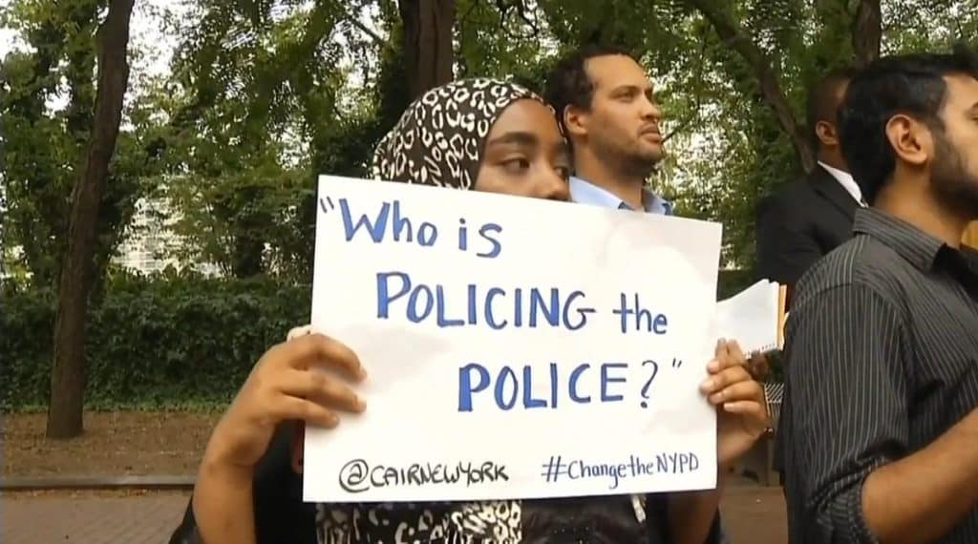
Policing the Police
Matt Ryan and Wes Ewing
Courtesy of Civil Liberties Defense Center

Slide 2
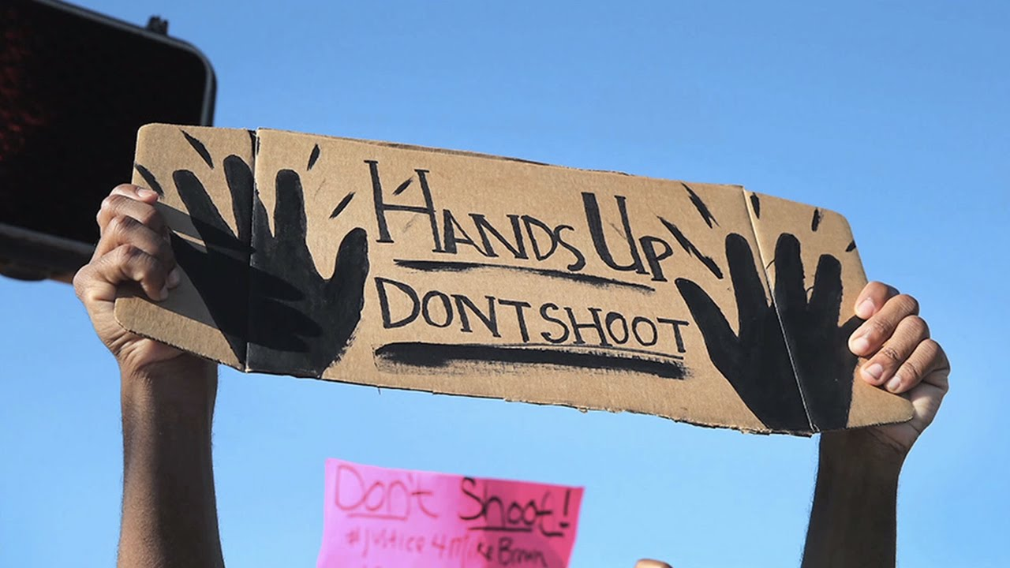
EQ: Does the United States have the tools to police the police?
Courtest of BITE News

Slide 3
Class Agenda
Policing the Police Activity
Plickers Mini-Quiz
Federalism Discussion
Exit Ticket and Wrap Up

Slide 4
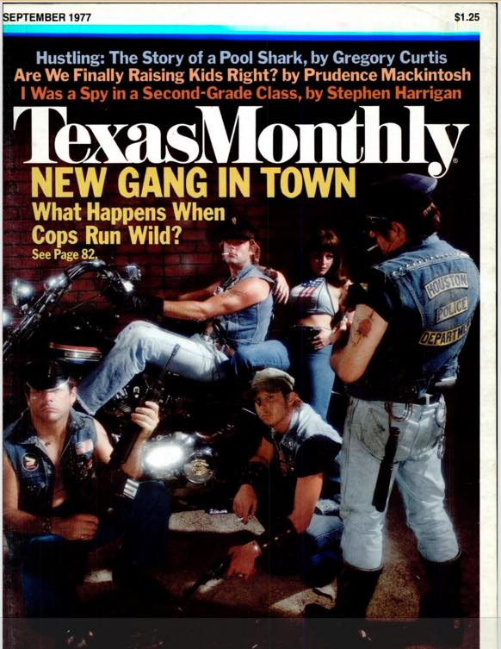

Simulation
OR

Slide 5
Activity Instructions
-Read the scenario you are given on your handout, and the mindset of the role you are given
-Using your given role, respond to the questions on the worksheet provided
-Use answers created to inform participation in class discussion

Slide 6
EQ: Does the United States have the tools to police the police?
-What was the most difficult part of crafting your response to the new political climate?
-What limited you/made it easier to come up with an effective response?
-How could you connect this activity to your own teaching?

Slide 7
Federalism and the separation of powers
-Separation of powers between the national government and state government
-Based in heritage of states as “mini-countries”
-Expressed powers
-Implied powers

Slide 8
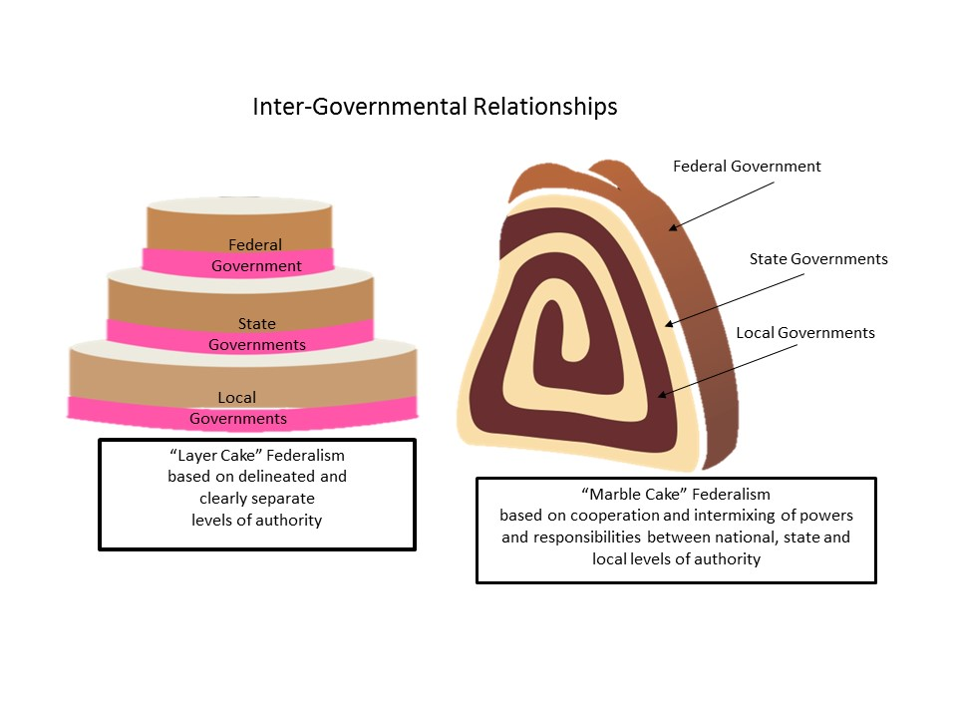
Courtesy of CK-12 Foundation

Slide 9
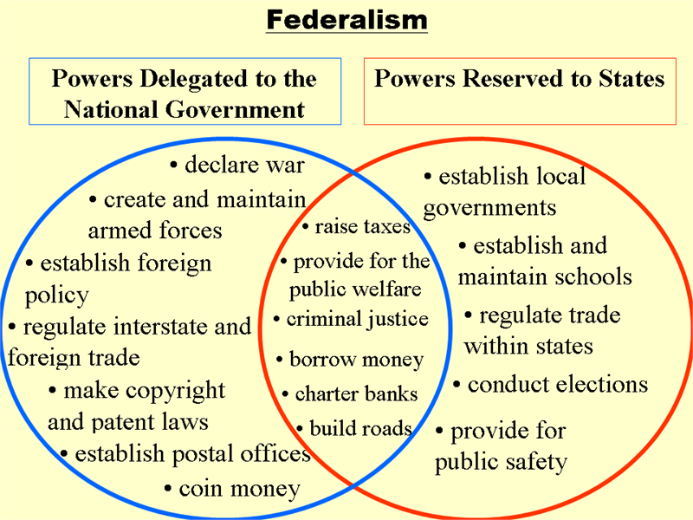
Govloop.com

Slide 10
Exit Ticket: Does the United States have the tools to police the police? Use evidence from both our activity and from the lesson/reading.

