Slide 1
World Population
By Benjamin Rall

Slide 2
Learning Objectives and Essential Question
Students will be able to describe how the global population has changed over time.
Students will be able to analyze how historical events have affected the world population.
What has led to increases in the global population?

Slide 3
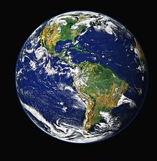
Origins Article
What current relationship does the article describe between humans and the environment?
How has this relationship changed over time?

