Slide 1
A LESSON BY DANIEL REDMAN & Emily Wiegand
LEAKERS AND WHISTLEBLOWERS
_______________________
HERO
OR
MENACE?
An editorial by J. Jonah Jameson
______________________________________________________________________

Slide 2
REMEMBER, REMEMBER, THE FIFTH OF NOVEMBER______
but maybe don’t remember Guy Fawkes so much because what a jerk, am I right?
-Anonymous releases KKK identities to Pastebin, Nov. 5, 2015
-Who is Anonymous?
-Guy Fawkes, Catholic terrorist, Houses of Parliament 1605 (King James I)
-V FOR VENDETTA, 1988 Comic Book by Alan Moore, Anarchy in the UK as an alternative to fascism (metaphor reflective of Thatcher-Era unrest)
-V FOR VENDETTA, 2006 Wachowski film adaptation (hated by Moore for turning story about “fascism, anarchy, England” into Bush-era screed)

Slide 3
LEAKS, WHISTLEBLOWERS & INFORMATION ATTACKS
FROM ORIGINS
Irwin, Ryan. "WikiLeaks, and the Past and Present of American Foreign Relations." Origins: Current Events in Historical Perspective 4.10 (2011): n. pag. Web.
Leaks, Whistleblowers, and Information-based “attacks” are nothing new!
From Alexander Hamilton slipping info about the Jay Treaty to the British, to Daniel Ellsberg and the Pentagon Papers, to Deep Throat and Watergate, all the way up to Chelsea (nee Bradley) Manning & Julian Assange’s famous Wikileaks released and Edward Snowden’s revelations…
… American life & history is replete with these events.
But leakers & whistleblowers are controversial figures.

Slide 4
american history extension
Am Hist 33: The United States faced new political, national security and economic challenges in the post-Cold War world and following the attacks on September 11, 2001.

Slide 5
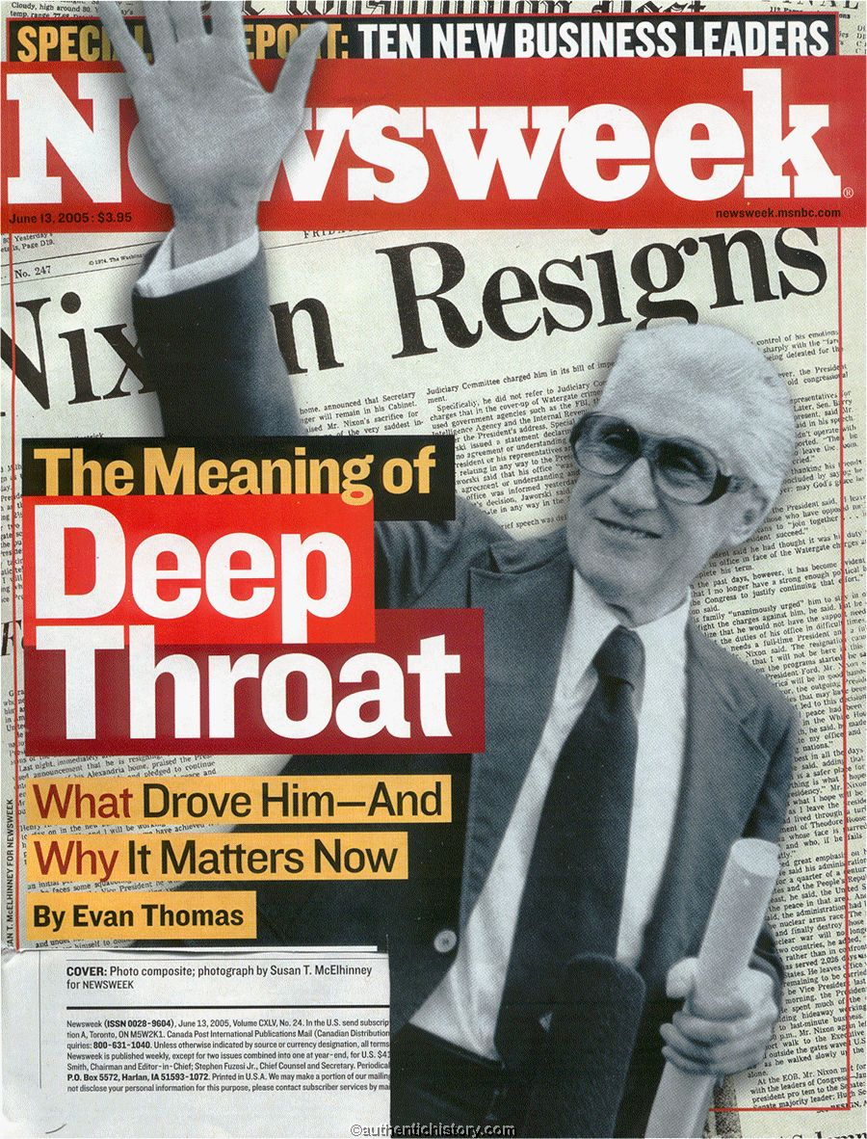

Slide 6
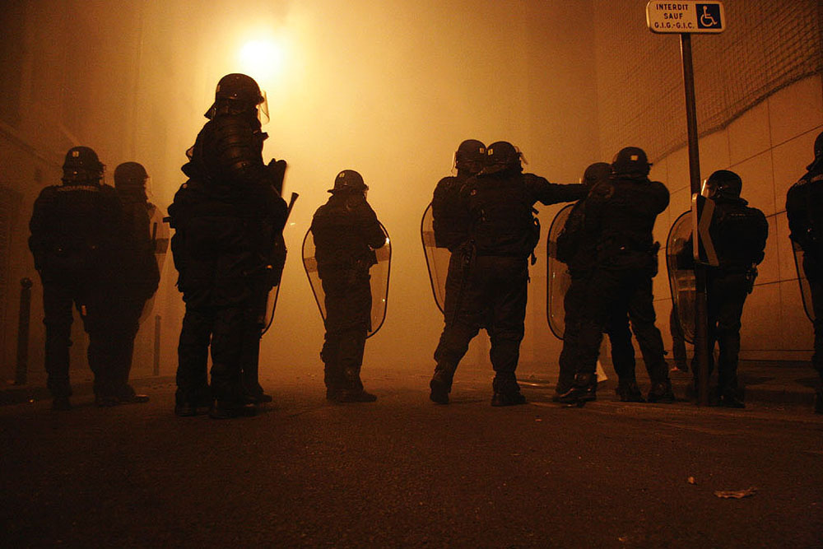
SOCIOLOGY EXTENSIONS
Sociology 7.2-4: Deviance and Social Control can be seen through either Functionalist or Conflict Theory lenses in very different ways.
LESSON IDEA: Dueling DBQ

Slide 7
7.4: A. Deviance in Industrial Society
1) Deviance is seen by those in power as threatening to their positions.
2) Rich and powerful use their position to define deviant behavior and decide on punishment.
7.2.b. Strain Theory
1) Rebellion – rejection of both success and means of achieving it. Substitute new set of goals and means

