Slide 1
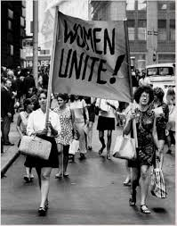
ARE WOMEN PEOPLE?!
The Equal Rights Amendment: Do we need an Equal Rights Amendment in the Constitution?

Slide 2
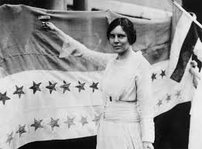
Background/ Perspective
Alice Paul
Suffragist
Responsible for passage of 19th Amendment
National Women’s Party, 1923
More than 1,000 state laws discriminating against women.
Rather than fighting all individually, why don’t we pass an amendment to tackle them all?
GOAL: Erase sex as a basis of legal classification

Slide 3
“Equality of rights under the law shall not be denied or abridged by the United States on account of sex.”
Current and Revised wording of the ERA

Slide 4
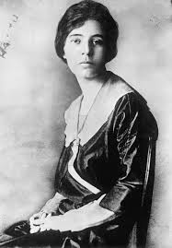
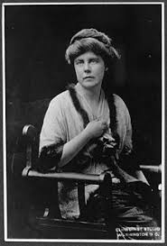
2017- Nevada becomes the 36th state to ratify on March 21st!
2018- Illinois becomes the 37th state to ratify on May 30th!

Slide 5
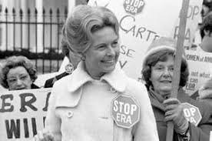
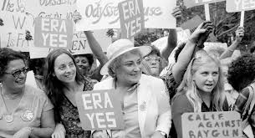
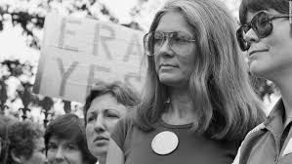
E.R.A.
For:
Against:
Women in business positions
Working class women
Elite women
Feminists/Activists (spread of 2nd wave feminism)
Motherhood and a career are not mutually exclusive
Women in labor and politics (1920s)
Working class housewives (later years 1970s)
Phyllis Schlafly
Can women be mothers and work?

Slide 6
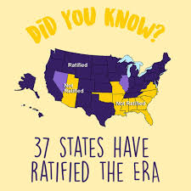
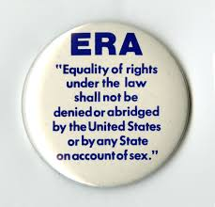
Do we need an Equal Rights Amendment added to the Constitution?
Goals for today:
I can discuss the arguments for and against the Equal Rights Amendment.
I can analyze if there is a need for an Equal Rights Amendment added to the Constitution.

Slide 7
Now it’s your turn to investigate the arguments!
Station 1: Primary Source Doc Analysis
You will read two accounts from different perspectives on the passage of the ERA
Station 2: Political Cartoons
You will view 3 different cartoons that will give you different perspectives on the time.
Station 3: Videos
Watch Phyllis Schlafly and Betty Friedan go head to head in an epic battle on the ERA!
Station 4: Research
Find 3 laws today that may suggest gender discrimination is still possible. Chat with your group on your findings.

Slide 8
Would an Equal Rights Amendment be beneficial/necessary today? Why or why not?
EXIT TICKET

