Slide 1
A History of Stolen Citizenship:
Why do some votes count less than others?

Slide 2
Why do some votes count less than others?
Welcome:
Take out your Origins reading and any notes.
Prepare your thoughts and observations from the reading.

Slide 3
Why do some votes count less than others?
From the Article:
“Laws denying rights and privileges of citizenship to those convicted of certain criminal acts have long existed in the western world.”
“In 1866…The Civil War had just ended, the 13th Amendment outlawed slavery in 1865, and the 14th Amendment—promising citizenship and equal protection—would soon be ratified (1868).”

Slide 4

Why do some votes count less than others?
From the Article:
“Desperate to stop black voting in order to maintain their racial hierarchies and privileged positions, white southern Democrats would soon turn to legal tools such as literacy tests and poll taxes to limit black suffrage, but the first methods they turned to after the war were existing laws disfranchising for crime.”

Slide 5
Why do some votes count less than others?
From the Article:
“The 15th Amendment, ratified in 1870 partially as a response to southern states’ suppression of the black vote, declared that “the right of citizens of the United States to vote shall not be denied or abridged by the United States or by any State on account of race, color, or previous condition of servitude.” Nevertheless, states found a variety of creative ways to deny black men the right to vote.”

Slide 6
Why do some votes count less than others?
How do some votes count less than others?

Slide 7
Why do some votes count less than others?
Today:
1. “I Can” describe key events in the history of disenfranchisement of African-American voters in the U.S.
2. “I Can” connect primary source images to important events or laws from the history of African-American disenfranchisement.

Slide 8
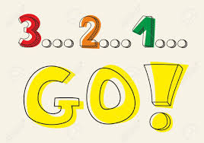
Why do some votes count less than others?
During the Mini-Lecture, Complete the 3-2-1 Handout:
3 key disenfranchisement laws from history. Define them.
2 modern forms of disenfranchisement. Briefly define them.
1 summary of disenfranchisement throughout American history. Use one law as support.

Slide 9
Why do some votes count less than others?
What is Disenfranchisement?
Simply: “to keep deprive someone of the right to vote” (Dictionary.com)
Throughout our history, it has taken many forms.
Today we will focus on the why and the how.
“History shows us that unjust obstacles to voting have undermined our democracy in the past and suggests that such practices may threaten it in the future as well” (Origins)

Slide 10
Why do some votes count less than others?
The Many Forms of Disenfranchisement:
By the 1830’s most states had laws that did not allow people convicted of certain crimes from voting.
In North Carolina, the use of public whippings was a tool used.
“every man who has been publicly whipped is excluded from the right of voting.”
“In the 1870s, every state under Reconstruction except Texas changed its laws to deny the vote to individuals convicted of petty theft and misdemeanor larceny—a change consciously designed to remove black voters from the rolls” (Origins)

Slide 11
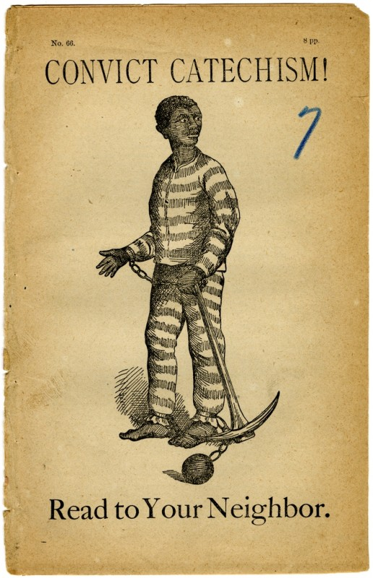
Why do some votes count less than others?
The Many Forms of Disenfranchisement:
The use of poll taxes – a fixed sum levied on every person regardless of income.
These taxes were meant to target black voters.
Mississippi’s “Pig Law” – expanded the definition of a felony to target black voters. (ex. Grand larceny could include stealing items worth only $10).

Slide 12
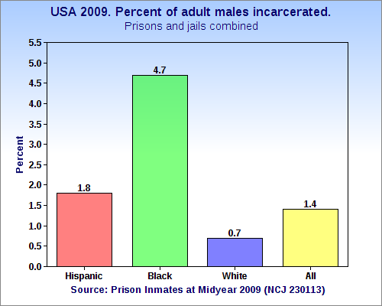
Why do some votes count less than others?
Disenfranchisement Today:
Mass incarceration – the US has the largest prisoner population in the world.
“Mass incarceration did not just mean expanding the number of people locked up; it also made a growing part of the population infamous and therefore disfranchised.”
Political terminology such as “war on drugs” or “tough on crime” attempt to make this movement more acceptable.
“The Sentencing Project reports that African American men are six times more likely to be incarcerated than white men”
The use of photo ID and voter purges have been used to suppress voting rights.

Slide 13
Why do some votes count less than others?
Big Paper Silent Discussion
The rules of the activity are:
It must be silent – only communication is through writing thoughts on the papers.
You are to attempt to get to all of the questions.
You will make at least one original response per paper. And you must respond to at least one classmate per paper.
You will place your names under their responses.
After you have completed your responses, please return to your seats.

Slide 14

Why do some votes count less than others?
Let’s Discuss!
What major tactics were used in the early 1880’s to mitigate voting?
How do these tactics help us understand early disenfranchisement?
How did you connect the police brutality protestor to the protestor calling for voting rights?

Slide 15
Why do some votes count less than others?
Let’s Discuss!
Why is it important to discuss these things, especially in a modern context?
How have these laws change your understanding of the right to vote in America?

Slide 16
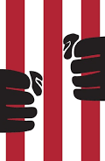
Why do some votes count less than others?
Exit Ticket: Reflect on one of the images you examined during the Silent Discussion activity.
How can you connect a historical disenfranchisement law and a modern form of voter suppression?

