Slide 1
The US-Iran Standoff:
How has America gotten Iran wrong?

Slide 2
The US-Iran Standoff: How has America gotten Iran wrong?
Welcome!
Once you get seated, please get your “US-Iran relations – a brief history” reading out.
Prepare any thoughts, observations or questions over the reading.
Be thinking about: What was the situation like for the United States and Iran in the 1950’s and 60’s?

Slide 3
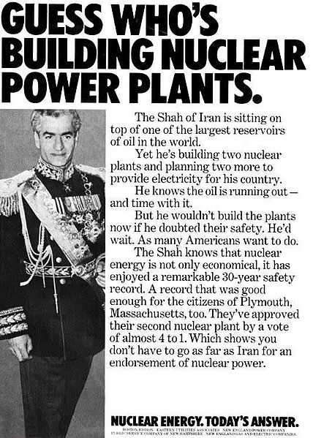
The US-Iran Standoff: How has America gotten Iran wrong?
Highlights from the BBC Article:
Iranian Revolution
US Embassy Hostage Crisis (1979)
Iranian Passenger Plane Shot Down
Iran as part of the “axis of evil” (Bush Administration)

Slide 4
The US-Iran Standoff: How has America gotten Iran wrong?
The US-Iran Standoff: How has America gotten Iran wrong?

Slide 5
The US-Iran Standoff: How has America gotten Iran wrong?
“I Can” distinguish the major events that lead to the Iran-United States standoff.
“I Can” critique actions taken by American and Iranian leaders that severed relations with the Iranian government.

Slide 6
The US-Iran Standoff: How has America gotten Iran wrong?
Gallery Walk!
1. To start, chose an image that is hung around the room that interests you.
2. Examine the picture, looking at the setting, the people or objects, and any other important details.
3. Answer the questions related to the image.
4. After answering the questions, move on to an image with the fewest number of students.

Slide 7
The US-Iran Standoff: How has America gotten Iran wrong?
Let’s Debrief:
1. How did you understanding of the US-Iran situation change?
2. What do the images tell us about how America’s involvement was viewed in Iran?

Slide 8
The US-Iran Standoff: How has America gotten Iran wrong?
Take-A-Stand
You will: Choose a Side!
Pick the side you believe is true and be prepared to defend your stance with source evidence! (“I chose my stance because [ ]”)
The ”Sides”:
The conflict with Iran was avoidable.
The conflict with Iran was unavoidable.

Slide 9
The US-Iran Standoff: How has America gotten Iran wrong?
The US-Iran Standoff: How has America gotten Iran wrong?

Slide 10
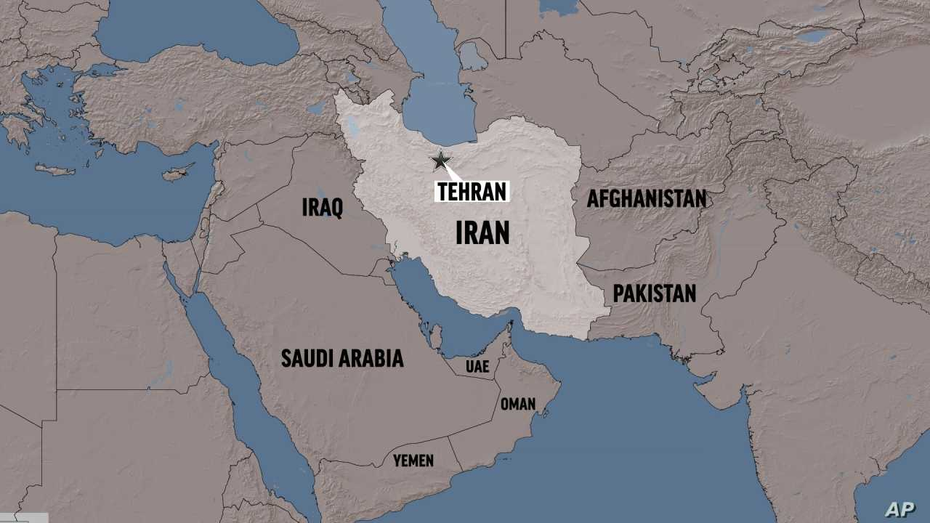
The US-Iran Standoff: How has America gotten Iran wrong?
Exit Ticket:
  Before you leave:
Was the conflict between the U.S. and Iran avoidable or unavoidable? What is the most convincing evidence from the images?

