Slide 1
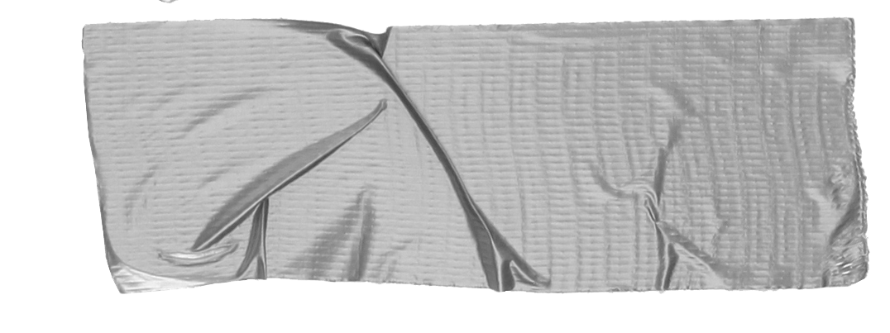

Sensationalism, Modern Media, & Presidential Elections
Note:
As you get ready for class make sure that you have the QR code scanner app.
A guide by Jill Hetki and Allison Irvin

Slide 2
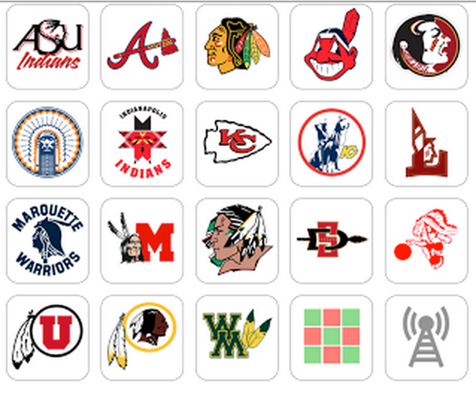
http://mattblake.net/210/images/native_am_logos.png
Jill Hetki and Allison Irvin 10/2016
https://www.youtube.com/watch?v=HTBT-_F6oYw

Slide 3
→ How has your opinion changed about these images?
→ How did the media influence your opinion?

Slide 4
I can...
Evaluate how media influences people.
Interpret how media chooses what they cover.
Jill Hetki and Allison Irvin 10/2016

Slide 5
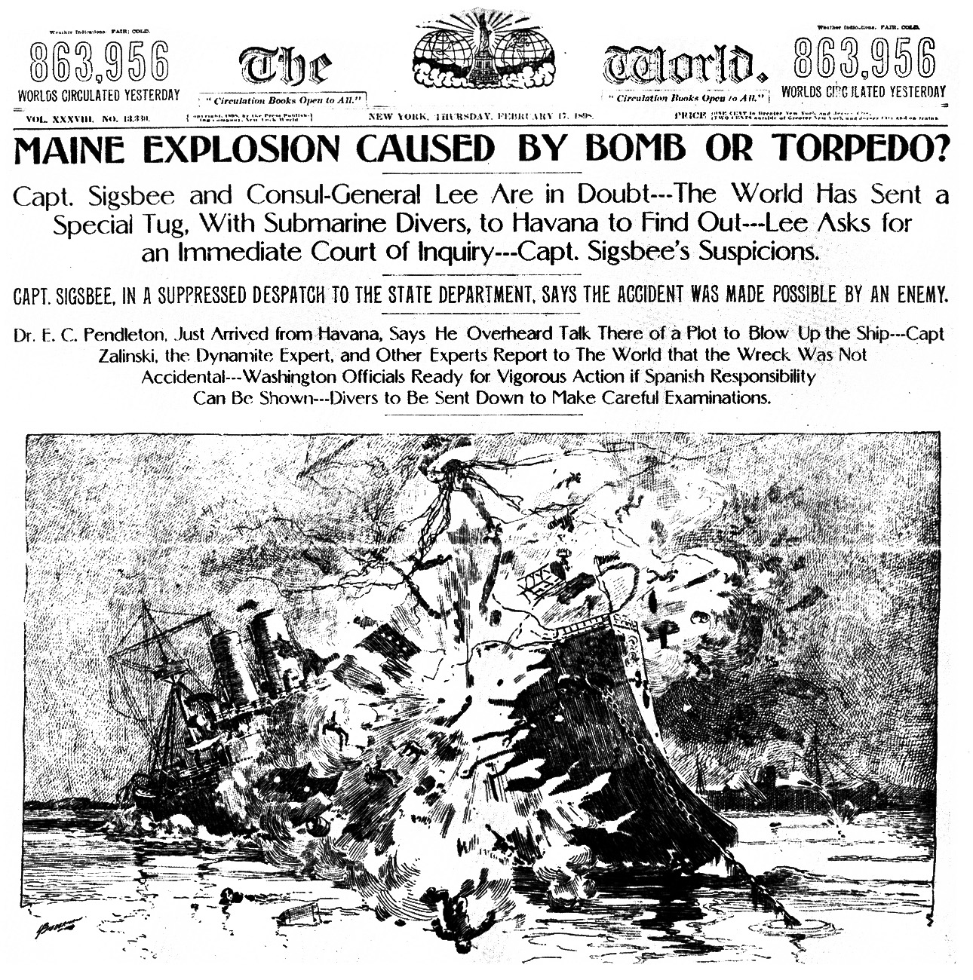
BRIEF Timeline of the History of Media
Mid 1800s---Penny Press &Yellow Journalism
1920s--------------------------------Broadcast Radio
1950s and 1960s---------------------------Televison
2004-------------------------------Facebook Created
2006----------------------------------Twitter Created
Jill Hetki and Allison Irvin 10/2016
http://www.latinamericanstudies.org/spanwar/world-2-17-1898.jpg

Slide 6
→In 2015, Donald Trump received 327 minutes of nightly news coverage.
→ Hillary Clinton received 121 minutes.
→ Bernie Sanders received 20 and dropped out in summer 2016.
Why would the media’s coverage differ so much from public opinion?
Voting Averages according to the CNN/ORC poll done between Sept. 28-Oct.2:
47% of likely voters support Hillary Clinton
42% of likely voters support Donald Trump
What is the main goal of media producers?
Jill Hetki and Allison Irvin 10/2016

Slide 7
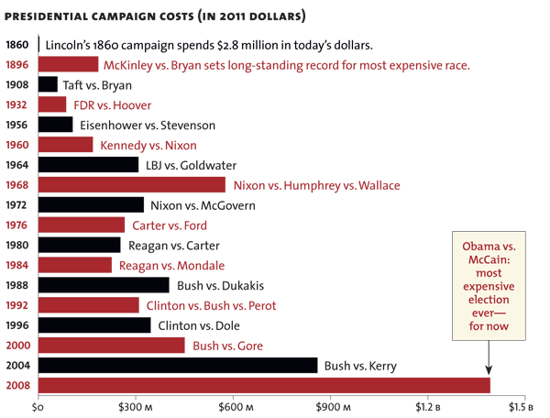
Check-in!
(With a little help from your smart phone )
https://www.polleverywhere.com/multiple_choice_polls/Er2JeO48vMC10xf
What is the main goal of media producers?
Facebook began in 2004…
Fun Fact:
Barack Obama spent $730 million getting to the White House in 2008
Jill Hetki and Allison Irvin 10/2016
http://www.motherjones.com/mojo/2012/02/historic-price-cost-presidential-elections

Slide 8
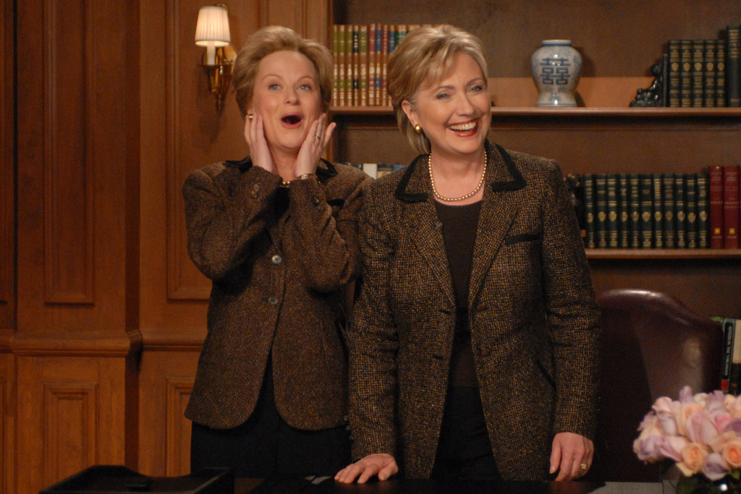
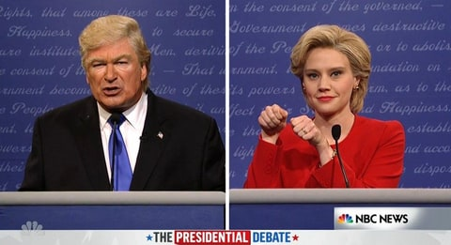
Did this number surprise you? What do you think are the goals of media based on this knowledge?
http://i2.cdn.cnn.com/cnnnext/dam/assets/150414113554-saturday-night-live-politics-gallery-2-super-169.jpg
https://i.ytimg.com/vi/OWPbhzlxMx4/maxresdefault.jpg
Jill Hetki and Allison Irvin 10/2016

Slide 9
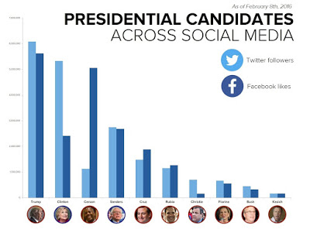
What do we know about candidates
from the media?
How has the media influenced our perception of candidates?
Jill Hetki and Allison Irvin 10/2016
http://alittleclass.blogspot.com/2016/03/the-digital-debate-social-media-in-2016.html

Slide 10
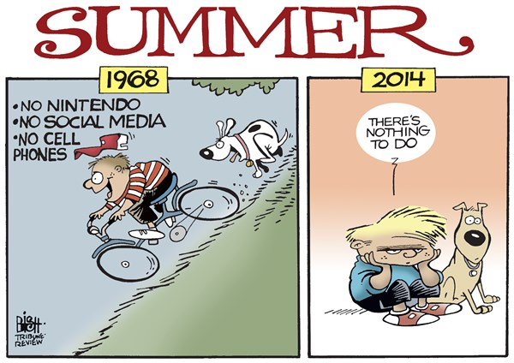
Jill Hetki and Allison Irvin 10/2016
http://www.theburningplatform.com/2014/07/13/sunday-funnies-19/

Slide 11
Jill Hetki and Allison Irvin 10/2016
http://www.theburningplatform.com/2014/07/13/sunday-funnies-19/

