Slide 1
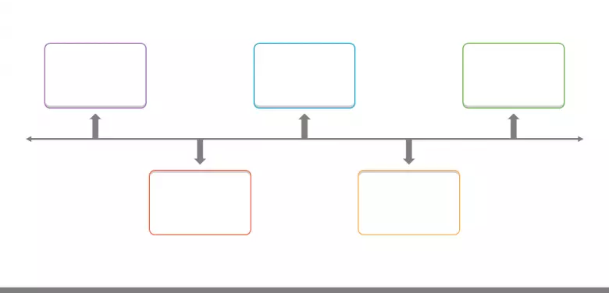
timeline
PrEP drug issued to prevent the transmission of HIV
AIDs becomes main cause of death among US men ages 25-44
1992
2011
1981
2008
2022
Estimated 56,300 new cases of HIV each year
Woman possibly cured of HIV
First report of AIDS epidemic in US
Notes:
Sources Packet- Document C
Direct questions teacher to ask students during small discussion on Timeline:
What was the order of your timeline? Why did you label your timeline in that order?
Were you surprised of the actual order of the timeline? Why or why not?
What is timeline showing?
(Expanding off the question before): From what we have analyzed from the timeline, what demographics are being impacted?
What else do you notice about this timeline?
What do you think is the topic for today’s lesson? Explain.

Slide 2
timeline
First report of AIDS epidemic in US
Estimated 56,300 new cases of HIV each year
Woman possibly cured of HIV
1992
2011
1981
2008
2022
AIDs becomes main cause of death among US men ages 25-44
PrEP drug issued to prevent the transmission of HIV
Notes:
Sources Packet- Document C
Direct questions teacher to ask students during small discussion on Timeline:
What was the order of your timeline? Why did you label your timeline in that order?
Were you surprised of the actual order of the timeline? Why or why not?
What is timeline showing?
(Expanding off the question before): From what we have analyzed from the timeline, what demographics are being impacted?
What else do you notice about this timeline?
What do you think is the topic for today’s lesson? Explain.

Slide 3
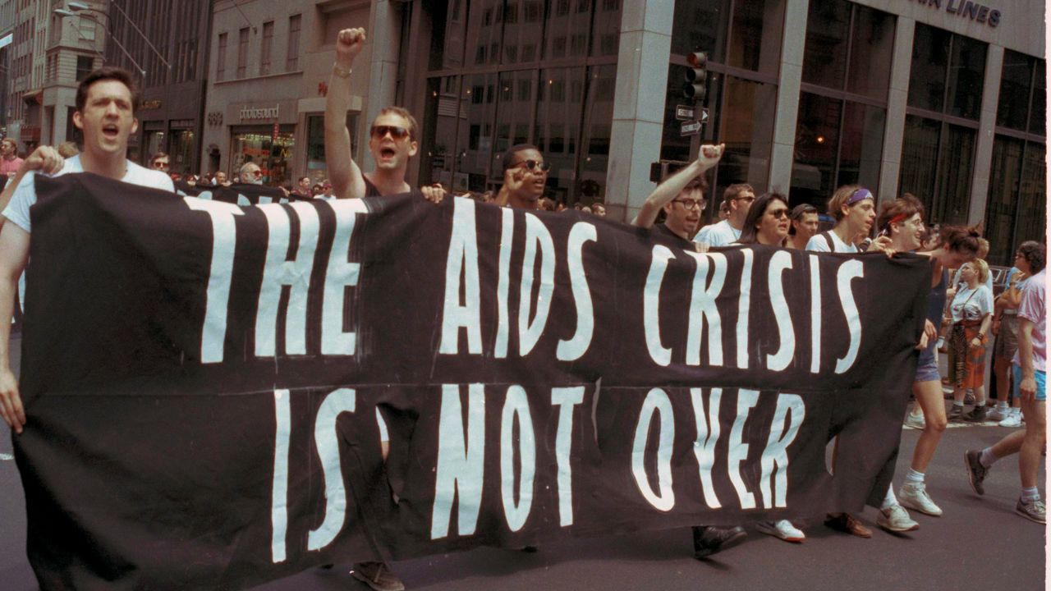
HIV:
Past & Present
(CQ): How did the action or inaction of the United States government impact the HIV epidemic during the 1980s to present?
Describe how this impact differs by demographic.
Notes:
Compelling Question (CQ) is also student’s exit ticket
Image- Sources Packet- Document K

Slide 4
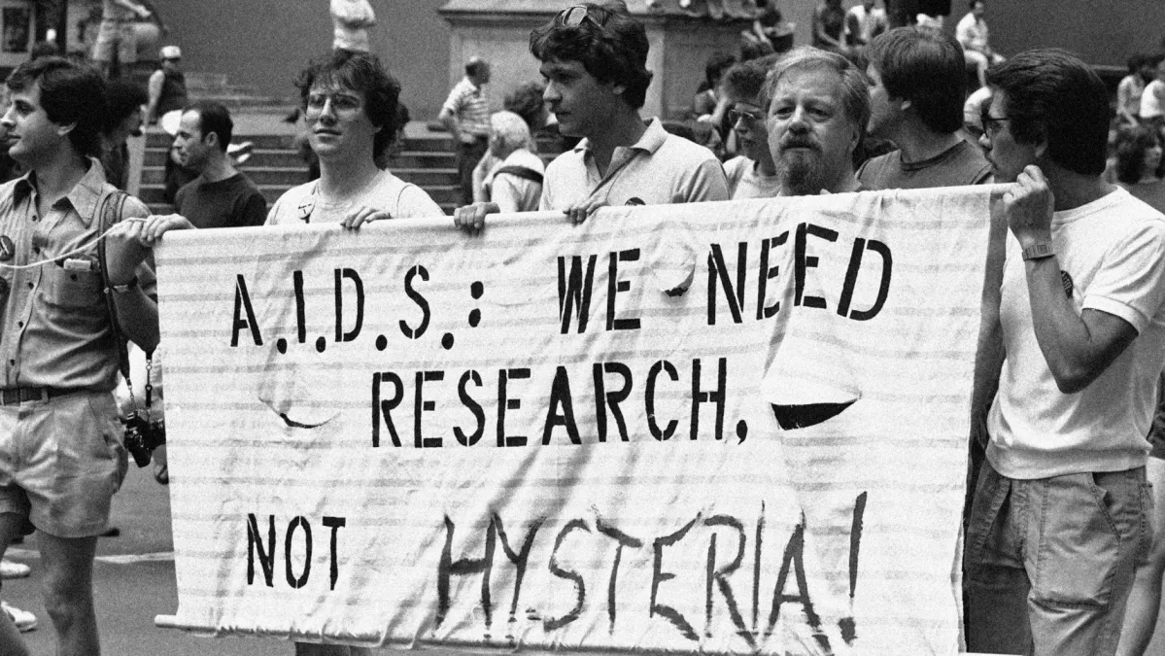
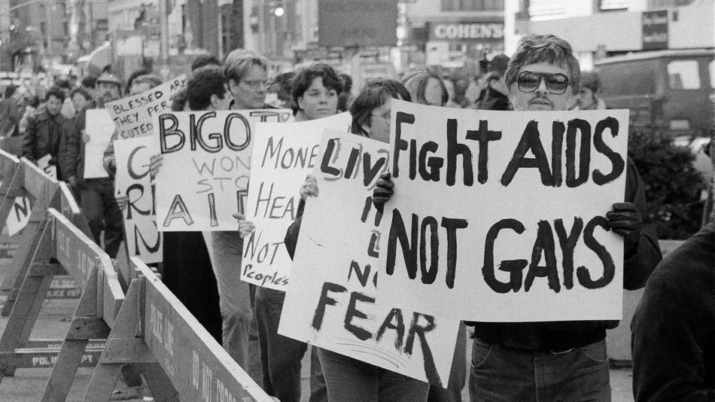
Overview
Timeline
K-W-L Chart (A Century of HIV)
Stations (Two-Way Table)
Class Discussion
Exit Ticket (CQ)
I can…
Examine primary and secondary sources focused on how the United States government handled the HIV epidemic from the 1980s-present.
Compare multiple demographics affected by HIV in the United States from the 1980s-present using a two-way table.
Notes:
For equity, use https://wheelofnames.com/ to choose student to read “I Can…” statements
Images- Sources Packet- Document I and J

Slide 5
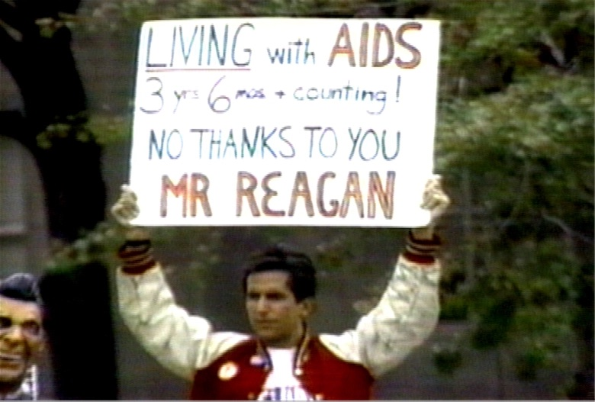
K-W-L Chart
What I Know about the HIV Crisis (2-3 facts)
What I Want to learn about the HIV Crisis (3-5)
Read A Century of HIV Article
What I Learned about the HIV crisis (5 facts)
Notes:
Image- Sources Packet- Document H
Sources Packet- Document A
K-W-L Chart Link: https://padletuploads.blob.core.windows.net/prod/115892916/431e43a733223085797c45635bfc759a/Ideas_for_Formative_Assessments.pdf
Direct questions for teacher to ask students during K-W-L Chart:
What do you already know about the HIV crisis?
What do you want to learn about the HIV crisis?
What is something you learned from the Century of HIV article?
What was HIV first referred as? Explain.
(Expanding off the question before): What demographics have been affected by the HIV crisis?
How did the Ronald Reagan administration handle the HIV crisis during the 1980s?

Slide 6

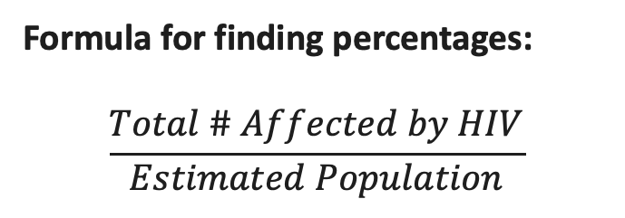
Two-Way Table
Stations
4 Stations-Groups of 6 Students:Two-Way Table
1. Station One: LGBTQ+ Community
2. Station Two: Black Community
3. Station Three: Latinx Community
4. Station Four: White Community
Demographic
Past
Present
LGBTQ+ Community
Black Community
Latinx Community
White Community
Formula for finding percentages:
$$\frac{Total \# Affected by HIV}{Estimated Population}$$
Notes:
Sources Packet- Document D, E, F, and G
Stations, Learning Strategy Link: https://www.facinghistory.org/resource-library/teaching-strategies/stations-interacting-multiple-texts
Two-Way Table Link: https://www.statisticshowto.com/two-way-table/#:~:text=A%20two%20way%20table%20is,category%20is%20represented%20by%20columns.
Direct Questions for the teacher to ask the students during stations:
What have you noticed about each demographic in your Two-Way Table?
(Expanding off the question before): From the percentages, have HIV positive cases improved since the 1980s? In which demographics? Why or why not?
What trends did you notice after analyzing the primary and secondary sources at each station?
Why do you think the HIV crisis is still prevalent after 40 years? Explain.
Are we seeing improvements on the handling of the HIV crisis? Explain.

Slide 7

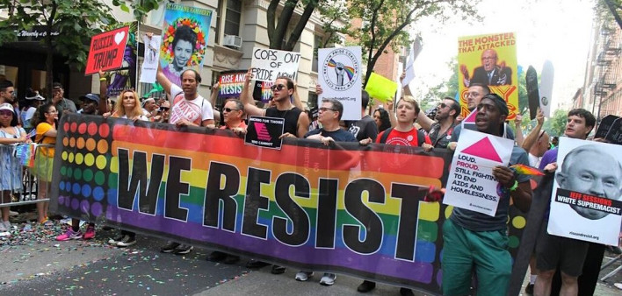
Class Discussion
Notes:
Images- Sources Packet- Document L and M
Sources Packet- Document A
K-W-L Chart Link: https://padletuploads.blob.core.windows.net/prod/115892916/431e43a733223085797c45635bfc759a/Ideas_for_Formative_Assessments.pdf
Sources Packet- Document D, E, F, and G
Stations, Learning Strategy Link: https://www.facinghistory.org/resource-library/teaching-strategies/stations-interacting-multiple-texts
Two-Way Table Link: https://www.statisticshowto.com/two-way-table/#:~:text=A%20two%20way%20table%20is,category%20is%20represented%20by%20columns.
Direct Questions for the teacher to ask the students during class discussion:
From the A Century of HIV article: How is the HIV crisis being handled currently? Give examples from the reading.
From the K-W-L Chart: Was anything answered in your “Want to Learn” column of your K-W-L chart? What do you still want to learn about the HIV crisis?
Two-Way Table: What trends did you notice after comparing the percentages in the Two-Way Table? Did any of the demographic’s percentages surprise you? Why or why not?
Two-Table and A Century of HIV article: How does the current government compare to the Ronal Reagan administration on handling the HIV crisis? Why or why not?
Two-Table and A Century of HIV article: What can society do more of on handling the HIV crisis? How about the government?
What are ways you can get involved in becoming activist for different demographics being affected by the HIV crisis?

Slide 8
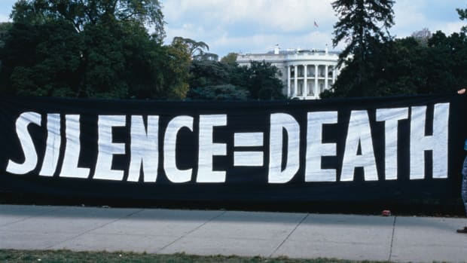
Exit Ticket
(CQ): How did the action or inaction of the United States government impact the HIV epidemic during the 1980s to present?
Describe how this impact differs by demographic.
Notes:
Reintroducing CQ from the beginning of the lesson
Image- Sources Packet- Document N

