Slide 1
Changing the Narrative

Slide 2
Agenda 1. Bell Ringer 2. Whole Class Reading 3. Jigsaw Activity 4. Closing Discussion

Slide 3
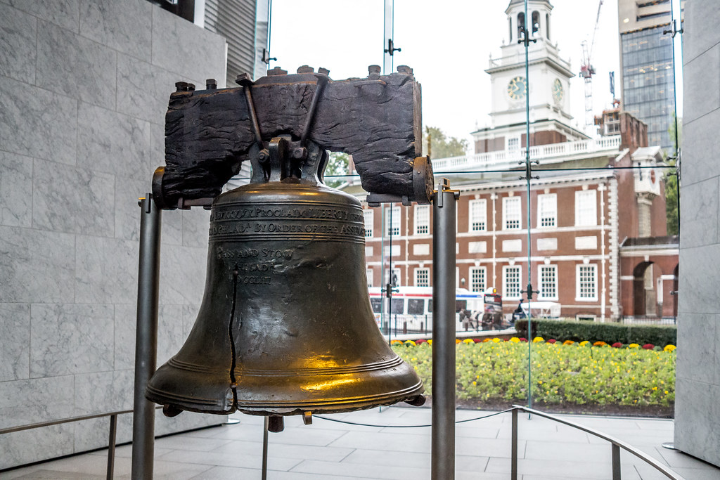
Bell Ringer
Why do we have
monuments and
memorials?
Notes:
Ask students to write down their answer to the Bell Ringer
Show students 9/11 memorial video. Explain to students this is an example of a memorial built to honor the lives lost in the September 11, 2001, terrorist attacks.
Discuss:
Have students use their Bell ringer answers and thoughts from the 9/11 video aloud with the class to generate discussion.
Ask the following supporting questions throughout discussion:
1. How do we use monuments and memorials?
2. Where have you seen monuments and memorials locally?
3. What do they tell you?

Slide 4
Definitions: What’s a Monument?
Monument:
A type of structure explicitly created to commemorate a person or event, or which has become relevant to a social group as a part of their remembrance of historic times or cultural heritage, due to its artistic, historical, political, technical or architectural importance.
Notes:
Point out the similarities in these definitions
Use the definitions to explain to students the purpose of a memorial and how it is representative of a shared history.
When we build or honor a monument or memorial, we are recognizing and collectively remembering a history of our society.
Discuss:
1. Does anything stick out to you in these definitions?
2. Are there any monuments or memorials that have significance to you? What kinds of feelings do they generate for you?

Slide 5
Definitions: What’s a Memorial?
Memorial:
Something (usually a structure) which serves the purpose of preserving remembrance. Reminds a people of a person or event.
Notes:
Point out the similarities in these definitions
Use the definitions to explain to students the purpose of a memorial and how it is representative of a shared history.
When we build or honor a monument or memorial, we are recognizing and collectively remembering a history of our society.
Discuss:
1. Does anything stick out to you in these definitions?
2. Are there any monuments or memorials that have significance to you? What kinds of feelings do they generate for you?

Slide 6
“Historical monuments are, among other things, an expression of power – an indication of who has the power to choose how history is remembered in public places.” – Historian Eric Foner
Notes:
Let students think about the quote individually.
Leave the quote on the board while students participate in the Jigsaw activity.

Slide 7
JIGSAW: DIRECTIONS
Step 1: Expert Groups
Read/explore the materials for your assignment monument or memorial
Everyone in your expert group will be working on the same materials
Answer the questions on the worksheet with your expert group
Step 2: Jigsaw Groups
Everyone in your jigsaw group will be an expert on a different monument/memorial
Share with the group about your monument/memorial.
Take notes on what others share in your worksheet and discuss as a group
Notes:
Arrange students in 5 groups
Pass out a monument/memorial to each expert group. Have students spend time reading the article individually and doing group exploration.
Students will answer the use the questions in the lesson plan to guide their analysis with their expert group.
Students should have access to the internet, if students finish early, they should continue researching their monument or memorial.
Students should read and explore the article or website and further research online.

Slide 8
JIGSAW: MONUMENTS AND MEMORIALS
1.Mary McLeod Bethune
2.Christopher Columbus
3.Theodore Roosevelt
4.Emmett Till
5.National Veterans Memorial and Museum

Slide 9
Jigsaw: Expert Groups
Questions for expert group monument/memorial:
What is this monument/memorial?
Was this removed or moved? Why?
Was this controversial? What were the conflicting perspectives?
Why was this monument/memorial significant? What role does it play in our shared history?
How does/did this monument or memorial minimize or amplify minority experiences in the Americas?
Notes:
These are the questions students should be thinking about, answering, and taking notes on in their expert groups.
When students move on to jigsaw groups, emphasize the importance of questions 3-5 in their disucssions.

Slide 10
Exit Ticket Questions
To whom are we responsible as a society when we create monuments and memorials to the past? How should we decide which events or individuals are important to remember?
How might your response differ when considering the social responsibility to others and then the educational responsibility to tell the truth about the past?

