Slide 1
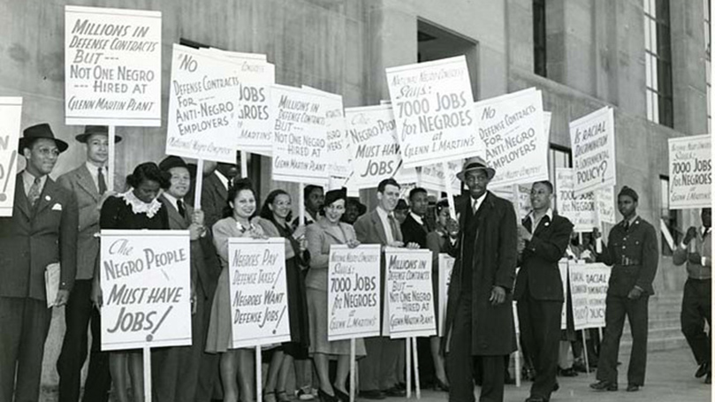
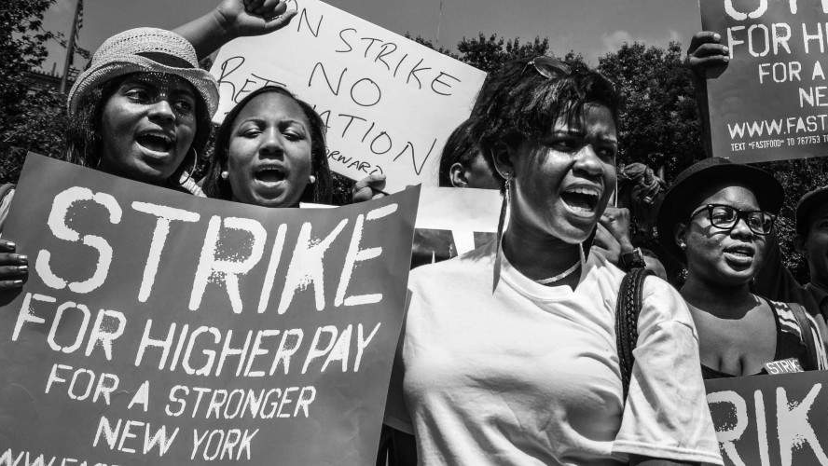
Then/Now
Notes:
Sources Packet- Document G, H
Direct Questions for the teacher to ask the students during small discussion about Then/Now Images:
What time period do you think the top image took place in? How do you know?
What time period do you think the bottom image took place in? How do you know?
How are the top and the bottom image’s protest signs similar? How are they different?
(Expanding off the question before): What social injustices are these two images fighting for?
What else do you notice about these two images that are the same?
What do you think is the topic for today’s lesson? Explain.

Slide 2
BLACK COMMUNISM
(CQ): How did the American Communist Party collaborate with Black Activists to fight for economic justice during the 1930’s?
Notes:
Compelling Question (CQ) is also student’s exit ticket

Slide 3
Overview
Then/Now
Give One, Get One (Workers of the World)
Think, Pair, Share (Black Communism Images)
Class Discussion
Exit Ticket (CQ)
I can…
Examine the relationship between the American Communist Party and Black Activists.
Discuss Black Communism and its effects on real-world issues during the 1930’s.
Notes:
For equity, use https://wheelofnames.com/ to choose student to read “I Can…” statements

Slide 4
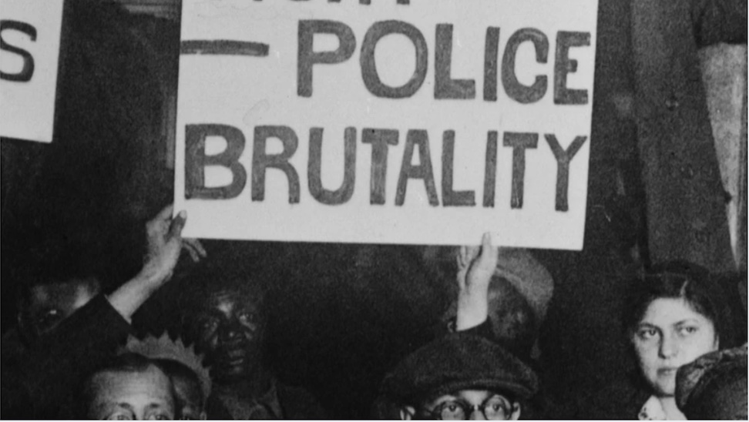
Give One, Get One
Read excerpts from article:
Workers of the World
1
Find 3 social injustices that helped build a relationship between the American Communist Party and Black Activists.
2
Give yours and Get 3 more social injustices that helped build a relationship between the American Communist Party and Black Activists from your peers.
3
Notes:
Sources Packet- Document A
Give One, Get One Learning Strategy Link: https://www.facinghistory.org/resource-library/teaching-strategies/give-one-get-one
Direct Questions for the teacher to ask the students during Give One, Get One:
What do you already know about the American Communist Party?
What do you already know about how the Black community was treated in the United States leading up to 1930’s?
What caused the American Communist Party to see social injustices as more than a class issue?
How did the American Communist Party support Black Activists? Explain.
What caused the Black membership in the American Communist Party to “boom”?

Slide 5

Think, Pair, Share
5 groups of 5 students
Each group will get a different image relating to Black Communism in the 1930’s
Think: What effects did Black Communism have on real-world issues during the 1930’s?
Pair with a group member
Share with your group members
Notes:
Sources Packet- Document C, D, E, F
Think, Pair, Share, Learning Strategy Link: https://www.readingrockets.org/strategies/think-pair-share
Direct Questions for the teacher to ask the students during Think, Pair, Share:
What social injustices were targeted in your group’s image?
(Expanding off the question before): What does this tell you about the real-world issues happening during the 1930’s?
How do these images relate to the Then/Now images from the beginning of the lesson?
Are we seeing these same social injustices happening in current society? Explain.
Based off your group’s image, how did Black Communists get their message out to Black community?

Slide 6
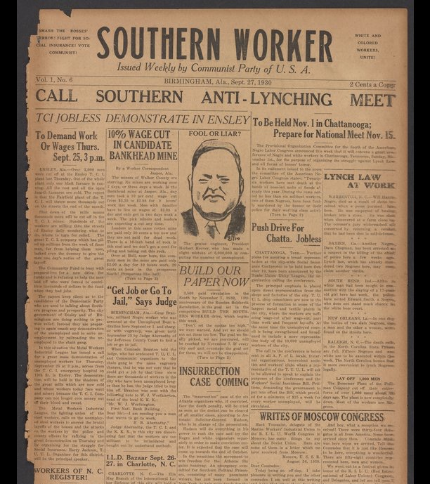
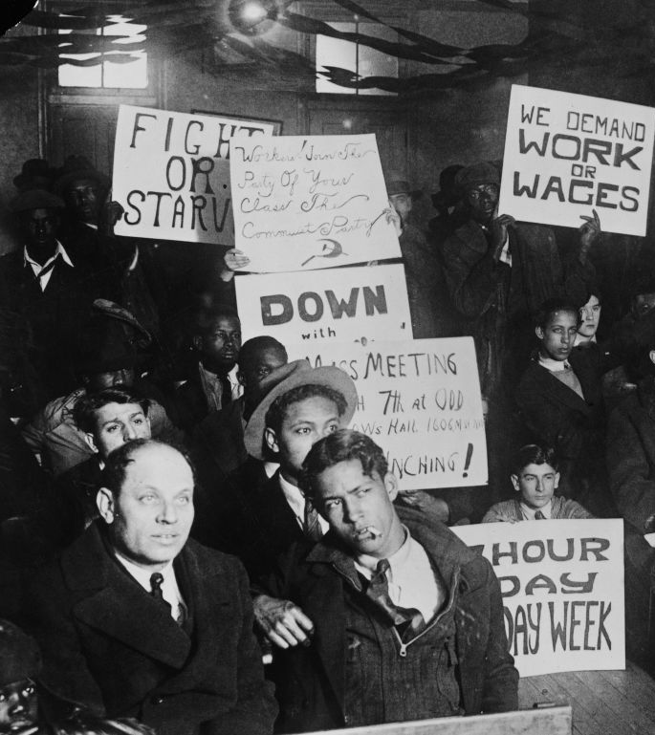
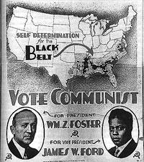
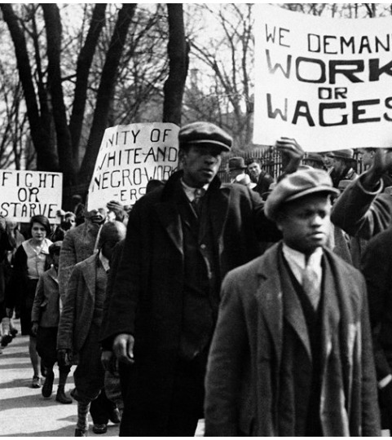
Class Discussion
Notes:
Sources Packet- Document C, D, E, F
Direct Questions for the teacher to ask the students during class discussion:
From the Give One, Get One: what was the relationship between the American Communist Party and Black Activists?
From the Give One, Get One: what do you think were the most important social injustices the American Communist Party and Black Activists were fighting for? Why?
From the Think, Pair, Share: how are these four images similar? How are they different?
From the Think, Pair, Share: how did Black Communists influence the Black community?
From the Think, Pair, Share: how has Black Communism impacted future Black Activist groups? Black panthers? Student Nonviolent Coordinating Committee? The Black Lives Matter Movement?

Slide 7

Exit Ticket
(CQ): How did the American Communist Party collaborate with Black Activists to fight for economic justice during the 1930’s?
Notes:
Reintroducing CQ from the beginning of the lesson

