Slide 1
International Ripples of the Civil Rights Movement
How has the Civil Rights movement impacted people outside the United States?

Slide 2
Today’s Agenda
Introduction: Photo Analysis
Group Presentations
Class Discussion
Exit Ticket

Slide 3
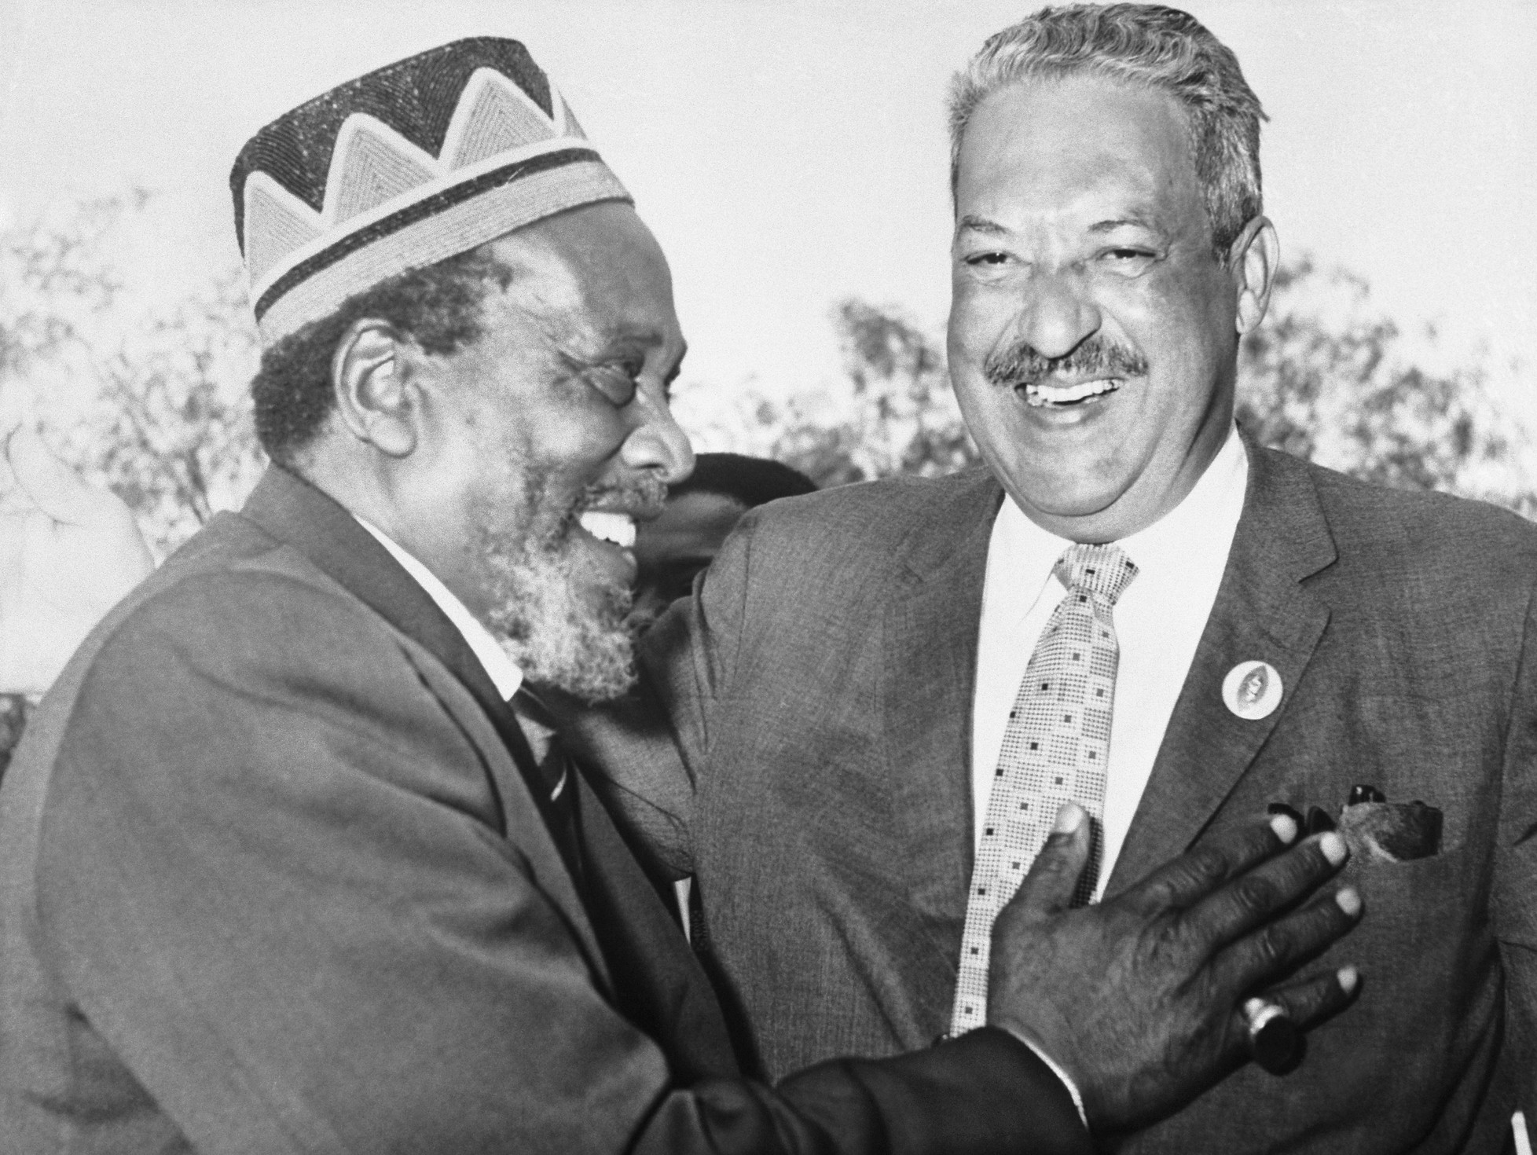
Thurgood Marshall
Federal district judge Thurgood Marshall had been sympathetic to the Kenyan decolonization struggle in the 1950s and he had defended African students as a lawyer for the NAACP.
In 1960, Marshall participated in the first of three Lancaster House Conferences that ultimately produced the first constitution of independent Kenya.

Slide 4
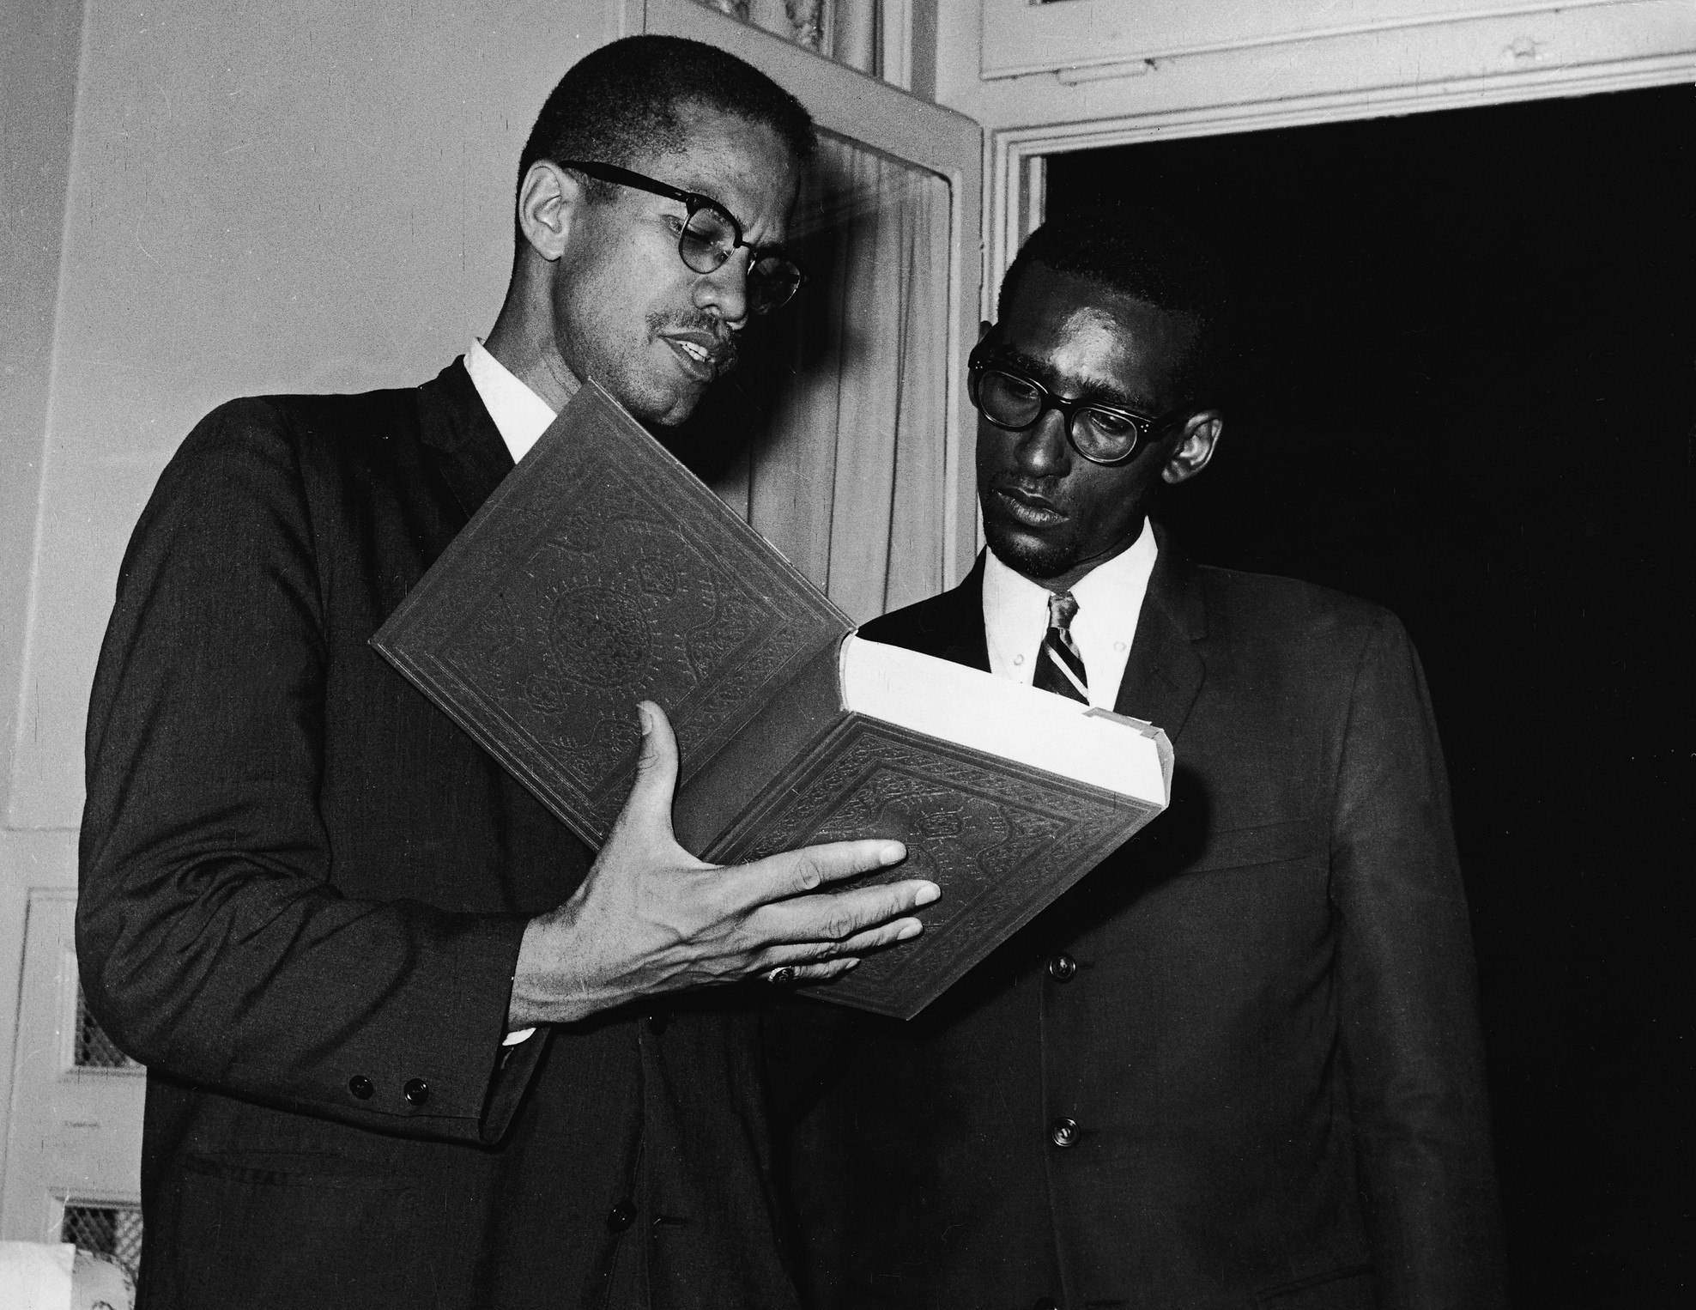
Malcolm X
In 1963, the Organization for African Unity (OAU) formed to establish mutual support and consolidate resources among an increasing number of newly formed African nations.
Civil Rights activist and Muslim minister Malcolm X (left) speaks with an unidentified man at the African Summit Conference in July 1964, the second gathering of OAU delegates.

Slide 5
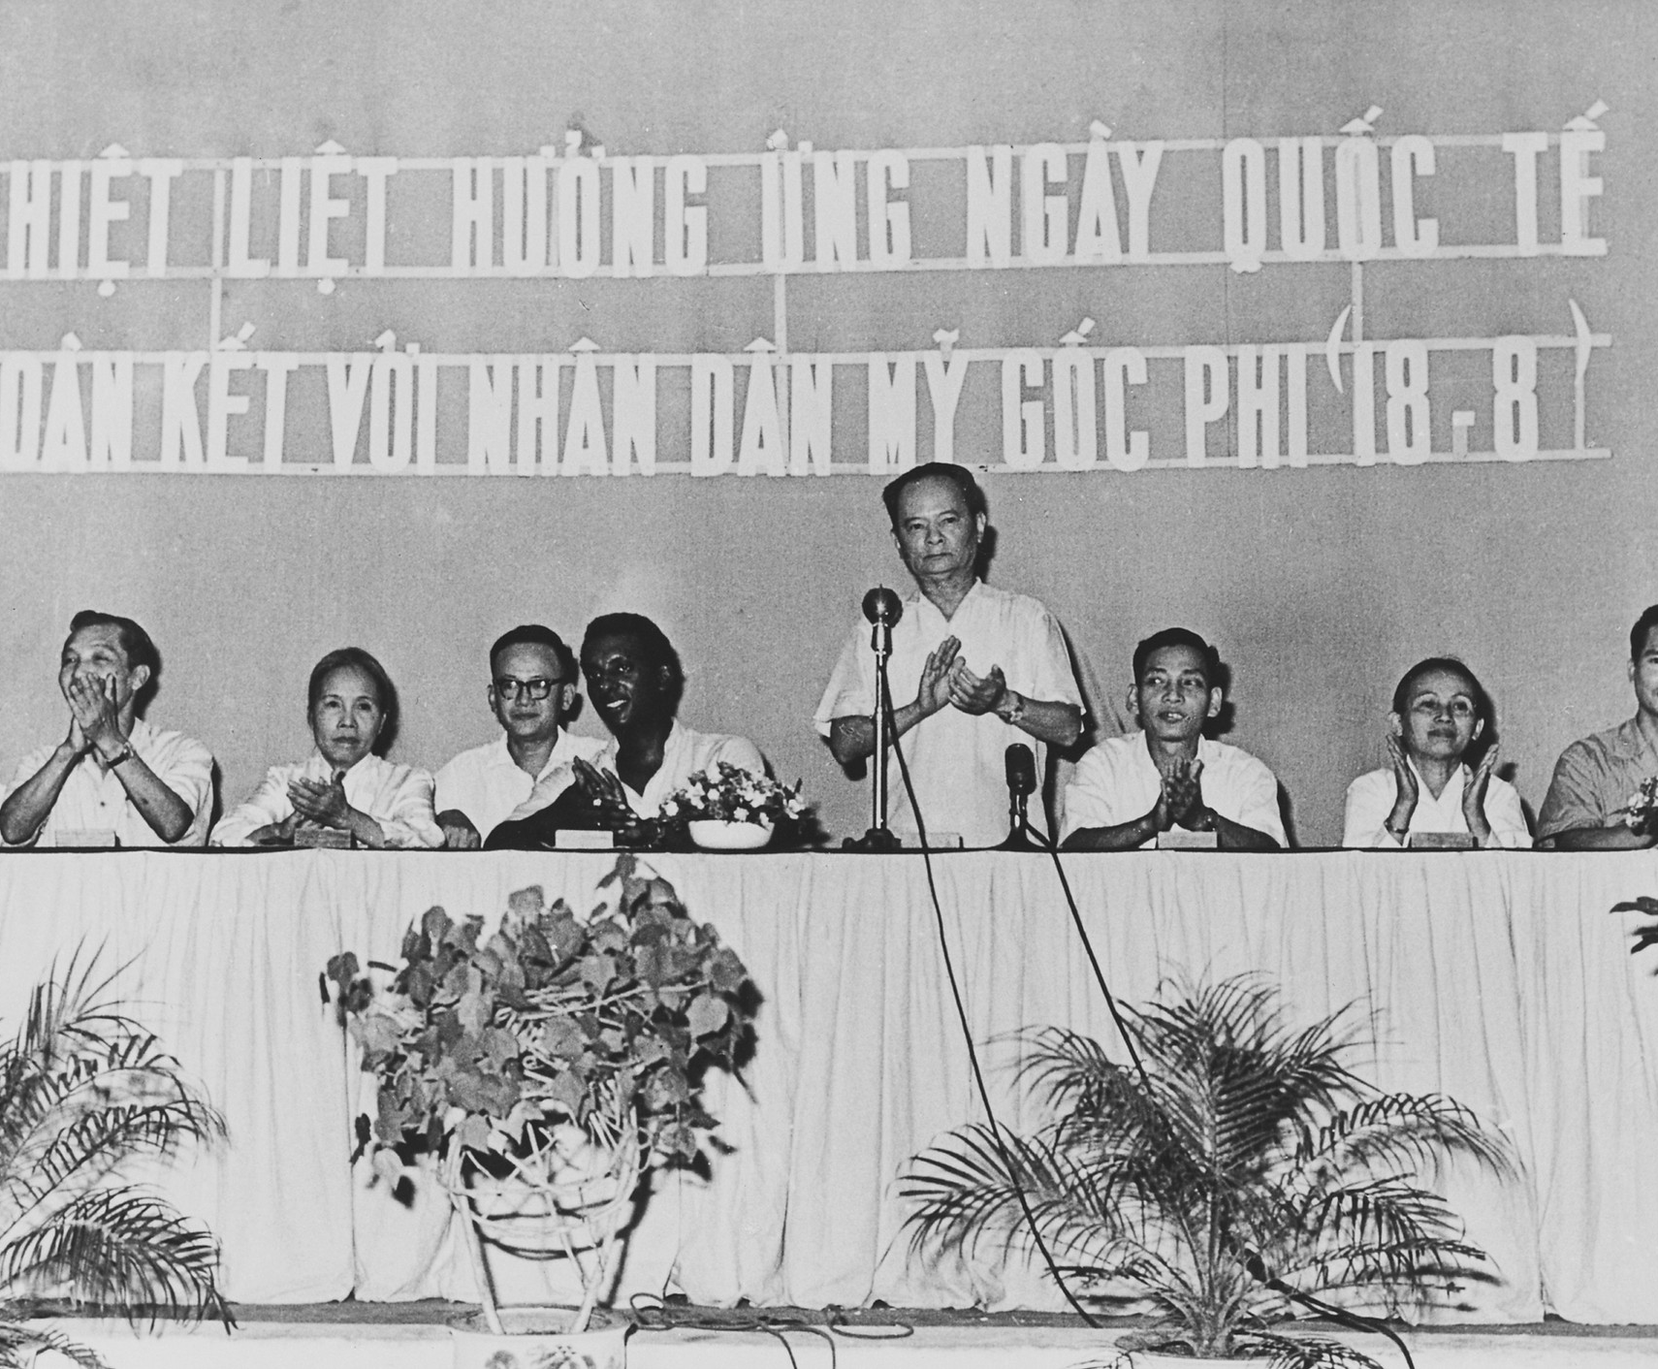
Stokely Carmichael
Stokely Carmichael appeared in Hanoi, North Vietnam on January 1, 1967 to celebrate the International Day of Solidarity with members of the Black Panther Party.
This ceremonial event reflects the global expansion of U.S. civil rights activism to encompass not only Africa but also alliances with developing nations in Asia and South America.

Slide 6
Assigned Groups
Group 1 (Document D)
x
x
x
x
Group 2 (Document E)
x
x
x
x
Group 3 (Document F)
x
x
x
x
Group 4 (Document G)
x
x
x
x
Group 5 (Document H)
x
x
x
x
Group 6 (Document I)
x
x
x
x

Slide 7
Student Presentations
Working as a group, you will:
Read your assigned document
Discuss with your group and answer the text-based question
Build a two-slide presentation that includes:
Brief summary of the document
Your answer to the text-based question
An image related to the text
Share your presentations with the class
While listening to other groups present, fill in the answers to the text-based questions for that document
Learning Objectives
Analyze how influential Civil Rights leaders built coalitions to support post-colonial freedom struggles.
Evaluate how effective these coalitions were at creating lasting change for both African Americans in the U.S. and minoritized people outside the U.S.
Compelling Question
How has the Civil Rights movement impacted people outside the United States?

Slide 8
Synthesis Discussion
What did we learn today?
What is something new you learned today about one of the Civil Rights leaders we discussed?
What do you think about the idea of pan-African unity?
In what ways could your actions affect other people?
Learning Objectives
Analyze how influential Civil Rights leaders built coalitions to support post-colonial freedom struggles.
Evaluate how effective these coalitions were at creating lasting change for both African Americans in the U.S. and minoritized people outside the U.S.
Compelling Question
How has the Civil Rights movement impacted people outside the United States?

Slide 9
Exit Ticket
Answer the following:
Based on everything you learned today, why do you think leaders of the Civil Rights Movement had such a profound impact on people outside the United States?
How can Civil Rights activists today work to broaden their reach beyond the United States? How can we use modern tools or technology to build these connections? How can you be a part of the movement?
Learning Objectives
Analyze how influential Civil Rights leaders built coalitions to support post-colonial freedom struggles.
Evaluate how effective these coalitions were at creating lasting change for both African Americans in the U.S. and minoritized people outside the U.S.
Compelling Question
How has the Civil Rights movement impacted people outside the United States?

