Slide 1
“Poise and Perseverance”
The Impact Three Black Women Had on Integrating Higher Education

Slide 2
​
Agenda
Introduction Video and Think-Pair-Share
Jigsaw Activity
Class Discussion
Flipgrid Video Reflection

Slide 3
Introduction
While watching the video think about the following:
1. What you think higher education means
2. Black people’s experience with higher education through history

Slide 4
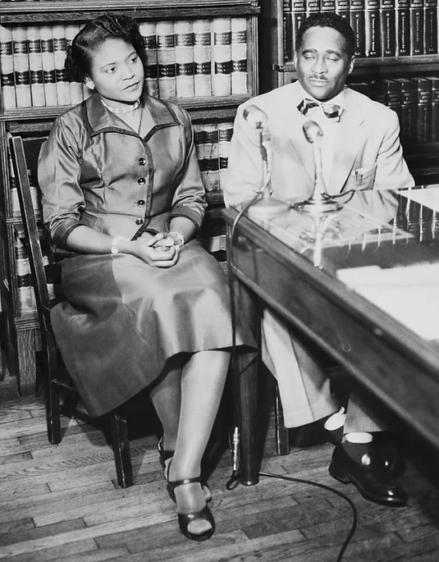
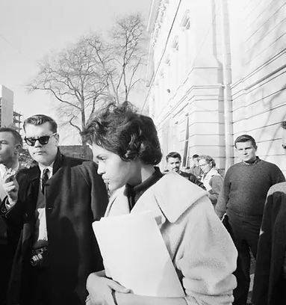
Jigsaw - Part 1
In your expert groups, you will use the reading, picture, and quote to answer the questions on your Jigsaw activity Graphic Organizer.
All images from Bettman Collection/Getty Images
Group A: Autherine Lucy Group B: Charlayne Hunter Group C: Vivian Malone

Slide 5
Jigsaw - Part 2
“One day, any day, you must be bold, have courage, and walk through a door that leads to opportunity for others.”
– Vivian Malone
In your mixed groups you will:
Summarize what you learned about your assigned woman to your new group
2) Read paragraph 10 together
Answer the discussion
question together

Slide 6
Flip Grid Gratitude!
Both Autherine Lucy and Charlayne Hunter are alive today!
Make a FlipGrid video addressing the following (at least 2 minutes in length):
Share how Lucy, Hunter, and Malone made a difference in higher education
Thank Lucy, Hunter, and Malone
Discuss how the Lucy, Hunter, and Malone have inspired you

