Slide 1
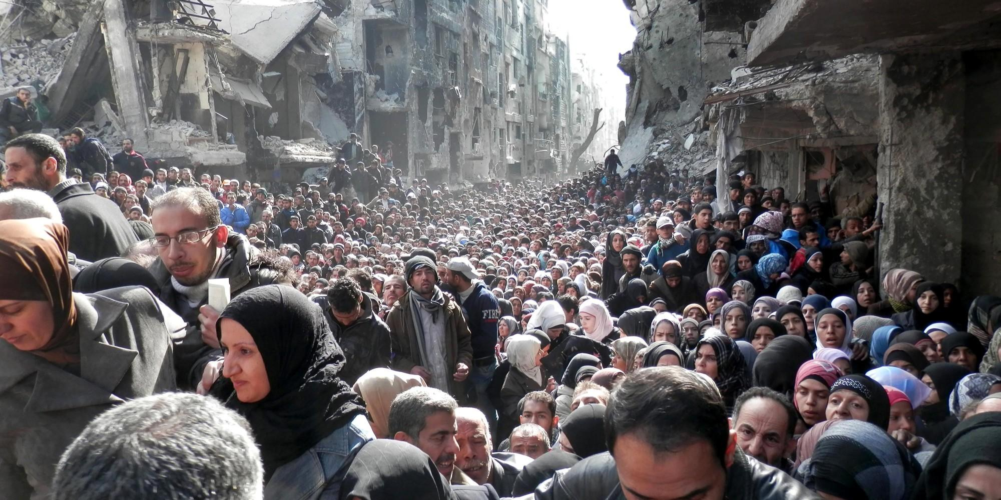
Syrian Civil War
The Syrian Crisis
Michael Reed
Joel Phillips
Andy Rhiel

Slide 6
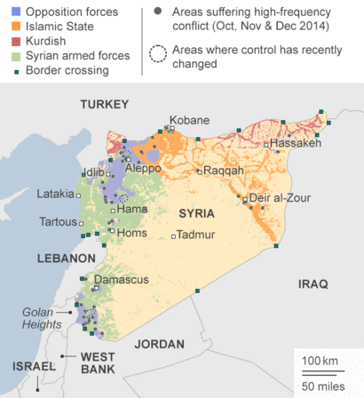
Background and Statistics
Since March 2011:
-250,000 Syrians killed
-11 million displaced Syrians
-alleged use of chemical weapons
-Rise of Jihadi groups.
-Proxy War (Russia, Iran, Saudi Arabia, U.S.A)

Slide 7
Implications for America
Refugee Crisis (Immigrants seeking asylum)
Syrian Civil War (Regional instability)
ISIS (Global Threat)
Relationships with Allies (Strained)

Slide 8
Essential Questions
American Government:
How are the three branches of government involved in creating foreign policy and domestic public policy?

Slide 9
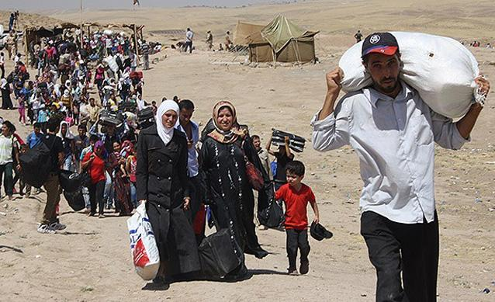
The U.S. has agreed to accept 10,000 Syrian refugees
Germany has accepted 100,000 and is expecting to accept up to 800,000
Venezuela has pledged to accept 20,000
Why isn’t the U.S. taking a more active role in helping Syrian refugees?
What kind of immigrants do we desire in this country?

Slide 10
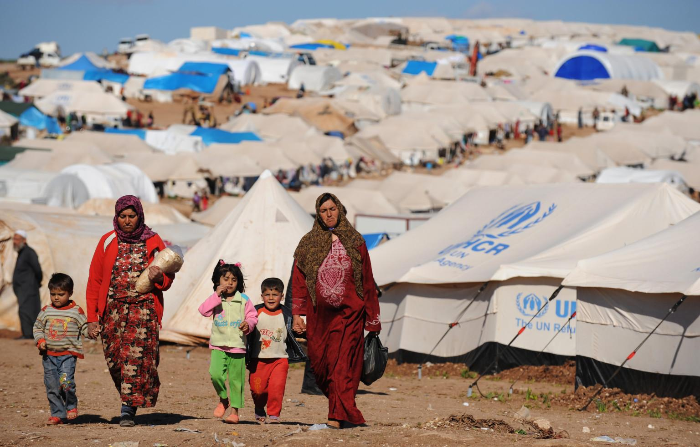
Learning Objective
-Evaluate the responses of the international community, specifically the US, in handling the influx of Syrian refugees following the Syrian Civil War.

Slide 11
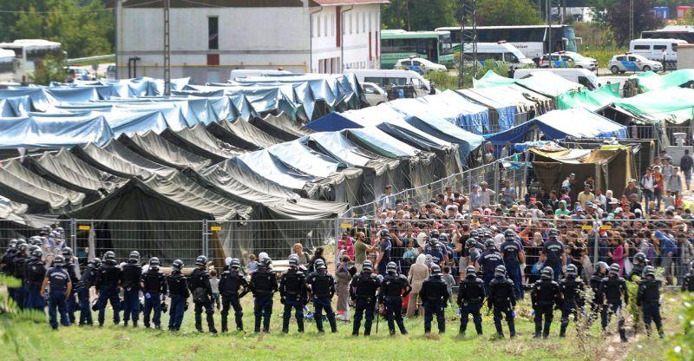
Video
http://www.cbsnews.com/news/disturbing-video-hungary-refugee-camp-europe-migrant-crisis/
http://www.bbc.com/news/world-europe-33986738
“Migrants crisis: Slovakia 'will only accept Christians'”

Slide 12
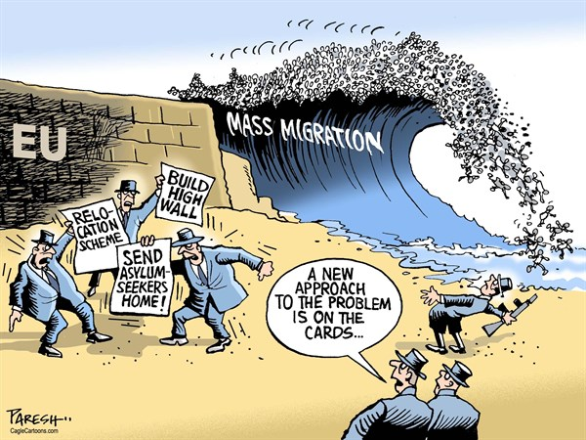

Slide 13
Where are the refugees going?
Germany-98,000
Sweden-64,000
France-6,700
UK-7,000
Denmark-11,500
Hungary-18,000
USA-1,500
Canada-10,000
Australia-12,000
UAE-250,000
Turkey-1,900,000
Lebanon-1,100,000
Jordan-629,000
Iraq-249,000
Egypt-132,000
Saudi Arabia, Kuwait, Qatar - 0
Are these numbers suprising? How so?
http://www.cnn.com/2015/09/09/world/welcome-syrian-refugees-countries/

Slide 14
Questions to consider
-What obligation do nations have to take in Syrian refugees?
-Where do morals and public policy intersect in this issue?
-Is it possible for all Syrian refugees to be provided for?
-Is it too difficult to use the channels of governments to achieve collective action in this issue?
-How will xenophobia shape the experiences of immigrants in the future? Will it be better or worse than the past?

Slide 15
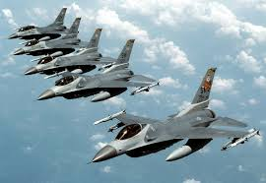
American Involvement in Foreign Conflicts
LO: Analyze a public policy issue in terms of collaboration or conflict among the levels of government involved and the branches of government involved.
Questions to Consider:
1. Who should the government consult?
2. What factors should we consider?
3. What Justification does Obama use to in his letter to congress?
4. Why might Obama seek Congressional approval here, but not in Libya?

Slide 16
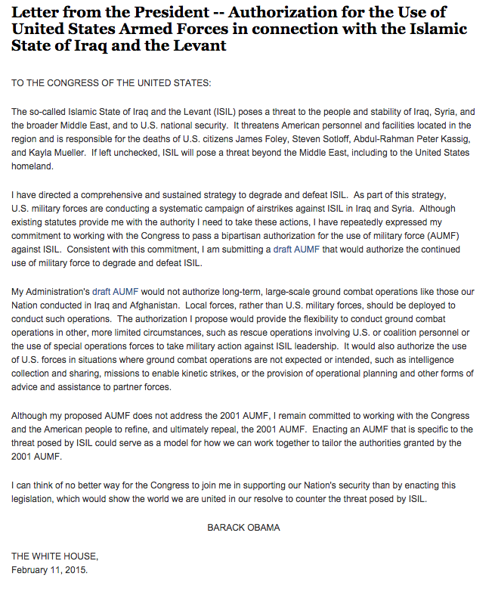
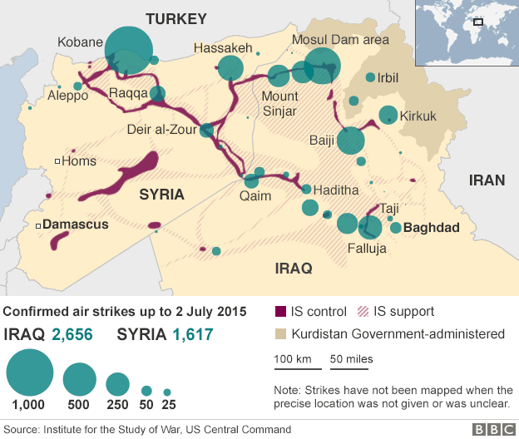
AUMF through the branches of government.
Is there a reference to dysfunctionality among the branches of government in Obama’s letter?

Slide 17
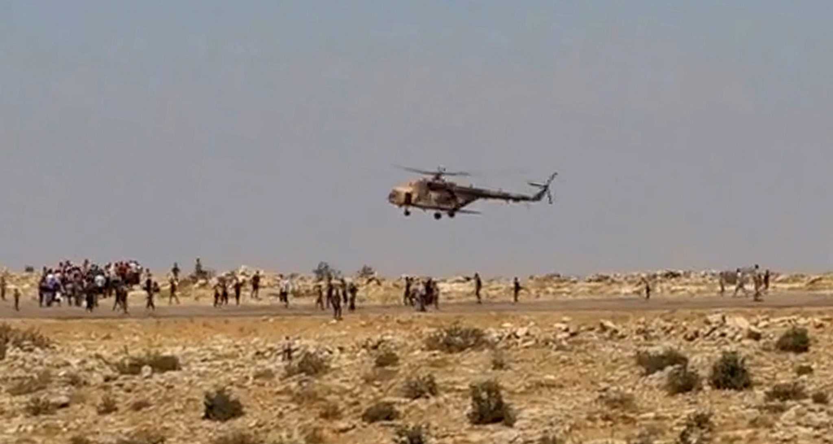
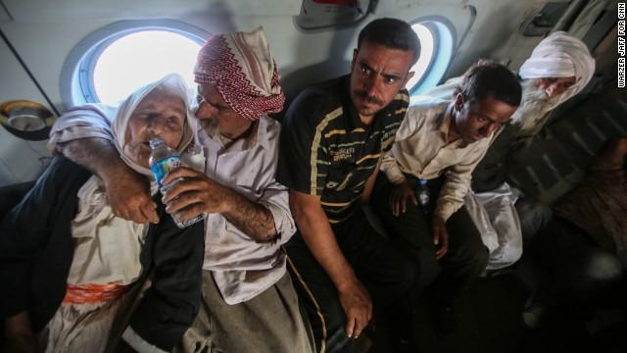
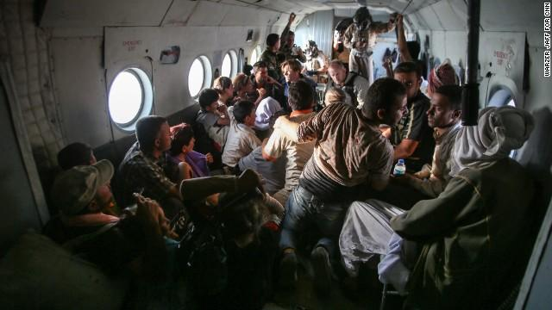
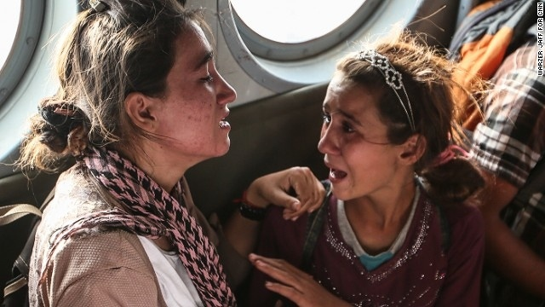
Yazidi Rescue Mission

Slide 18
Exit Slip
Please take a moment to answer the question in connection to Understanding the Middle East:
Why might we consider an historian’s perspective(s) when considering foreign policy concerning the Syrian Civil War?

