Slide 1
Racism: Past and Present
Brock Graham and Scott Jackson

Slide 2
EQ: Was the American Civil Rights Movement of the 1960’s successful in ending racial inequality?
Learning Objectives:
LO1: Students will evaluate the effectiveness of the American Civil Rights Movement of the 1960’s.
LO2: Students will compare the protests of the 1960’s to present-day protests going on throughout the U.S.

Slide 3
Population Statistics
Percentage of Prison Population:
White: 58.9%
Black: 37.7%
Asian: 1.5%
*NOTE: 48.4% of inmates are imprisoned for drug-related charges.

Slide 4
Population Statistics
Percentage of American Population:
White: 63.7%
Black: 12.2%
Asian: 4.7%
*NOTE: Out of every 100,00 people in the U.S., 698 are imprisoned.
Percentage of Prison Population:
White: 58.9%
Black: 37.7%
Asian: 1.5%
*NOTE: 48.4% of inmates are imprisoned for drug-related charges.

Slide 5
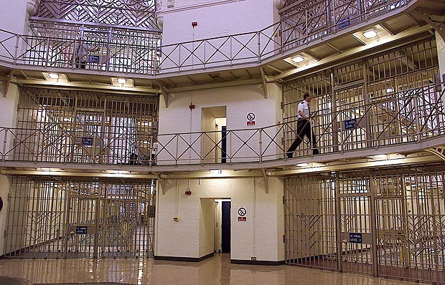
America’s Prisons
https://www.youtube.com/watch?v=NaPBcUUqbew

Slide 6
“The War on Crime”
Government policies were implemented to combat crime in an effort to help the Civil Rights Movement. As a result it sparked the “War on Crime.”
  Targeted racially poor regions of the United States
Increased police force was viewed as being oppressive “white dominance” over racial minorities
Presidential policies under Johnson, Nixon, and Reagan that aimed to combat crime led to an increase in prison populations.
These prisoners were disproportionately of minority groups.

Slide 7
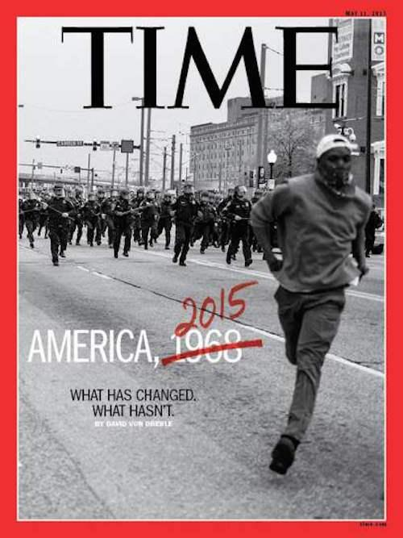
“What has changed. What hasn’t.”

Slide 8

Class Activity - “Extra! Extra!”
For each picture, create a newspaper headline under which the picture would appear.
Be sure your headline captures the theme of the photograph and engages your target audience.

Slide 9
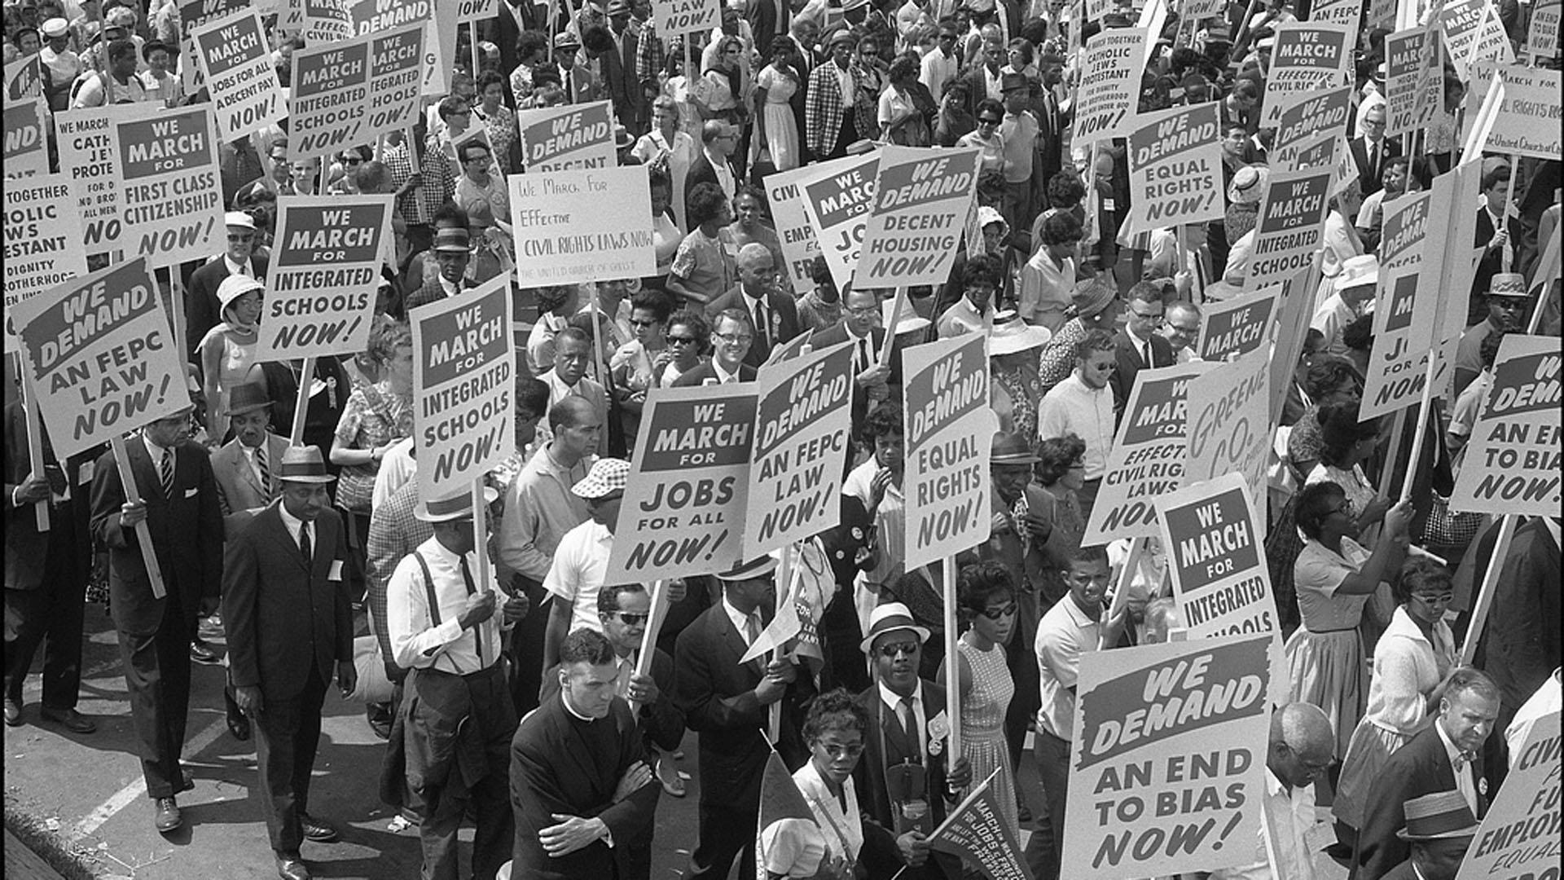

Slide 10
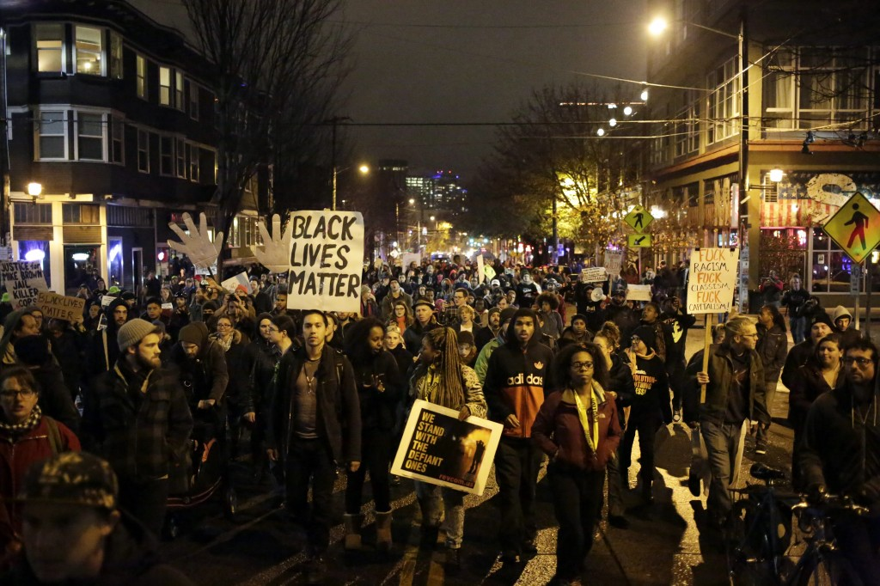
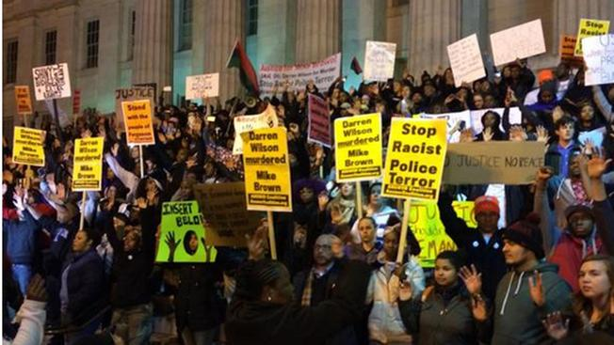

Slide 11
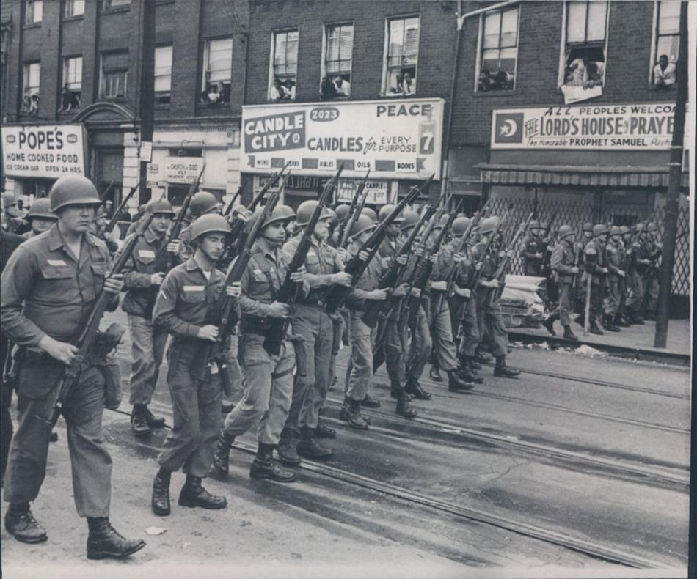

Slide 12
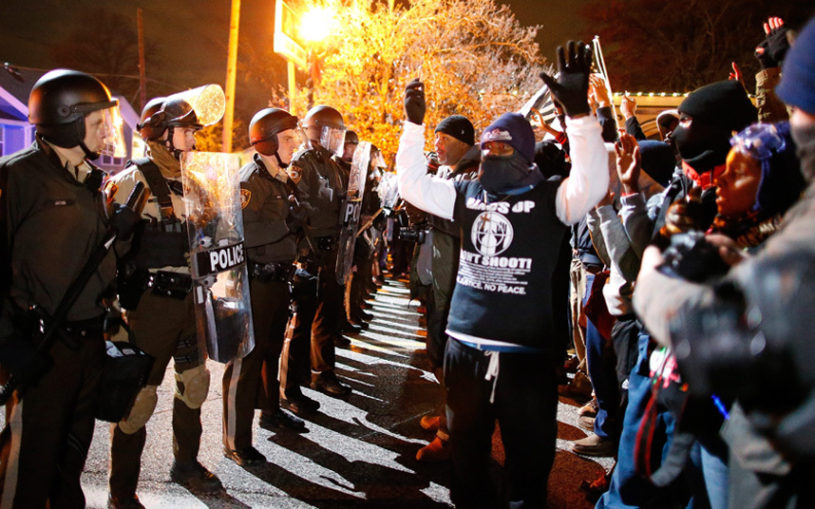

Slide 13
Group Discussion
With your group, discuss (and be ready to share with the class) the following questions:
How do your headlines help you better understand the similarities and differences between the protests of the 1960’s and today?
Why do you think conflict between police and African American communities still exists today? What factors play a role in these conflicts?

Slide 14

Exit Ticket
Was the American Civil Rights Movement of the 1960’s successful in ending racial inequality?

