Slide 1
It’s Kimpossible to get married in Rowan county kentucky right now
BY: Thomas R. Krucek and Marcus D. Lingrell

Slide 2
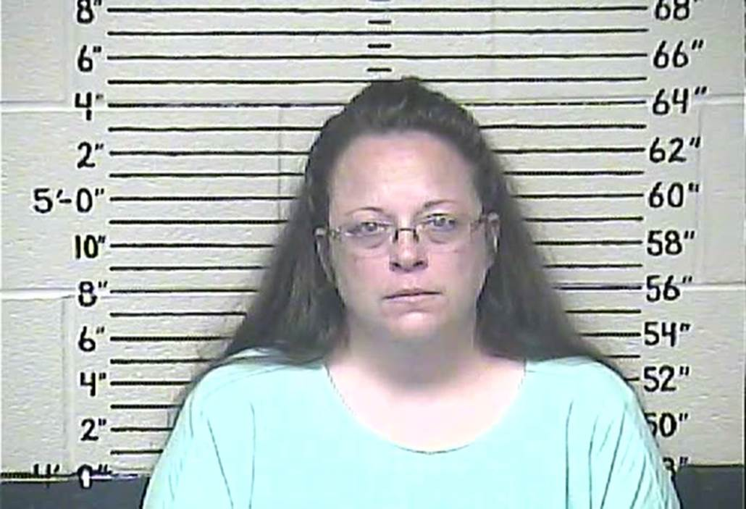
Kim Davis: The Yoda of marriage sanctity
Give you license, I cannot.

Slide 3
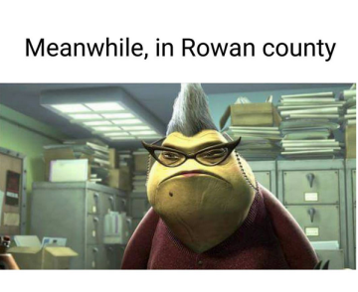
Kim Davis: ROZ In Disguise?

Slide 4
It’s the.. eye of the tiger it’s the thrill of the fight

Slide 5
Marriage Equality in recent news:
June 26th:http://www.nytimes.com/2015/06/27/us/supreme-court-same-sex-marriage.html?_r=0
July 21st:http://www.courier-journal.com/story/news/local/2015/07/21/marriage-license-suit-vs-clerk-back-court/30319757/
Sept. 5th:http://www.usatoday.com/story/news/nation/2015/09/05/kim-davis-christian-gay-rights/71772980/

Slide 6
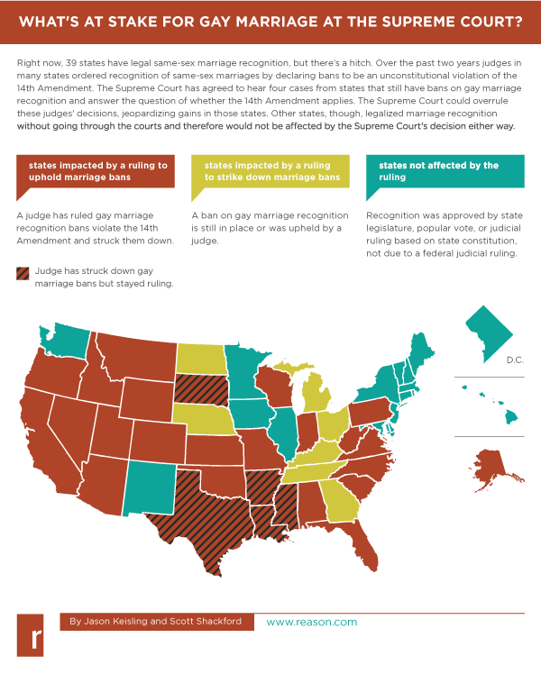
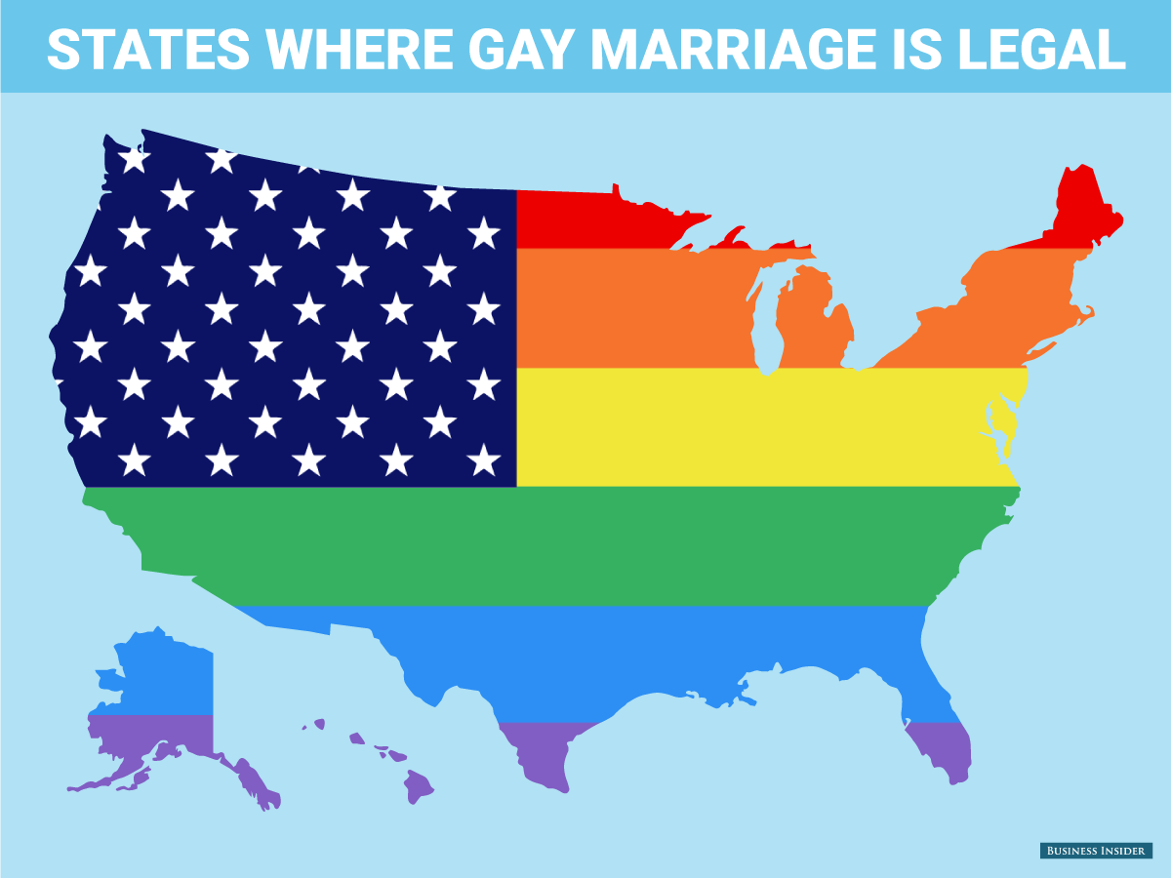
NOW:

Slide 7
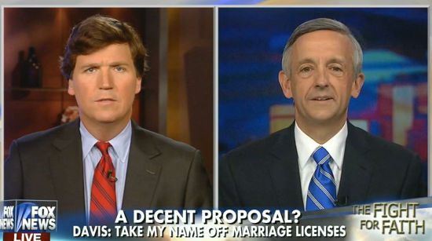
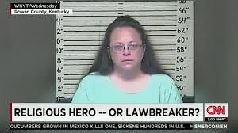
Media discussions:
In other important news: stop eating cucumbers now!

Slide 8
It’S Time for...Dueling Documents!

Slide 9
How does this story relate to U.S. government?
The better question would be how doesn’t it?
This story combines multiple facets of government including individual rights and liberties, judicial involvement, freedom of press, etc.
U.S. Supreme court rules in favor of same sex marriage, overturning previous rulings and setting new precedent
Kim Davis cites freedom of religion in not awarding marriage licenses
But the constitution guarantees a separation of church and state
Groups of protesters exercise their right of freedom of assembly
Courts execute due process of law in bringing Kim Davis to jail after she violates federal law

Slide 10
How does this story relate to sociology?
Sociology is the study of interactions, including those between humans and institutions.
Over time, the institution of marriage has changed to serve many purposes including having a clear division of labor, maintaining prescribed gender roles, and bringing two families closer together.
The revolutionary aspect of same-sex marriage as it stands today, is the lack of defined roles in terms of gender and labor.
This revolution is not new however. Beginning in the Enlightenment period, marriage was redefined to allow individuals to choose their significant other based on love and attraction. This ran in direct opposition to the practicality marriage was supposed to stand for.

