Slide 1
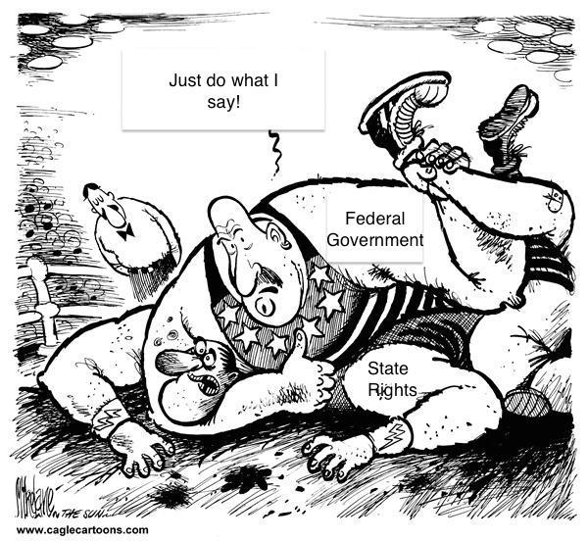
Monday Night
Government Smackdown
Who has the power???

Slide 2
Government Learning Objectives
Government Class Learning Objective 1 - Students will examine the idea of Federalism by looking at Ohio’s Issue 3.
Government Class Learning Objective 2 – Students will decide which level of government has/should have the ultimate authority over the issue.

Slide 3
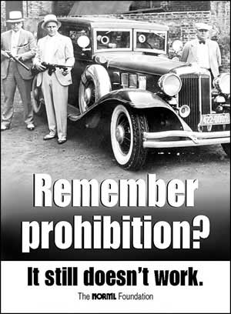
Origins Article
- https://origins.osu.edu/milestones/december-2013-celebrating-repeal-drink-not-joint
Questions:
- What does the author say people are really celebrating on Repeal Day?
- Why is this important?
- NORML.org

Slide 4
Ohio Marijuana Legalization Initiative Issue 3
- On the ballot November 3, 2015
- Would legalize the medical and personal use of marijuana for persons 21 years and older
- Key points:
- Doctor’s note required for medical use
- Recreational user allowed to possess only one ounce or less
- Only allowed to grow four plants at a time for recreational use at home with cultivation license
- Amendment would already provide for 10 Marijuana Growth, Cultivation, and Extraction facilities (MCGE) which are the only places that would have these powers

Slide 5
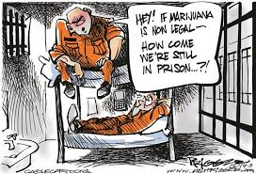
Is It Legal??
Use the information provided at the following link to help you answer the questions.
http://ballotpedia.org/Ohio_Marijuana_Legalization_Initiative,_Issue_3_(2015)

Slide 6
Is It Legal??
Scenario | State Government | Federal Government
1. An 18 year old citizen smoking marijuana | No | No
2. A 32 year old woman possessing an ounce of marijuana | Yes | No
3. A 46 year old woman smoking marijuana in her own home | Yes | No
4. A private citizen growing 4 marijuana plants in their private residence | Yes | No
5. A 23 year old man smoking marijuana at the State House | No | No

Slide 7
What’s The Point??
Federalism: Power split between a central government and smaller regional governments
Potential Problems: Confusing/contradicting laws over the same issue

Slide 8
Potential Problems Video
Questions:
What is the contradiction?
Which law is supreme and why?
What are the consequences for violating the federal law?
Is this fair? Why or why not? Support your answer with evidence from the Is It Legal activity and video.
https://www.youtube.com/watch?v=CYCXqqSMOnI

Slide 9
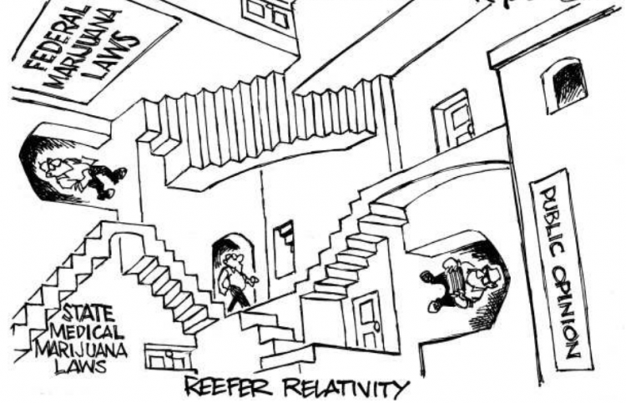
Federalism: Does it work?
Talk in your groups

Slide 10
Exit Slip!
Question: Does Federalism working or does the United States need a new system of government? Why or why not? Defend your answer with evidence from the Origins article and video.

