Slide 1
The Relationship Between Media and Politics

Slide 2

Today's Agenda
Learning objectives
Think-Pair-Share
Mini-lecture
Stations activity
Exit ticket

Slide 3
Learning Objectives
SWBAT identify the relationship between politics and media.
SWBAT compare how politics has been used for media profit throughout the decades.

Slide 4
Think Pair Share
For this activity, you will answer this question on a scrap sheet of paper:
What do you think the relationship is between media and politics?
You will first answer this question on your own
After a few minutes, you will turn and talk to your partner about your ideas
After that conversation, we will come together as a whole class to discuss

Slide 5
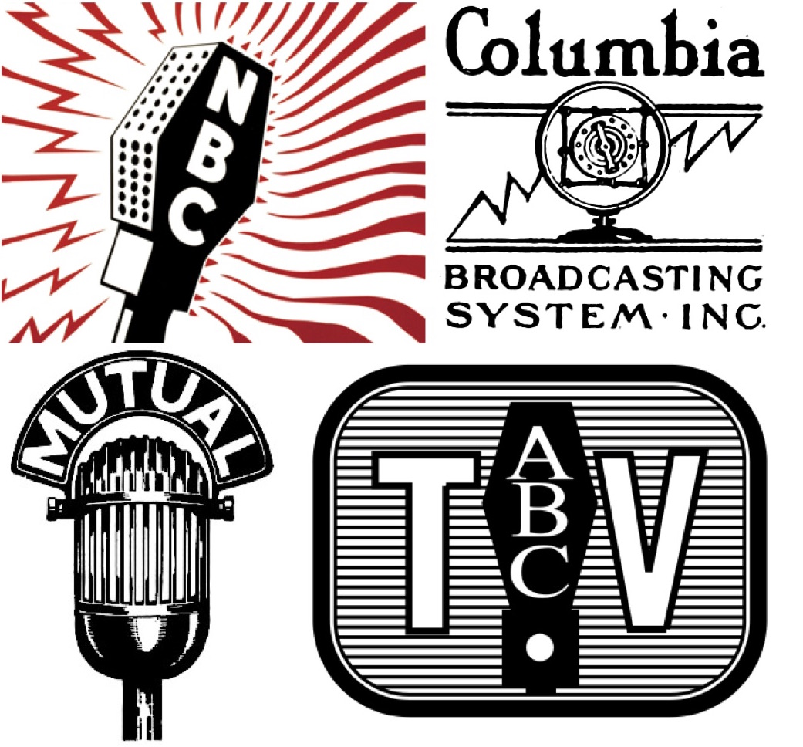
The Profit Driven News Media
In the early 20th century, profits from advertising generated about 80% of the revenue to media corporations
  This is much higher than other media businesses around the world
Radio started to become popular as well, which also had an interest in advertisement revenue
  Congress had little power to regulate this new media, and public options were limited
  Public radio stations came much later in the US than it did in other countries

Slide 6
The Profit Driven News Media
By the mid-1940s, there were four major broadcasting companies
  National Broadcasting Company (NBC)
  Columbia Broadcasting System (CBS)
  Mutual Broadcasting System (MBS)
  American Broadcasting Company (ABC)
  - Had been a part of NBC until 1943
Most broadcasters viewed their primary role as selling airtime to advertisers who developed programs and promoted their products

Slide 7
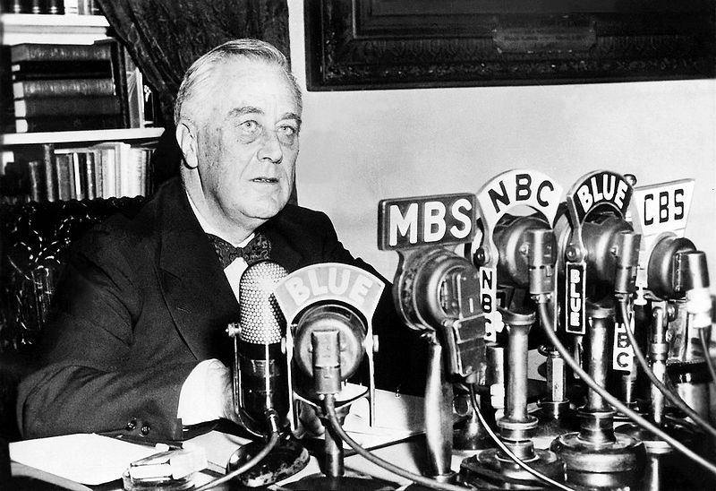
The Profit Driven News Media
Advertisers, or sponsors, would be entire time slots to advertise their product or service
  Shows like soap operas, the term given to 1940s radio serials due to their frequent soap company sponsorship, gave sponsors free rein to air numerous commercials and even to influence actual programming
The Federal Communications Commission (FCC) had power to make certain changes for public interest, but no actions were taken at the time
  This could be partly related to President Franklin Delano Roosevelt's partnership for his "Fireside Chats"

Slide 8
The Profit Driven News Media
As newspaper companies began buying radio agencies, FDR saw the problem that was occurring and wanted to make a change
The government began making some changes going against these monopolies
  In 1943, the FCC took anti-monopoly measures against chain broadcasters, which forced NBC to divest itself of a major network (which became ABC)
  Two years later, the Supreme Court issued an antitrust ruling affirming the need for “diverse and antagonistic sources” against the Associated Press
While these weren't as successful as they had hoped, they did at least create more companies, stopping a potential monopoly

Slide 9

The Profit Driven News Media
Some of the corporate-friendly policies also translated to the new medium in the 1950s and 60s: television
  Again, this comes with the complaints about serving the public and having public options for television
  Because of this, we see the creation of stations like NPR and PBS because of the 1967 Public Broadcasting Act and the Supreme Court’s 1969 Red Lion case

Slide 10
The Profit Driven News Media
As the years continued into the 1980s and 1990s, the government started to pull back some of the control that they had tried to establish earlier
  With the presidencies and Ronald Reagan and George Bush, the regulations on broadcasting diminished
  This led to another decrease in overall companies, seeing a decline from 50 corporations in 1983 to 6 by 2000

Slide 11
The Profit Driven News Media
Now, news coverage of presidential campaigns is even overrun by advertising
  News companies give more air time to the candidates that are the most entertaining
  They do this to bring more viewers, which will then lead to more sponsors wanting to advertise on those networks
What do you think this could mean for news coverage of future political campaigns?

Slide 12
STATIONS
For this activity, you will be reading and looking over the documents at each station and you will be answering questions about each of them as you go
Each section of this worksheet corresponds to a station, so make sure that you are answering the questions for the appropriate station
You are going to be working together in your groups, just make sure that everyone is filling out the worksheet, because each person will submit their own

Slide 13
Main Points
Politics can impact media by regulating number of companies and by regulating content the media can cover.
  This is important because the government can stop companies from having a monopoly of the media business. Monopolies are bad because they can limit the amount of information that is available for the public to have access to.
Media can impact politics by limiting the amount of airtime certain candidates get on their show or newspaper.
  This is important because it can restrict people from having access to certain candidates and to their ideas. If candidates have limited exposure, they likely will not be elected. Because of this, media companies can influence elections by giving their candidate of choice more exposure than the candidates they do not agree with.

