Slide 1
Military Drones: A Long Cultural History

Slide 2
Military Drones
Agenda:
Small Group quote analysis
Whole class comparison discussion
Mini-Lecture
Check for understanding
Stations
Check for understanding
Historical analysis
Exit Ticket

Slide 3
“From the Civil War to our struggle against fascism, on through the long twilight struggle of the Cold War, battlefields have changed and technology has evolved.”
Former President Obama

Slide 4
What is a Drone?

Slide 5
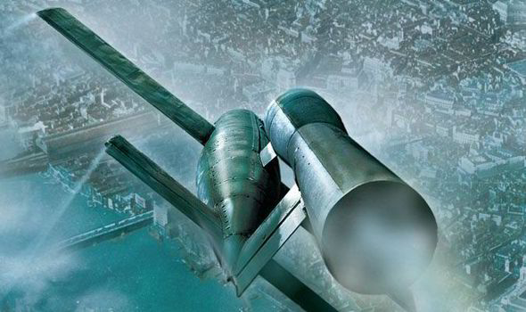
For our purposes, a Drone is a pilotless aircraft that is commonly used by militaries

Slide 6
When was the first drone used?

Slide 7
The first drones were seen prior to World War I, like the steam powered Aerodrome in 1896 which was made from fabric and wood.
Soon after its creation people were already advocating for its military use by filling it with gun powder.
Military drones became a cultural phenomenon through features in early movies prior to the US entry in World War I.
When the US entered World War I, military planners began drafting plans to create and use military drones. The “Kettering Bug” became the first mass produced drone.

Slide 8
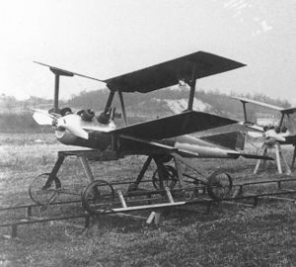

Slide 9
Were drones used in WWII?

Slide 10
Yes! The German V1

Slide 11
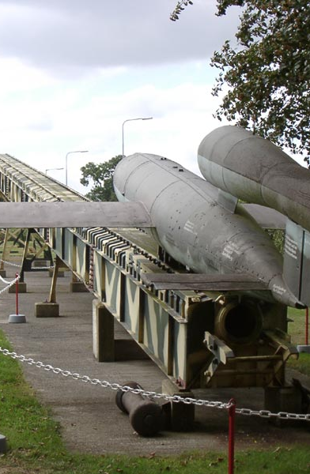
The V1
    The V1 or Vengeance 1 was one of the Nazi’s “wonder weapons” in the later phases of WWII.
    It was an unmanned drone that used rockets to propel itself at high speeds.
    It was calibrated to run out of fuel and drop from the sky at a particular point.
    The Germans used the V1 to attack British cities without the fear of losing bombers and pilots.
    Because of this, the V1 stoked fear among many British citizens.

Slide 12
Effects of the V1:
When the V1 was first used, the British RAF (Royal Air Force) could not stop the V1s from reaching their target
The primary target of the V1 was British civilian centers such as the capital: London
Because of the RAF’s early inability to stop the V1s, there was destruction and many British citizens lived in fear of the next attack.
Soon the RAF found a solution to intercept the V1s and reduce their damage.

Slide 13
How is this different than the Blitz?

Slide 14
The Blitz was the bombing of London by conventual military bombers; meaning that they were piloted by people
A Bomber is a large airplane, usually slow, with the purpose of dropping bombs on a target
Bombers in World War II also bombed in mass, meaning that there would be hundreds of bombers on the radar
If the British could identify an enemy with radar it could be intercepted and warn the civilian population
V1s, because of their speed and singular formations, were difficult to detect with radar, therefore the British military could not give proper warning to the civilians.

Slide 15
What about after WWII?

Slide 16
After World War II the United States and the Soviet Union both captured German scientists working for the Nazis
Along with these scientists they took many prototypes as well as weapons they were creating, such as the V1.
The United States brought the scientists as well as their designs and weapons to military bases in the America through Operation Paperclip
Operation Paperclip: using German scientists to reverse engineer their weapons for usage in the United States Military, including military drones

Slide 17
What are modern drones like??

Slide 18
Modern drones are slightly smaller than modern military airplanes.
These drones are still massive in comparison to older drones like the V1 and have major differences in usage.
Modern drones, such as the Predator Drone, are remotely controlled and have weapons on them.
Predator Drones use missiles to shoot at targets, making them reusable and more deadly
These drones do not run out of fuel and drop from the sky, like the V1 did over London.

Slide 19
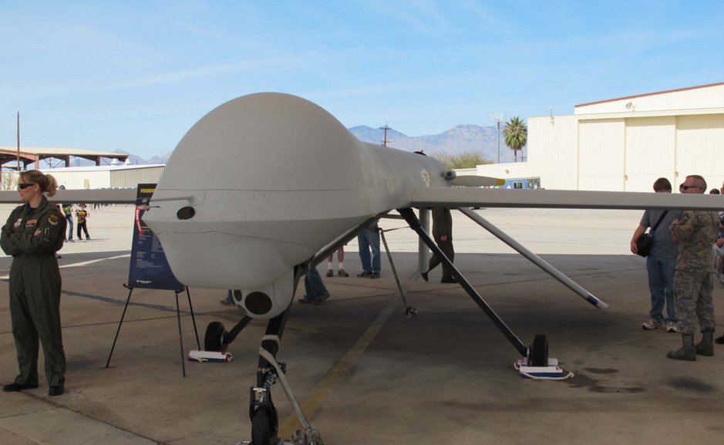

Slide 20
How did the usage of drones change from before World War I through World War II?

Slide 21
Drones in WWI were primitive, meaning that the were made from canvas and wood
Drones in WWI did not see extensive use.
In WWII, drones such as the V1 were made from metal and used rockets. They were used extensively against British cities

Slide 22
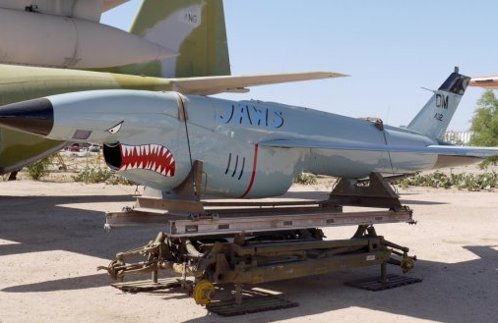
Stations!

Slide 23
Station 1: Modern Drones: (Poster and reading)
Station 2: V1 Drone: (Poster and Video)
Station 3: Early drones (WWI era): (Picture and reading)

Slide 24
Station Check: How has the purpose for military drones changed over time?

Slide 25
The first use of military drones were as terror weapons: being used against civilian targets to incite fear
The role of drones has generally changed to targeting more military targets such as terrorist cells

Slide 26
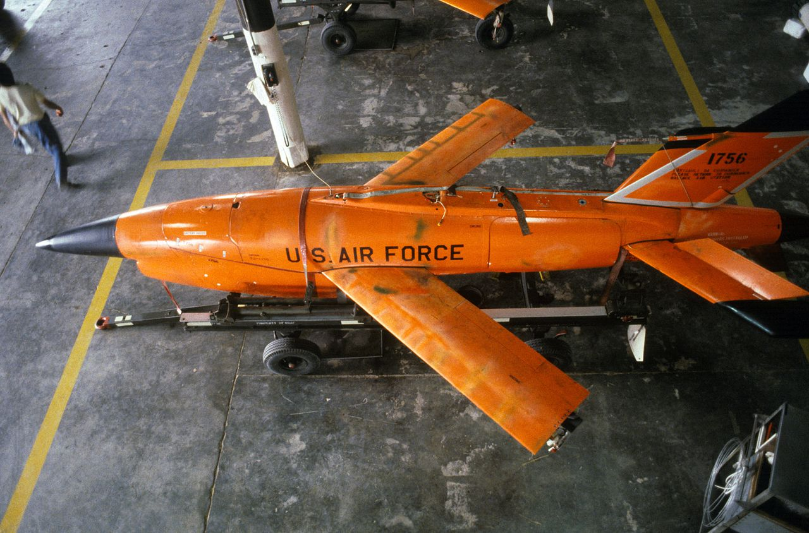
Back to Stations!

Slide 27
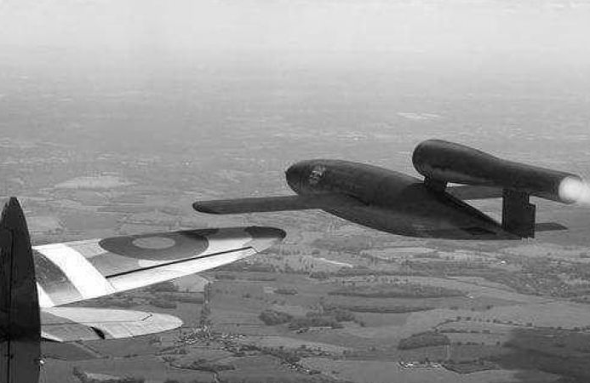
Historical Analysis

Slide 28
Debrief Discussion Questions:
What was the role of the first drones? (Kettering Bug and V1)?
How has the role changed with the modern Predator drone?
How do people make the argument that the role has not changed?
What is the cultural impact of drones? How have people viewed drones in the past? How do we view them now?

Slide 29
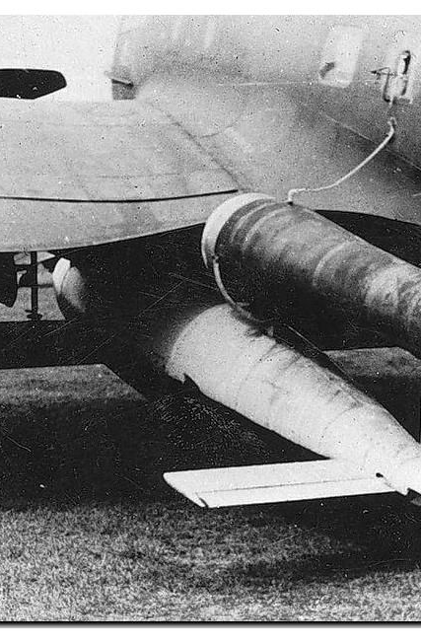
Exit Ticket: Describe the progression of military drones and how it makes the subject complex. In addition to this, discuss how the history of drones effects your own viewpoint on the continuing usage of them by using evidence from the provided sources.

Slide 30
Work Cited:
(n.d.) Retrieved from: https://www.express.co.uk/news/uk/479386/Terror-of-the-Doodlebugs-Sinister-V-1-flying-bomb-that-menaced-Britain-70-years-ago
(n.d.) Retrieved from: https://en.wikipedia.org/wiki/Kettering_Bug
(n.d.) Retrieved from: https://www.tapatalk.com/groups/track48/what-color-would-you-paint-a-v-1-launch-ramp-t4778.html
(n.d.) Retrieved from:https://www.govtech.com/products/US-Military-Exploring-Defense-Methods-Against-Drones.html
(n.d.) Retrieved: https://understandingempire.wordpress.com/2-0-a-brief-history-of-u-s-drones/
(n.d.) Retrieved: https://aviationoiloutlet.com/blog/early-uavs-the-cold-war/
(n.d.)Retrieved:https://www.reddit.com/r/Warthunder/comments/9c52hi/just_ruin_my_life_please_it_is_a_v1_on_a_he_111_h6/

