Slide 1
American Individualism and COVID-19
How has the increased sense of American Individualism created challenges in fighting COVID-19?

Slide 2
American Individualism and COVID-19
“I say let the world go to hell, but I should always have my tea.”
- Fyodor Dostoevsky, 1821-1881
Notes from the Underground

Slide 3
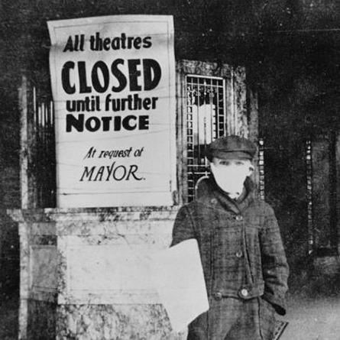
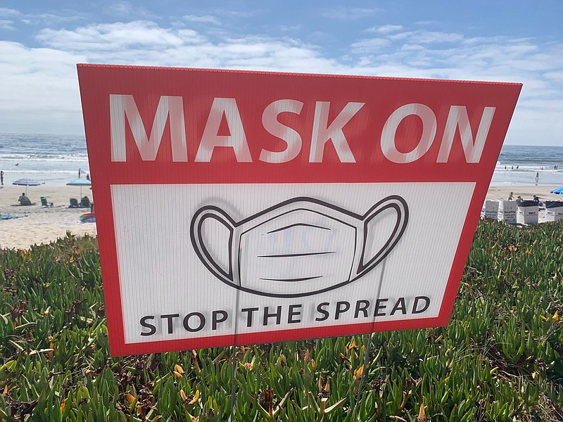
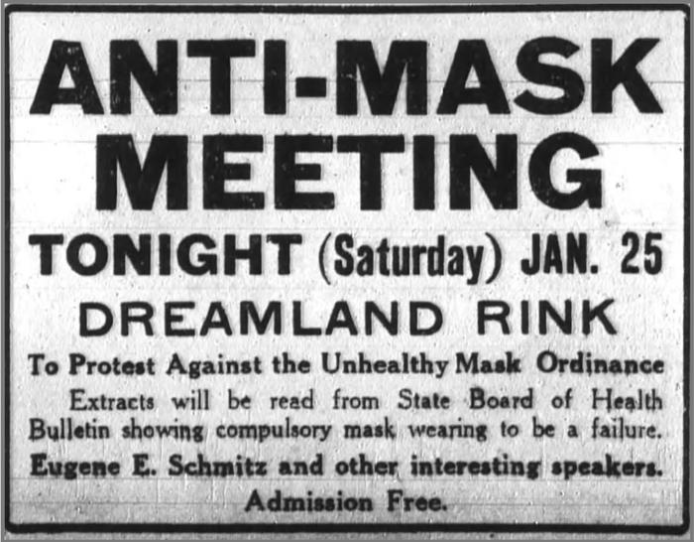
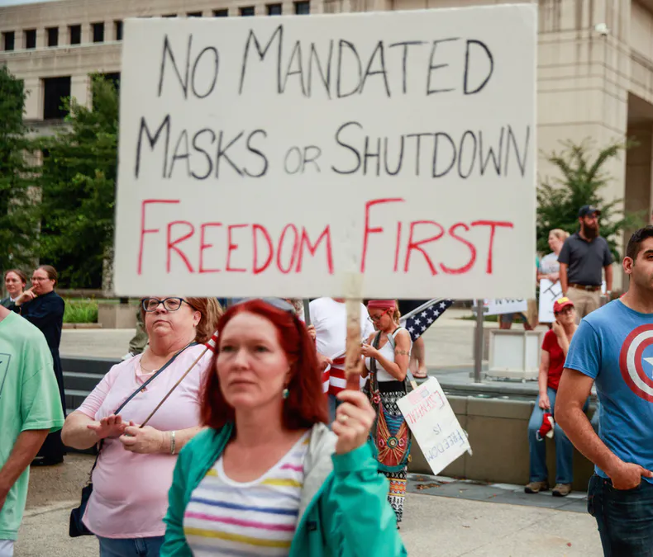
American Individualism and COVID-19
Bell Ringer:
What connections can you make between the images?
What is likely different between these two eras?
What reasons do you think people have for these protests?

Slide 4
American Individualism and COVID-19
Learning Objectives:
LO1: SWBAT compare American xenophobia and distrust between the Spanish Flu and COVID-19
LO2: SWBAT chart changes in citizen support for government actions over time

Slide 5
American Individualism and COVID-19
Question:
How has the increased sense of American Individualism created challenges in fighting COVID-19?
•What do the learning objectives and compelling question tell us about our focus for today?

Slide 6
American Individualism and COVID-19
Key Vocabulary:
Important concepts and events about pandemics and America

Slide 7
American Individualism and COVID-19
Spanish Influenza:
An Unusually Deadly Influenza Pandemic: One of the Deadliest in History
1918-1920
Rampant spread during and after WWI
Economies suffered in entertainment and service industries
Healthcare boomed
Cities that implemented quarantine measures suffered the least

Slide 8
American Individualism and COVID-19
World War I:
First Global War, Known as the Great War
1914-1918
The “war to end all wars”
Caused by militarization of countries, formations of alliances, imperialism and nationalism
One of the deadliest conflicts in history
Allied Powers vs Central Powers

Slide 9
American Individualism and COVID-19
Globalization:
Increased Interaction and Integration Among International People, Companies, and Governments Worldwide
Arguably began with the Age of Discovery
The term first appeared in the early 20th Century
Rapid expansion of globalization throughout the 20th Century
Driven by economics, immigration, and the spread of knowledge
Created global interconnectedness and sparked widespread debate

Slide 10
American Individualism and COVID-19
American Individualism:
The Idea that the Individual Should Possess the Freedom to Decide What is Best for Themselves, as Opposed to Collectivism
Reflected in America’s commitment to capitalism as opposed to socialism
Sometimes manifests as the belief in, “pulling oneself up by one’s bootstraps”
Can be seen as radical self-expression OR self-interest over the interests of others
Can be tied to American patriotism in the minds of many

Slide 11
American Individualism and COVID-19
COVID-19:
A Deadly Respiratory Disease
Began in 2019 in Wuhan, China
Caused a global economic shutdown
Distrusted debates about the government’s role in assisting to stop the disease
Lack of agreement on citizen’s role in combatting the spread of the disease

Slide 12
American Individualism and COVID-19
Graphic Organizer:
Going Viral: COVID Conspiracies in Historical Perspectives
How do we see suspicion of authority playing out in public reactions?
How do we see suspicion of foreign actors playing out in public reactions?
How do we see fear of globalization playing out in public reactions?

Slide 13
American Individualism and COVID-19
Citizen’s Support Chart:
Consider the following for the Citizen’s Support Chart
• Based on the reading, estimate visually how much public support for government initiatives and mobilization efforts there was at the indicated events throughout time.

Slide 14
American Individualism and COVID-19
Discussion:
What general trends do we think we see over time in terms of the public’s willingness to mobilize for common purpose?
What events have contributed to this trend?
How are today’s challenges similar to or different from those of the past?

Slide 15
American Individualism and COVID-19
Exit Ticket
At the bottom of your Citizen Support Chart, return to the Essential Question from the beginning of the lesson:
•How has the increased sense of American Individualism created challenges in fighting COVID-19?

