Slide 1
Who Owns the Past?

Slide 2

Video Bell Ringer:
Black Panther. (2018). Retrieved from https://www.youtube.com/watch?v=pfBWPhsiN_w

Slide 3
In the scene, who knows more about the artifacts – Erik Killmonger or the museum expert?

Slide 4
According to Erik, how did the museum get the artifacts?

Slide 5
Today’s Vocab:
Cultural Heritage
Repatriation
Restitution

Slide 6

Cultural Heritage:
Things that have been passed down through generations and are believed by a group or society to be important to their culture.
physical artifacts (buildings, books, paintings)
intangibles (songs, stories, beliefs)
natural items (animals, plants, places)
United Nations Educational, Scientific and Cultural Organization - United Nations Educational, Scientific and Cultural Organization, Public Domain, https://commons.wikimedia.org/w/index.php?curid=42713779

Slide 7

Repatriation:
Re+patria+tion
Patria =? (think patriotism)
San Salvador Repatriation Flights – From https://sv.usembassy.gov/repatriation-flights-booking-information/

Slide 8
Restitution: to return something to its original owner, or to pay an original owner back for something taken from them.

Slide 9
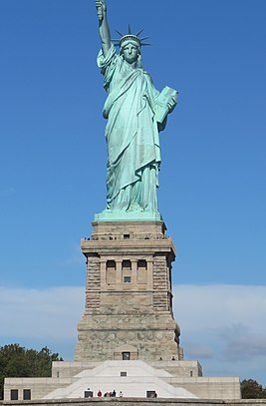
Cultural Heritage:
What are some examples of (physical, intangible, natural) items that are important to American cultural identity?”
Statue of Liberty
By Mcj1800 - User:Mcj1800, CC BY-SA 4.0, https://commons.wikimedia.org/w/index.php?curid=84048565

Slide 10
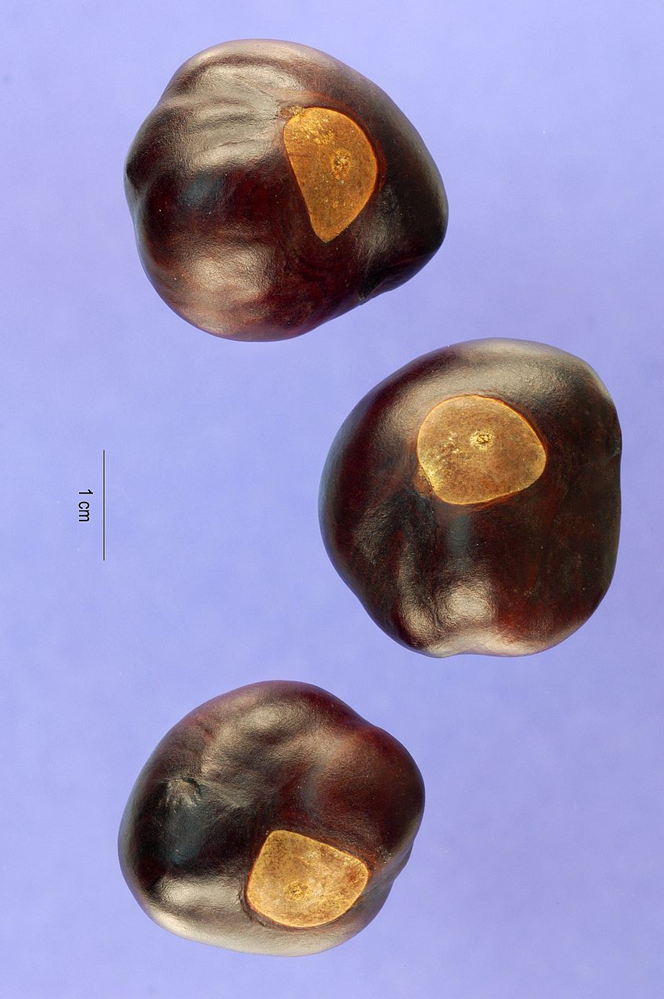
Cultural Heritage:
What are some examples of (physical, intangible, natural) items that are important to Ohioan cultural identity?
Buckeyes (seeds)
By Steve Hurst @ USDA-NRCS PLANTS Database - USDA, Public Domain, https://commons.wikimedia.org/w/index.php?curid=1145121

Slide 11
Think-Pair-Share:
What are some examples of (physical, intangible, natural) items that are important to our city’s cultural identity?
On your own, write down one example.
Buckeyes (seeds)
By Steve Hurst @ USDA-NRCS PLANTS Database - USDA, Public Domain, https://commons.wikimedia.org/w/index.php?curid=1145121

Slide 12
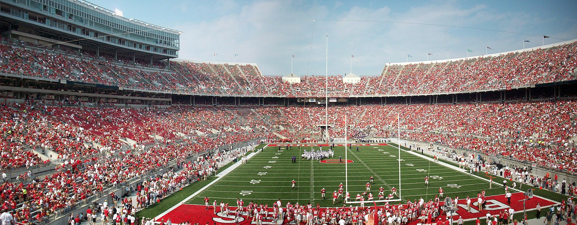
Bell Ringer:
How would you feel if, somehow, Michigan stole Ohio Stadium?
Suppose that they took it apart, drove the pieces to Ann Arbor, and reassembled it there.
Ohio Stadium, Panoramic View
By Joebengo at English Wikipedia, CC BY 3.0, https://commons.wikimedia.org/w/index.php?curid=73539765

Slide 13
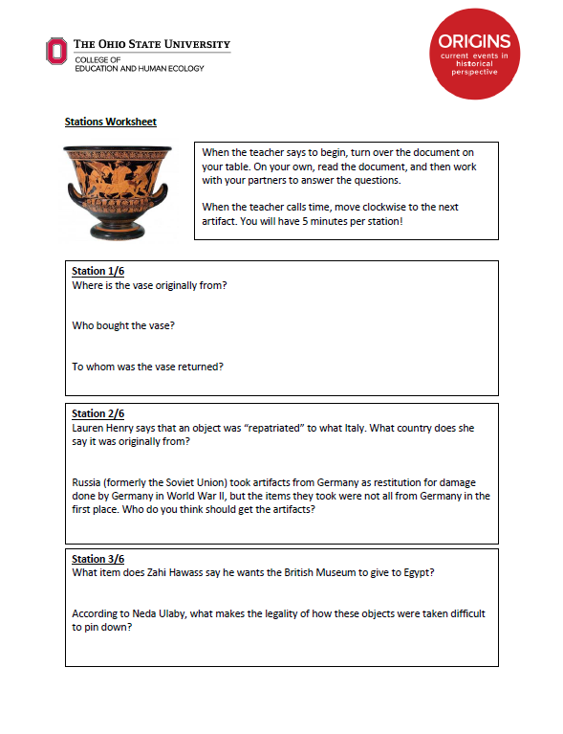
Stations!
Read the document on your table.
With your partners, answer the related questions on your worksheet.
When time is called, move clockwise to the next table and repeat.

Slide 14
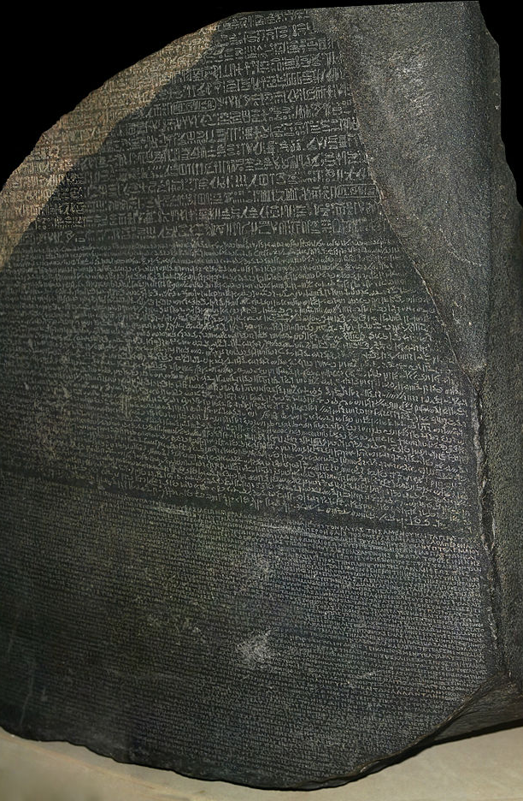
Exit Ticket:
Who should get to keep these cultural heritage artifacts, and why?
Rosetta Stone
By © Hans Hillewaert, CC BY-SA 4.0, https://commons.wikimedia.org/w/index.php?curid=3153928

