Slide 1
Pandemics Now, Then, and Again

Slide 2
Pandemics Now, Then, and Again
Agenda
-Think Pair Share
-Stations Activity
-Synthesis Discussion
-Exit Ticket Reflection

Slide 3
Pandemics Now, Then, and Again
Think Pair Share
Complete the Think Pair Share Worksheet

Slide 4
Pandemics Now, Then, and Again
Influenza Pandemics Now, Then, and Again
1957-1958 saw an influenza pandemic that killed between 1.5 million and 2 million people worldwide.
Early warning provided by the WHO in 1957.
The American government decided to gear up to vaccinate more widely.
Negotiations with vaccine producers immediately proved difficult.
Hesitant to produce an expensive product when there was no proof the pandemic would reach the U.S.
When they at last agreed to make the vaccines—because evidence could no longer be ignored that the pandemic had indeed grown—it was essentially too late.

Slide 5
Pandemics Now, Then, and Again
Influenza Pandemics Now, Then, and Again
Although the U.S. managed to vaccinate a larger percentage of the population than ever before, it was only after a period of panic that there would not be enough available.
With vaccine production starting late in the game, the American vaccination program also came at the cost of many unused vials of vaccine that came off the production lines after the pandemic had essentially passed.
Not much was learned from these experiences and a similar pattern of events occurred in 1968.

Slide 6
Pandemics Now, Then, and Again
Stations Activity
  - Investigate the three stations around the room.
  - You and your group will move clockwise to the next station when directed.
  - Analyze the sources at each station
  - Use the information to complete the stations worksheet.

Slide 7
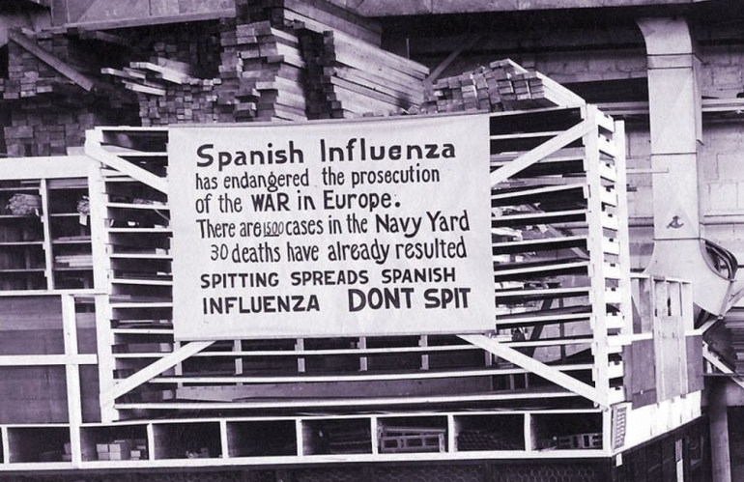
Pandemics Now, Then, and Again
N.P. (1918). [Photograph] Retrieved from https://maxdisclosure.com/2018/09/12/own-signs-and-dont-spit-in-1918/

Slide 8
Pandemics Now, Then, and Again
Influenza Pandemics Now, Then, and Again
The worldwide system for determining and monitoring pandemics is a relatively recent invention.
In 1918 there was no planet-wide health organization like the WHO.
While there were radios and telegraphs to spread information, there was no CNN to report its findings to a waiting world or obviously no internet.
The only international system for coordinating disease, the Paris-based International Public Health Office, was all but shut down as a result of World War I.

Slide 9
Pandemics Now, Then, and Again
Influenza Pandemics Now, Then, and Again
The war slowed down the spread of crucial information about the disease in other ways.
Anxious to avoid giving away potential military advantage, states involved in World War I refused to release flu data.
The 1918 pandemic was referred to as the Spanish Flu because Spain did not participate in World War I, so it published its disease statistics internationally while other nations did not.

Slide 10
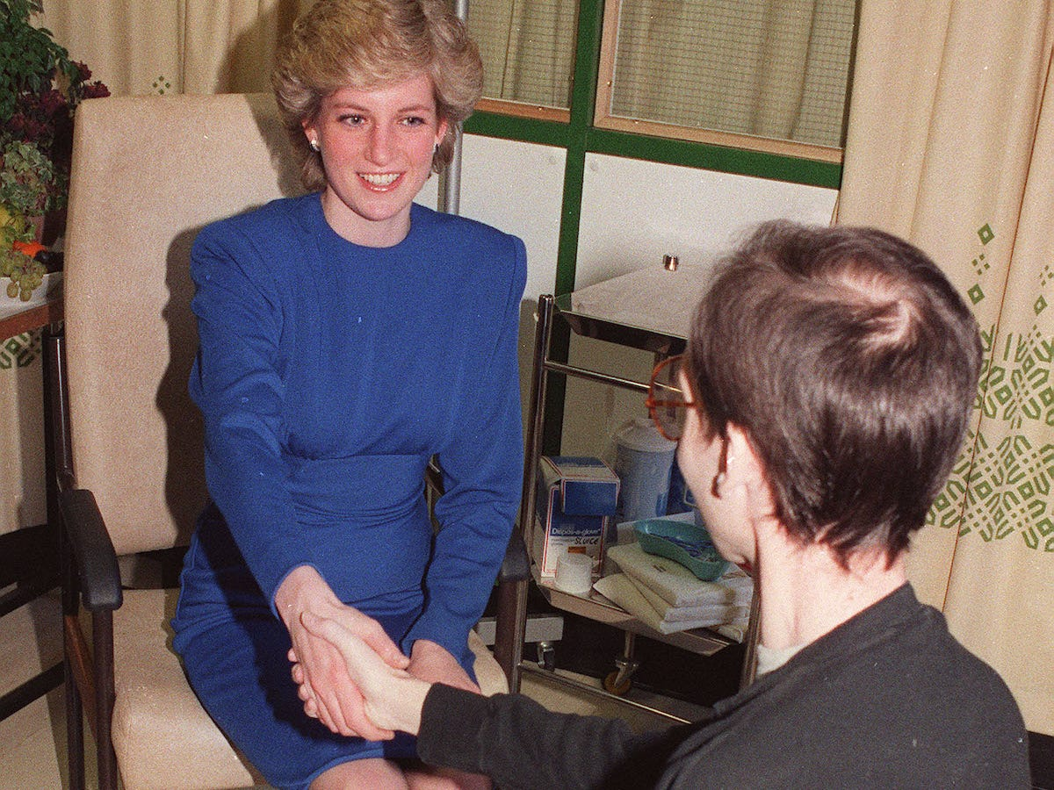
Pandemics Now, Then, and Again
Document F
Redman, J. (1987). [Photograph]. Retrieved from https://www.insider.com/photo-princess-diana-shaking-hand-aids-patient-1987-2017-8

Slide 11
Pandemics Now, Then, and Again
Larry Speakes & Lester Kinsolving Dialogue
-Larry Speakes
White House Press Secretary 1981-1987
-Lester Kinsolving
Political radio host
Document E

Slide 12
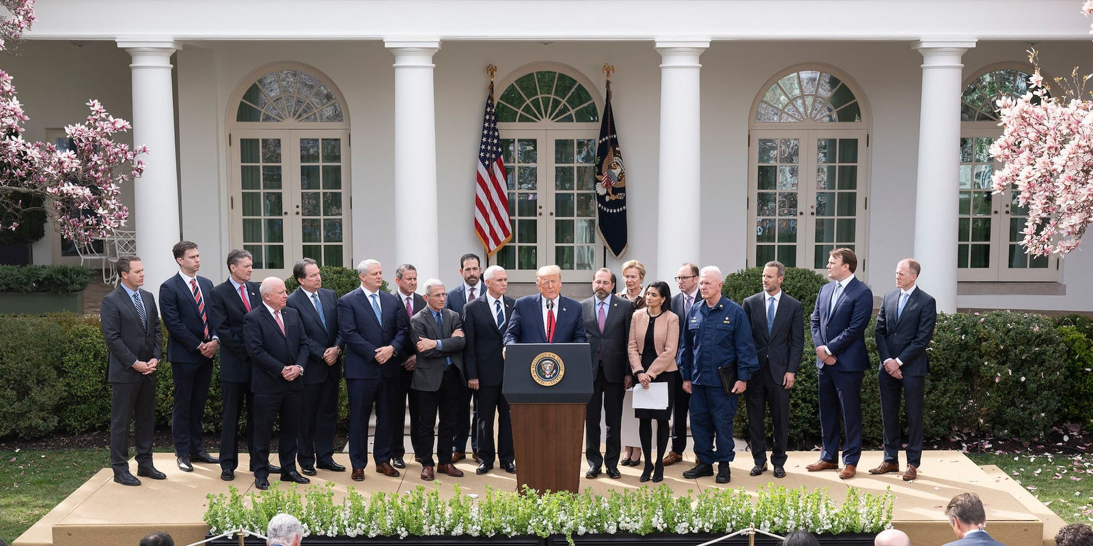
Pandemics Now, Then, and Again
Document B
Craighead, S. (2020). [Photograph]. Retrieved from https://www.businessinsider.com/trump-crowded-coronavirus-press-conferences-photos-2020-3

Slide 13
Pandemics Now, Then, and Again
CNBC Article
“I would love to have that. It’s such an important day for other reasons, but I’d love to make it an important day for this. I would love to have the country opened up, and rarin’ to go by Easter.”
Document C

Slide 14
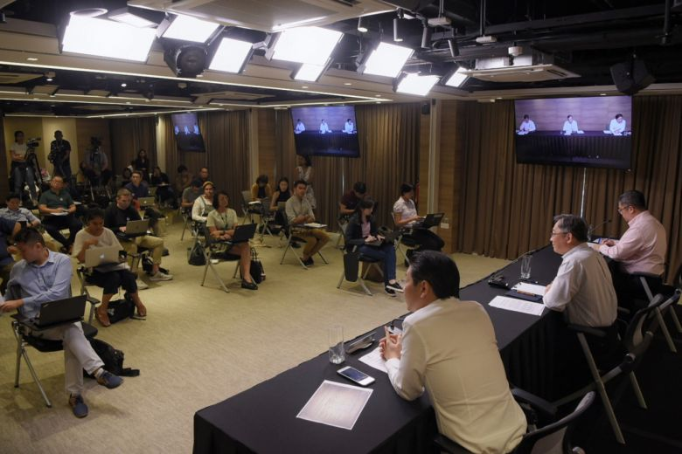
Pandemics Now, Then, and Again
Document D
Cheong, M. (2020). [Photograph]. Retrieved from https://www.straitstimes.com/singapore/gan-kim-yong-and-lawrence-wong-sit-1-metre-apart-at-covid-19-presser-as-part-of-social

Slide 15
Pandemics Now, Then, and Again
How well do you think that the United States has done responding to COVID-19?
Exit Ticket Reflection

