Slide 1
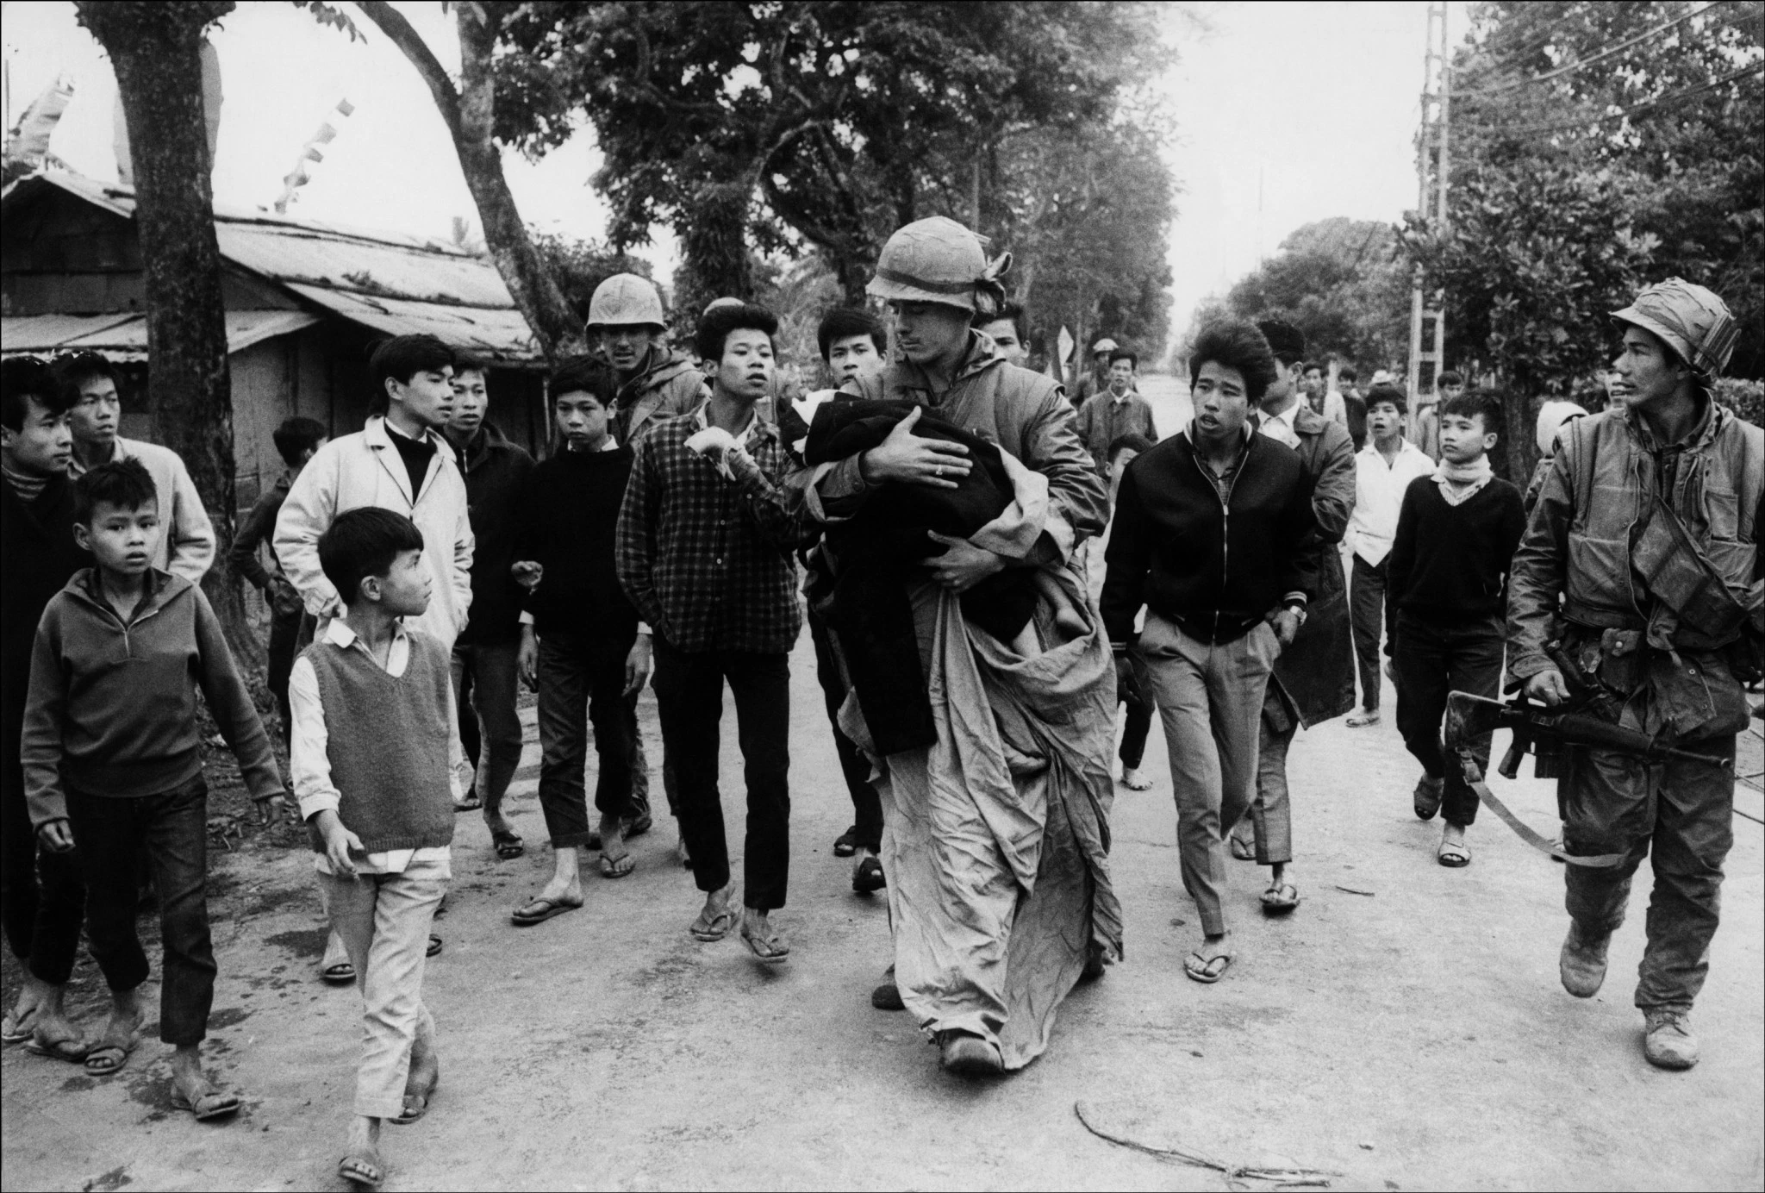
Voices of the Vietnam War
Notes:
https://time.com/vietnam-photos/

Slide 2
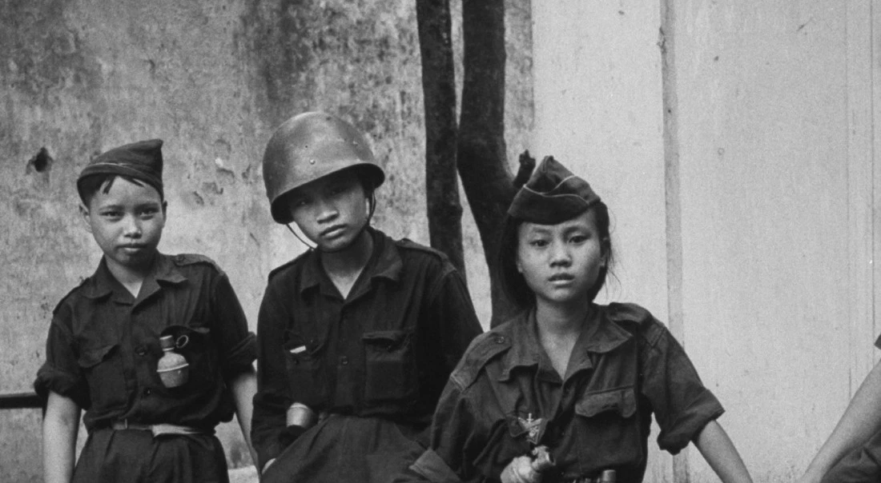
Voices of the Vietnam War
Notes:
https://time.com/vietnam-photos/

Slide 3
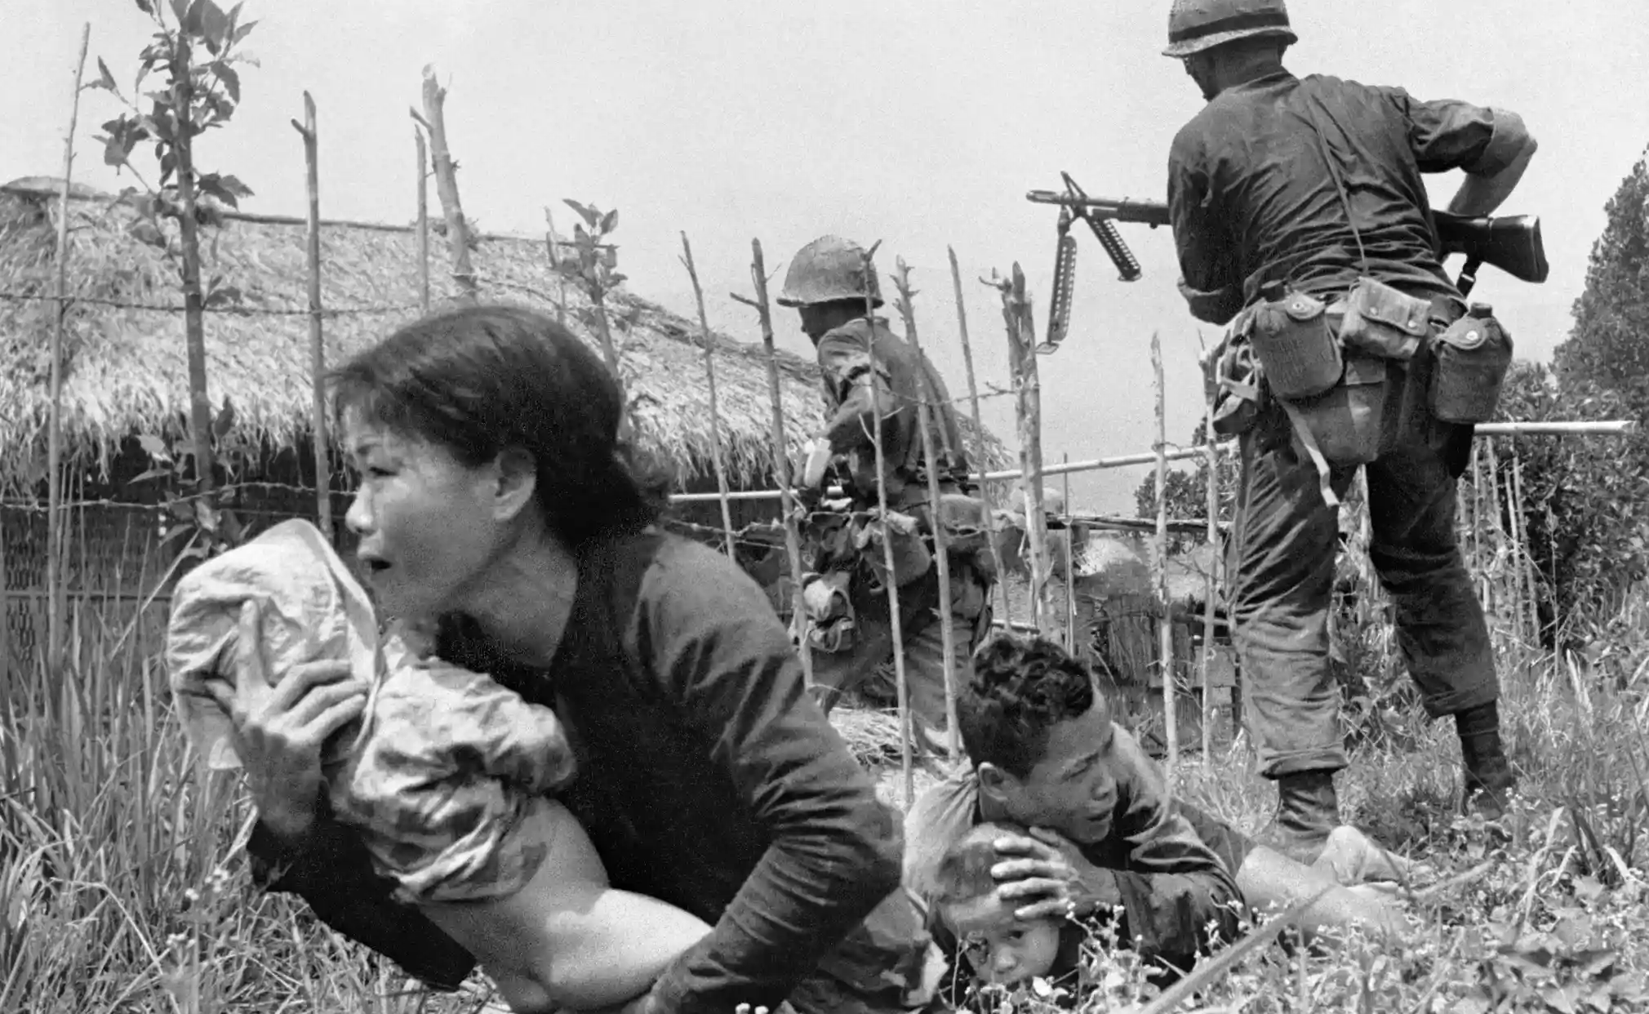
Voices of the Vietnam War
Notes:
https://www.theguardian.com/artanddesign/gallery/2015/apr/22/vietnam-the-real-war-a-photographic-history-by-the-associated-press-in-pictures

Slide 4
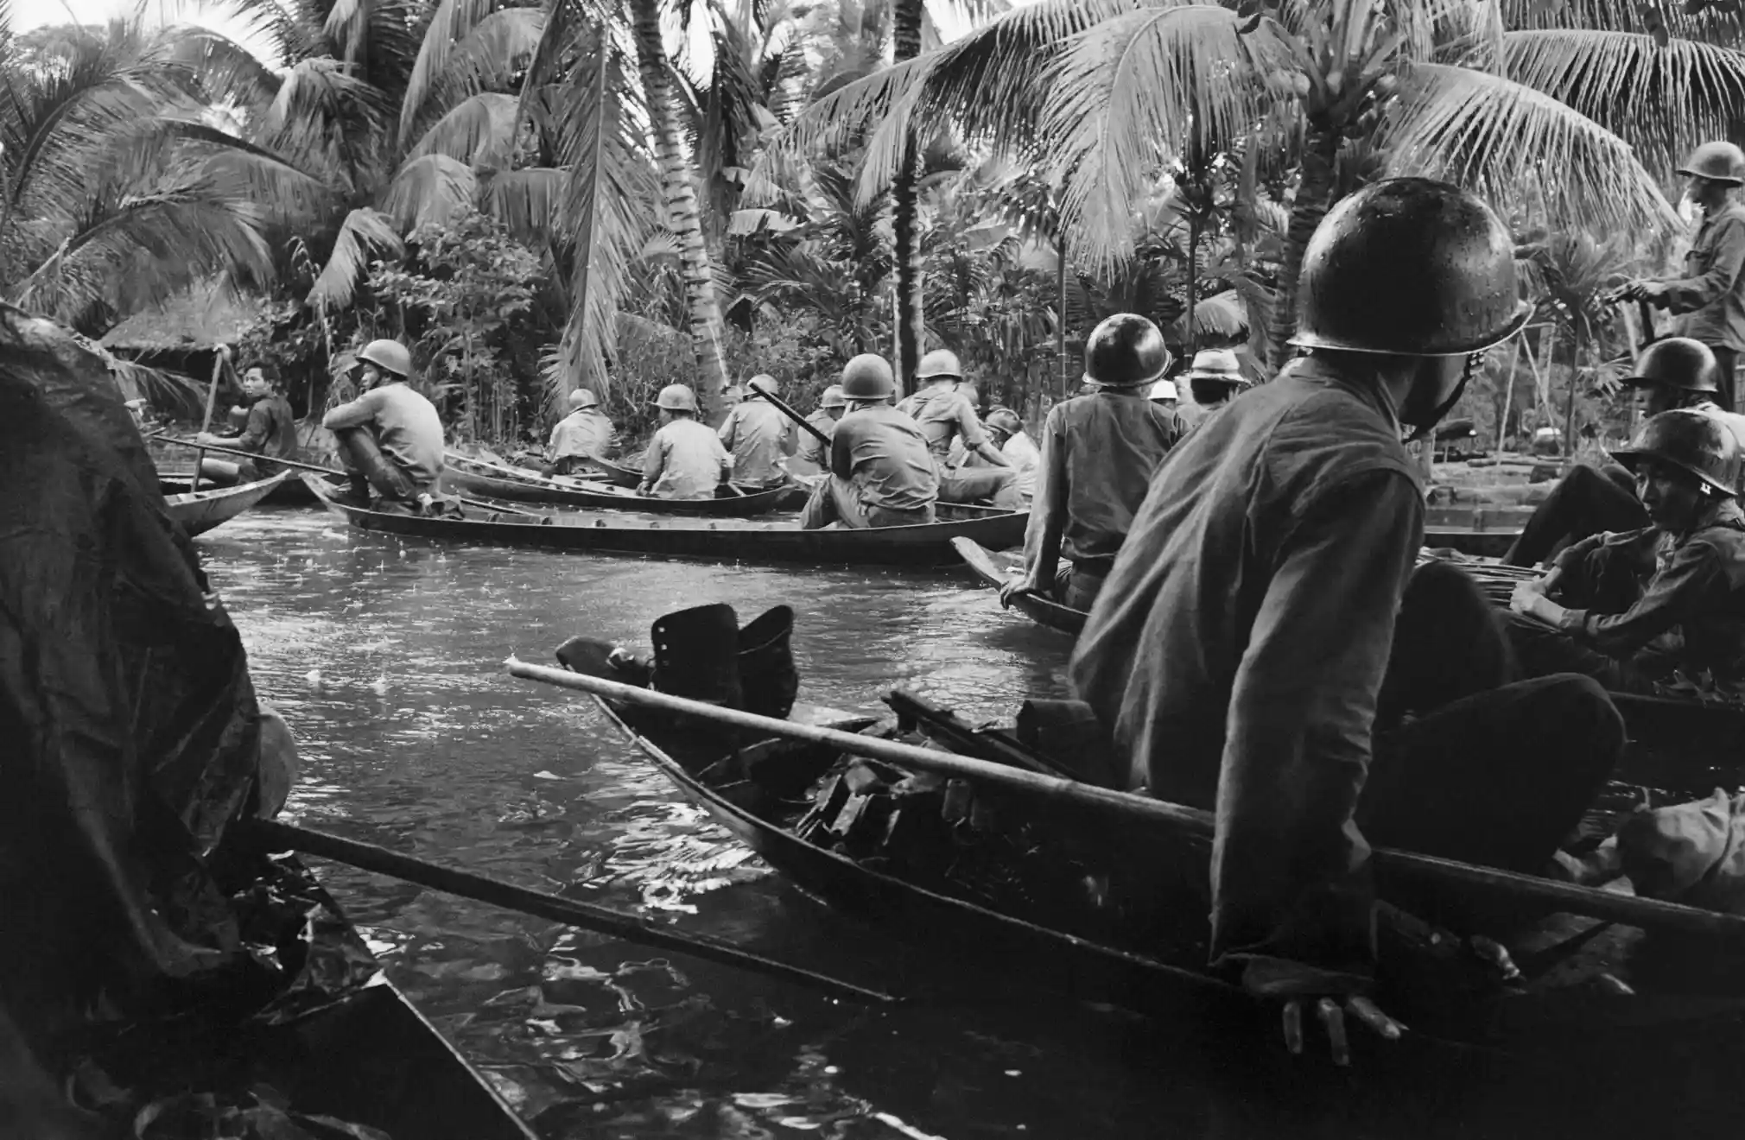
Notes:
https://www.theguardian.com/artanddesign/gallery/2015/apr/22/vietnam-the-real-war-a-photographic-history-by-the-associated-press-in-pictures

Slide 5
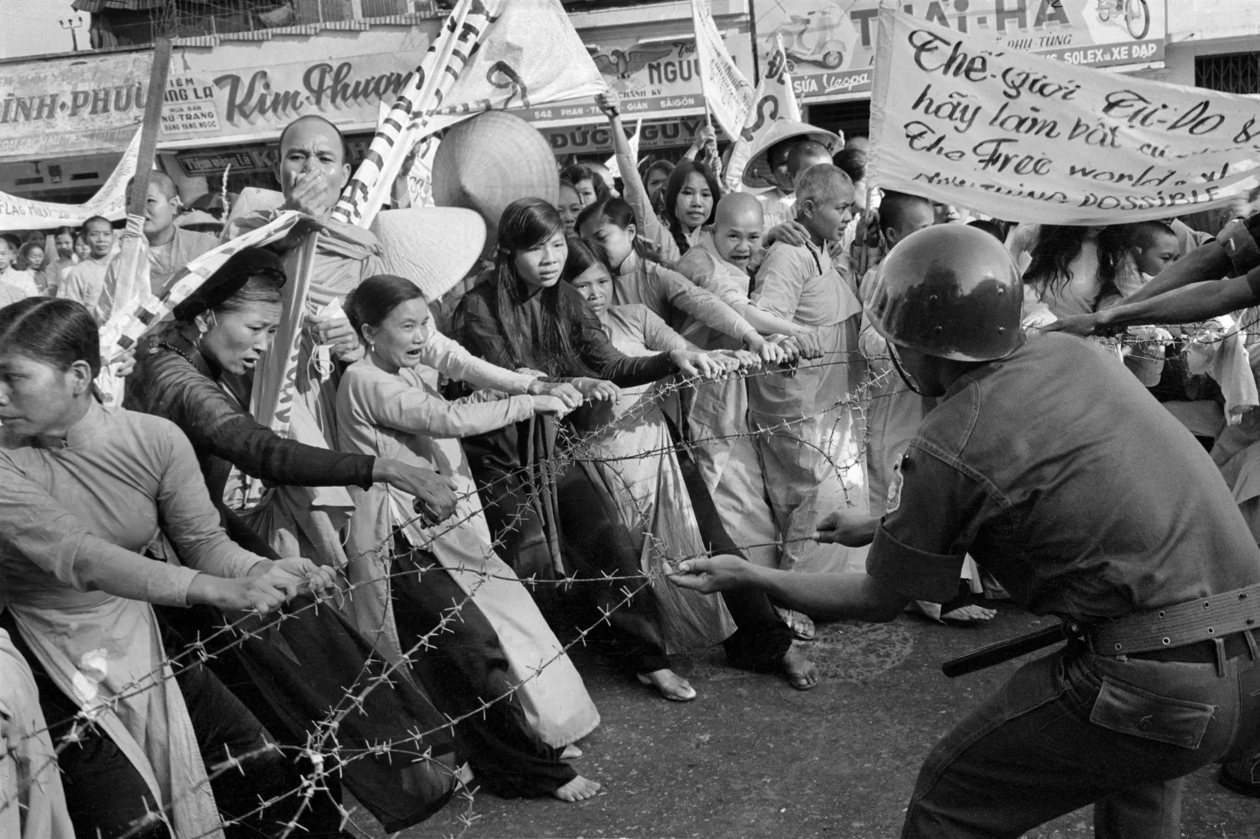
Voices of the Vietnam War
Notes:
https://www.theguardian.com/artanddesign/gallery/2015/apr/22/vietnam-the-real-war-a-photographic-history-by-the-associated-press-in-pictures

Slide 6
Vietnam War: Two Stories / One Conflict

Slide 7
Voices of the Vietnam War
Agenda
Vietnam War Background Info
Learning Objectives
Sources Packet
Group Discussion
Exit Ticket

Slide 8
Voices of the Vietnam War
  Vietnam Background Information
  France loses control of Vietnam
  Divided Vietnam (South vs North)
      South – Ngo Dinh Diem (Anti-Communist – USA supports) North – Ho Chi Minh (Pro – Communist)
    Fear of Communism from the Western powers (USA)
  March 8th, 1965: USA enters the conflict with Lyndon B Johnson
  Vietnam War lasts 20 years with 2 million Vietnamese casualties and 58,000 American casualties

Slide 9
Voices of the Vietnam War
Learning Objectives:
SWBAT use primary and secondary sources to analyze the different perspectives of the Vietnamese and Americans and how they viewed the conflict of the war at that time
SWBAT make a judgement as to how the Vietnam War impacted those who were involved

Slide 10
DBQ Source Packet
Directions:
Use the sources to answer the questions
5 Sources = 5 minuets per source
Show teacher once finished with all sources
Questions to Consider:
What are some similarities and differences that you are seeing between the sources?
What connections are you seeing between the sources and the images that were shown earlier?
What perspectives/involvements are you seeing in the Vietnam War?
How is the war impacting those involved?

Slide 11
Voices of the Vietnam War
Group Discussion
What was the perspectives of those who were involved in the Vietnam war in America?
What was the perspectives of those who were involved in the Vietnam war in Vietnam?
How did the Vietnam war affect the soldiers and those involved?
Why did the American/Vietnamese fight in the conflict?
What might have happened if the USA had not been involved in the war?
How did Agent Orange impact those who were involved in the war
How do you think that the Vietnam war impacted the relationship between American and Vietnamese peoples?

Slide 12
Voices of the Vietnam War
Exit Ticket Question
Using the sources, evaluate how the Vietnam War impacted those involved. Include 2-3 sentences and make sure to include evidence from the source(s)

