Slide 1
The Rise of New Populism
The United States, The Philippines, Hungary, and Poland

Slide 2
Essential Question and Learning Objectives
Essential Question: What are the shared ideas in the rise of populism?
LO1: Students will be able to identify common trends across populist countries.
LO2: Students will be able to analyze the link between social conditions and the rise of new populism.
LO3: Students will be able to analyze the link between economic conditions and the rise of new populism.

Slide 3
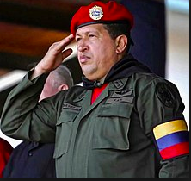
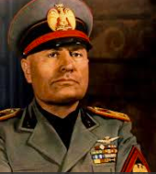
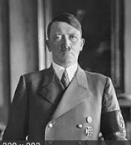
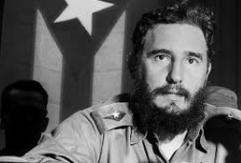
Populism
Defined as a political approach that attempts to appeal to ordinary citizens.
Exemplified by Hugo Chavez of Venezuela, Benito Mussolini of Italy, Fidel Castro of Cuba, and Adolf Hitler of Germany

Slide 4
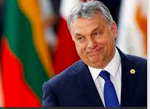
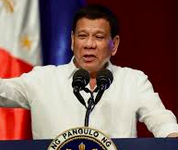
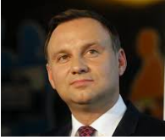
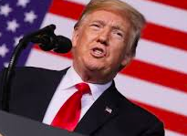
Populism today: Viktor Orbán (Hungary), Rodrigo Duterte (the Philippines), Andrzej Duda (Poland), and Donald Trump (United States)

Slide 5
Populism at home: Donald Trump
Took on “political outsider” role
1
Re-emergence of “of an openly, ostentatiously white-nationalist conservatism.”
2
Trump’s appeals to racism were not coded or covert– they were open, obvious, and profound
3
Ran a campaign toward a ”politics of immigration restriction, anti-internationalism, and cultural resentment.”
4
Finally, an increase in tension between homogeneity and cosmopolitan ideals played a huge role in voter turnout
5
Notes:
Source: https://origins.osu.edu/article/fear-and-loathing-around-world-rise-new-populism

Slide 6
Populism in the Philippines: Rodrigo Duterte
Supports a ruthless drug war, which killed approx. 6,000 people in 6 months
Threatened to leave the United Nations and pulled out of the International Criminal Court
“Driven by views of a pure “people” set against a corrupt, subversive “elite.”
Banned the Vice President (elected separately in the Philippines) from Cabinet meetings, increased the Presidential budget, and arrested influential critics
Notes:
https://origins.osu.edu/article/fear-and-loathing-around-world-rise-new-populism

Slide 7
Populism in Hungary: Viktor Orbán
Unlike other Eastern European countries, Hungary did not have a lot of success with democracy pre-WWII
Became one of the most indebted Communist countries because past leaders overspent to stave off social conflict
After taking power Orbán:
altered the constitution and made the electoral system even more favorable towards the winner
centralized political, cultural, and economic power across the board
spent millions on propaganda to increase fear and hatred of the “other”
limited free and fair elections
Notes:
https://origins.osu.edu/article/fear-and-loathing-around-world-rise-new-populism

Slide 8
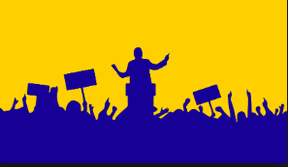
Today…
We are going to explore populism in The United States, the Philippines, Hungary, and Poland more closely.

Slide 9

Stations Activity:
As you move around the room, think about the following questions:
  Are there religious similarities between the countries?
  Is there a community or group of people who are being scapegoated by those in power?
  What, in your opinion, is appealing about populist ideas?

Slide 10
Whole Class Discussion
Lets talk about the following questions:
  What are far-right movements fighting for (or against)?
  Why are they gaining popularity across the globe?
  Do they present a threat to democracy and civil liberties in other countries? Why or why not?

Slide 11
Final Thoughts…
For an exit ticket, please answer these questions:
  Which do you think is the strongest argument in favor of populism?
  Can you think of any ways to counter the rise of populism in other countries?

