Slide 1
Westward Expansion VS Imperialism

Slide 2
Are westward expansion and imperialism a horse of a different color?
Agenda:
Brain Dump
Venn Diagrams
Mini Lecture
Source Analysis
Picture Analysis
4 Corners
Exit Ticket: Quick Write

Slide 3
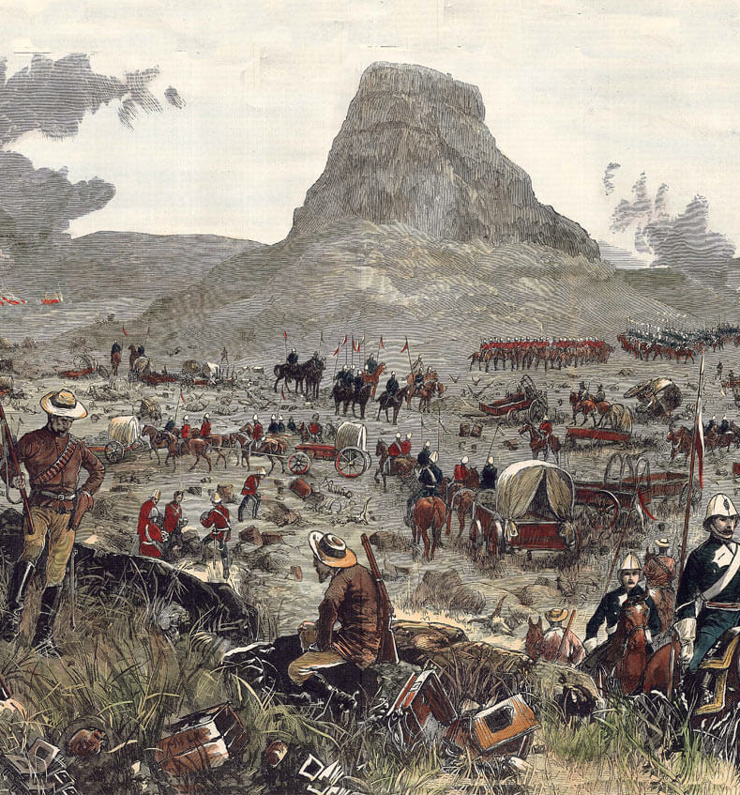
Are westward expansion and imperialism a horse of a different color?
Brain Dump:
Two Groups !
Group one - write down everything you know about Westward Expansion
Group two - write down everything you know about Imperialism
Only write down relevant word/phrases!

Slide 4
Are westward expansion and imperialism a horse of a different color?
Venn Diagrams:
In small groups, Use the words or ideas from the brain dump to compare and contrast Westward Expansion and Imperialism

Slide 5
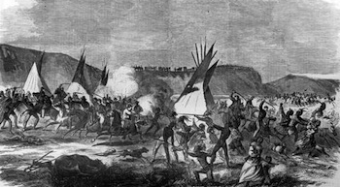
Are westward expansion and imperialism a horse of a different color?
MINI LECTURE

Slide 6
Are westward expansion and imperialism a horse of a different color?
What is Westward Expansion?

Slide 7
Are westward expansion and imperialism a horse of a different color?
Westward Expansion
In America, it was result of Manifest Destiny: the idea that the United States needed to expand to the West.
When Canada became a Nation in 1867, it also began to take direct control of more land.
The United States took Native American land through a series of wars and relocation with the Native Americans.
The Canadians also resettled First Nation and Inuit peoples in their Western Territories.

Slide 8
Are westward expansion and imperialism a horse of a different color?
Westward Expansion continued
Native Americans were often forced off their ancestral homelands and had to live on highly regulated reservations
The reservations were usually smaller than their homelands and the youth were sent to boarding schools to be assimilated into European culture
In Canada, First Nations people and Inuit's were also forced off their land through unfair trades
Through a series of acts made by the Canadian government, many were forced to assimilate

Slide 9
Why is westward expansion still important?

Slide 10
Are westward expansion and imperialism a horse of a different color?
Why is Westward Expansion still important?
The land taken from Native Americans, First Nations, and Inuit peoples have not been returned.
These peoples lost their sovereignty and have had more limited rights under the US and Canadian governments.
In addition many lost cultural traditions that were persecuted by both governments
People are still fighting the injustice today, such as Canadians during the 150th celebration of the creation of Canada.

Slide 11
Source Analysis:
In pairs or small groups, use the sources on the source resource sheet to answer the corresponding questions.

Slide 12
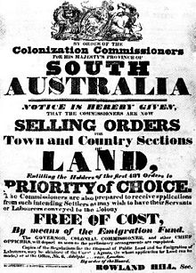
Are westward expansion and imperialism a horse of a different color?
Source Analysis
Doc. A

Slide 13
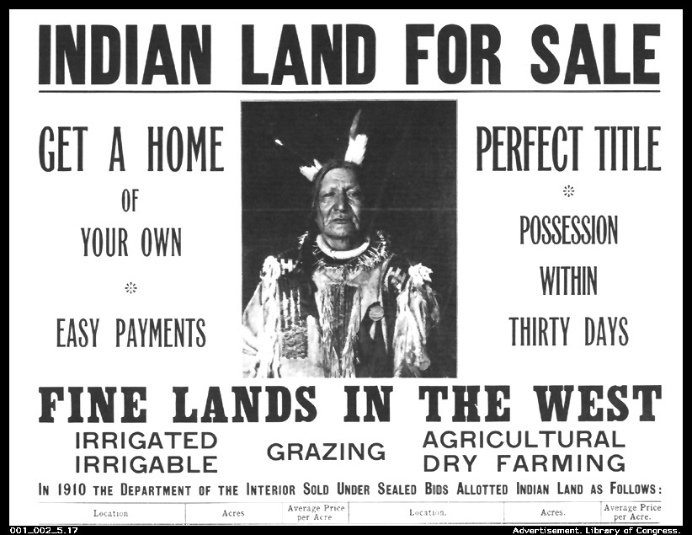
Are westward expansion and imperialism a horse of a different color?
Source
Analysis
Doc. B

Slide 14
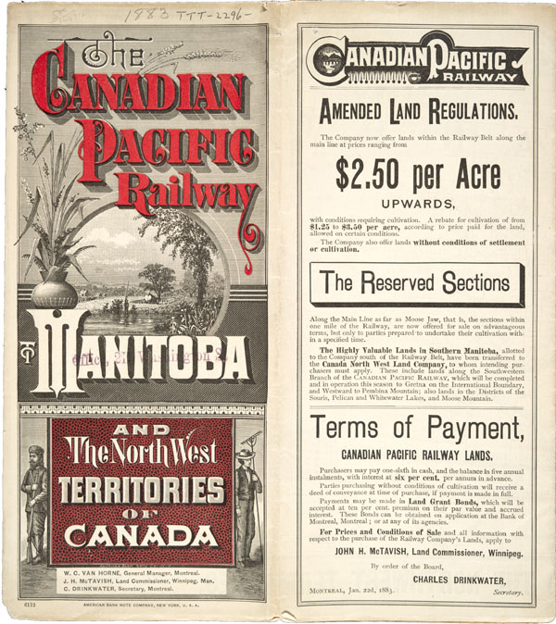
Are westward expansion and imperialism a horse of a different color?
Source
Analysis
Doc. C

Slide 15
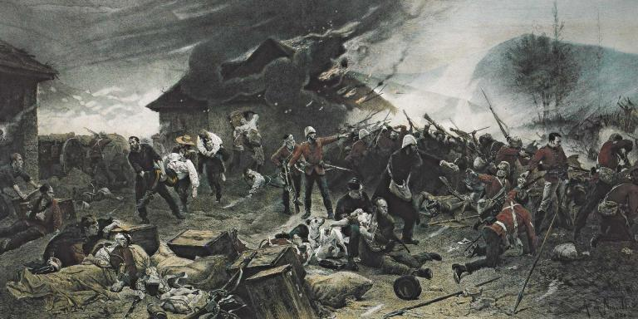
Are westward expansion and imperialism a horse of a different color?
Each group share :
What are the characteristics imperialism presents in these sources?
What similarities and differences between the sources did your group identify?
How are imperialism and westward expansion alike and different?

Slide 16
Are westward expansion and imperialism a horse of a different color?
Picture Analysis

Slide 17
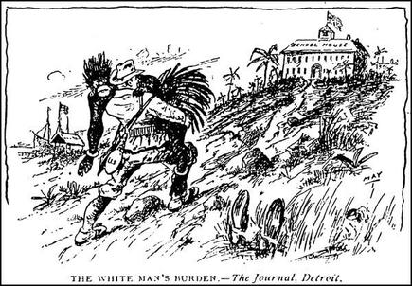
Are westward expansion and imperialism a horse of a different color?
“White Man’s Burden”
  What is the role of the two people in this picture?
  How does this connect to what you know about the “white man’s burden?”
  How does this reflect what you know about westward expansion?

Slide 18
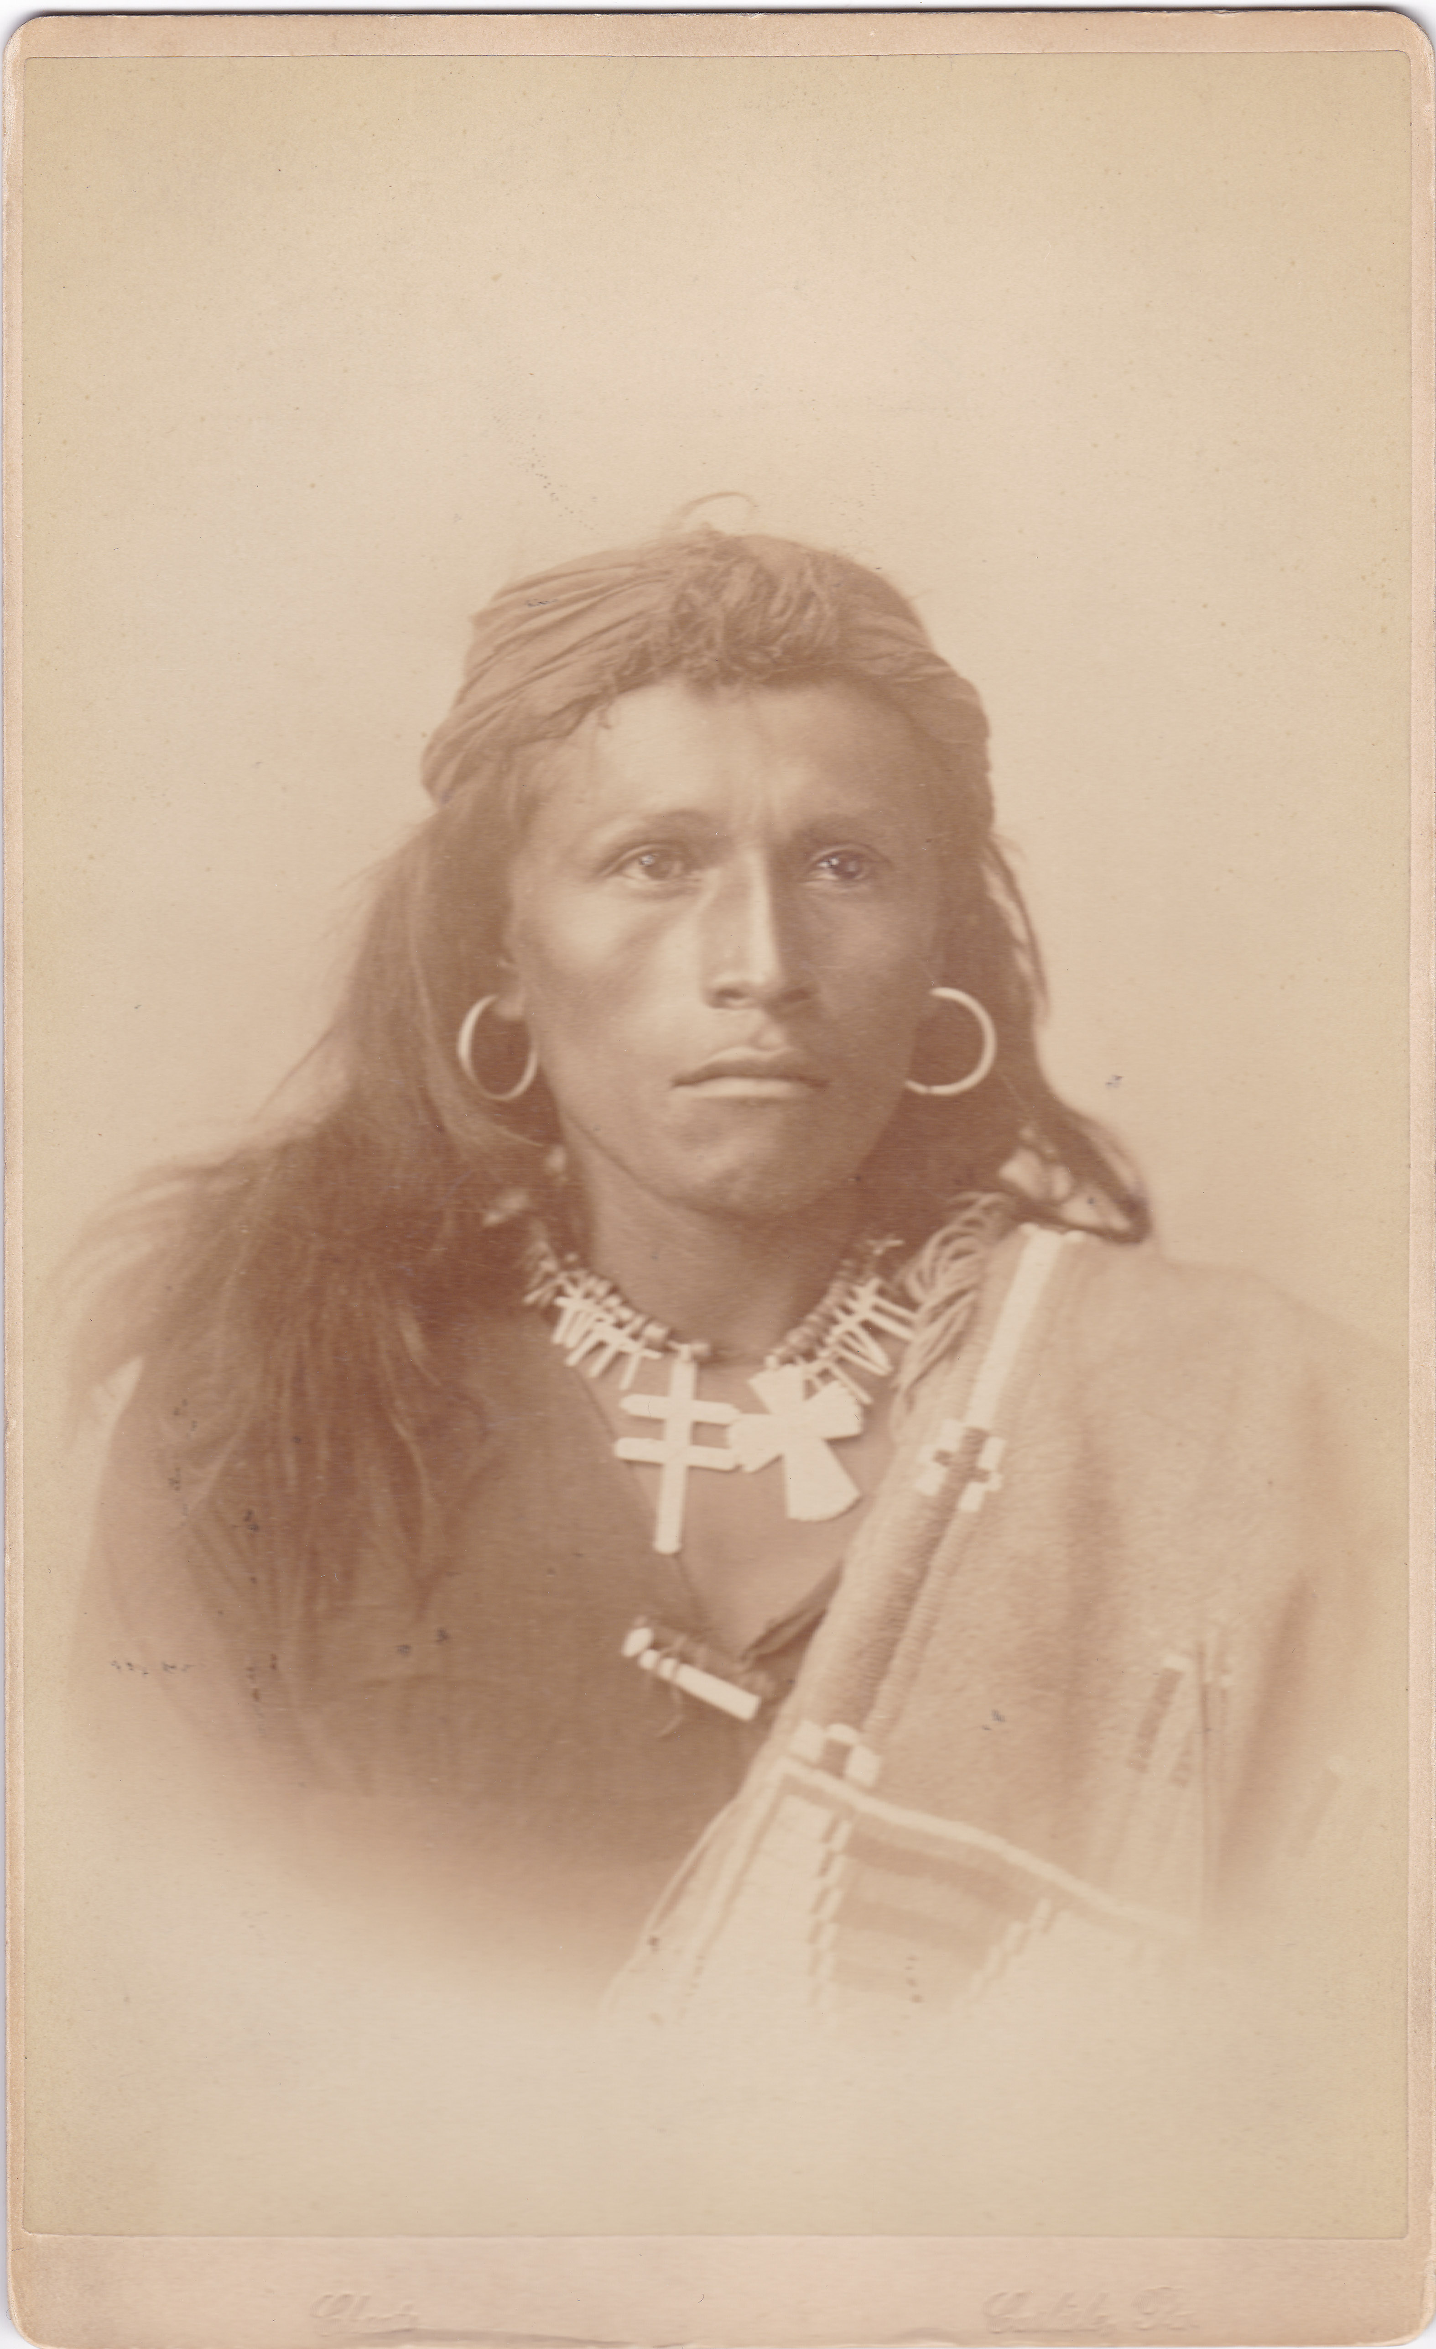
Are westward expansion and imperialism a horse of a different color?
Tom Torlino: Before Boarding School
Tom Torlino was a member of the Navajo tribe
The Navajo tribe is a large Native American tribe located in the Southwest
Describe the person in the picture:
How does his appearance reflect his Navajo culture?

Slide 19
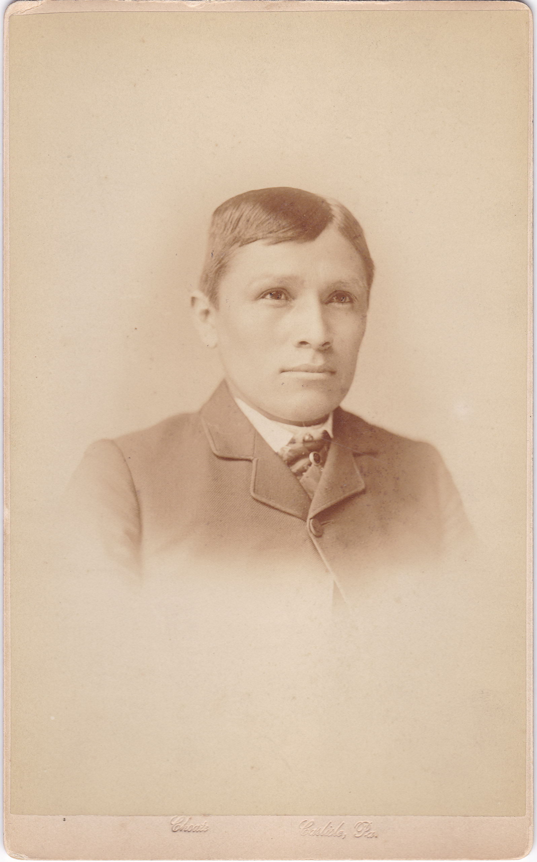
Are westward expansion and imperialism a horse of a different color?
Tom Torino After Boarding School
  Tom Torlino was sent to the Carlisle Indian School, located in Pennsylvania, where Native Americans were forced to assimilate
  Describe his appearance now? What is different?
  How does he reflect the cultural values of the Europeans?

Slide 20
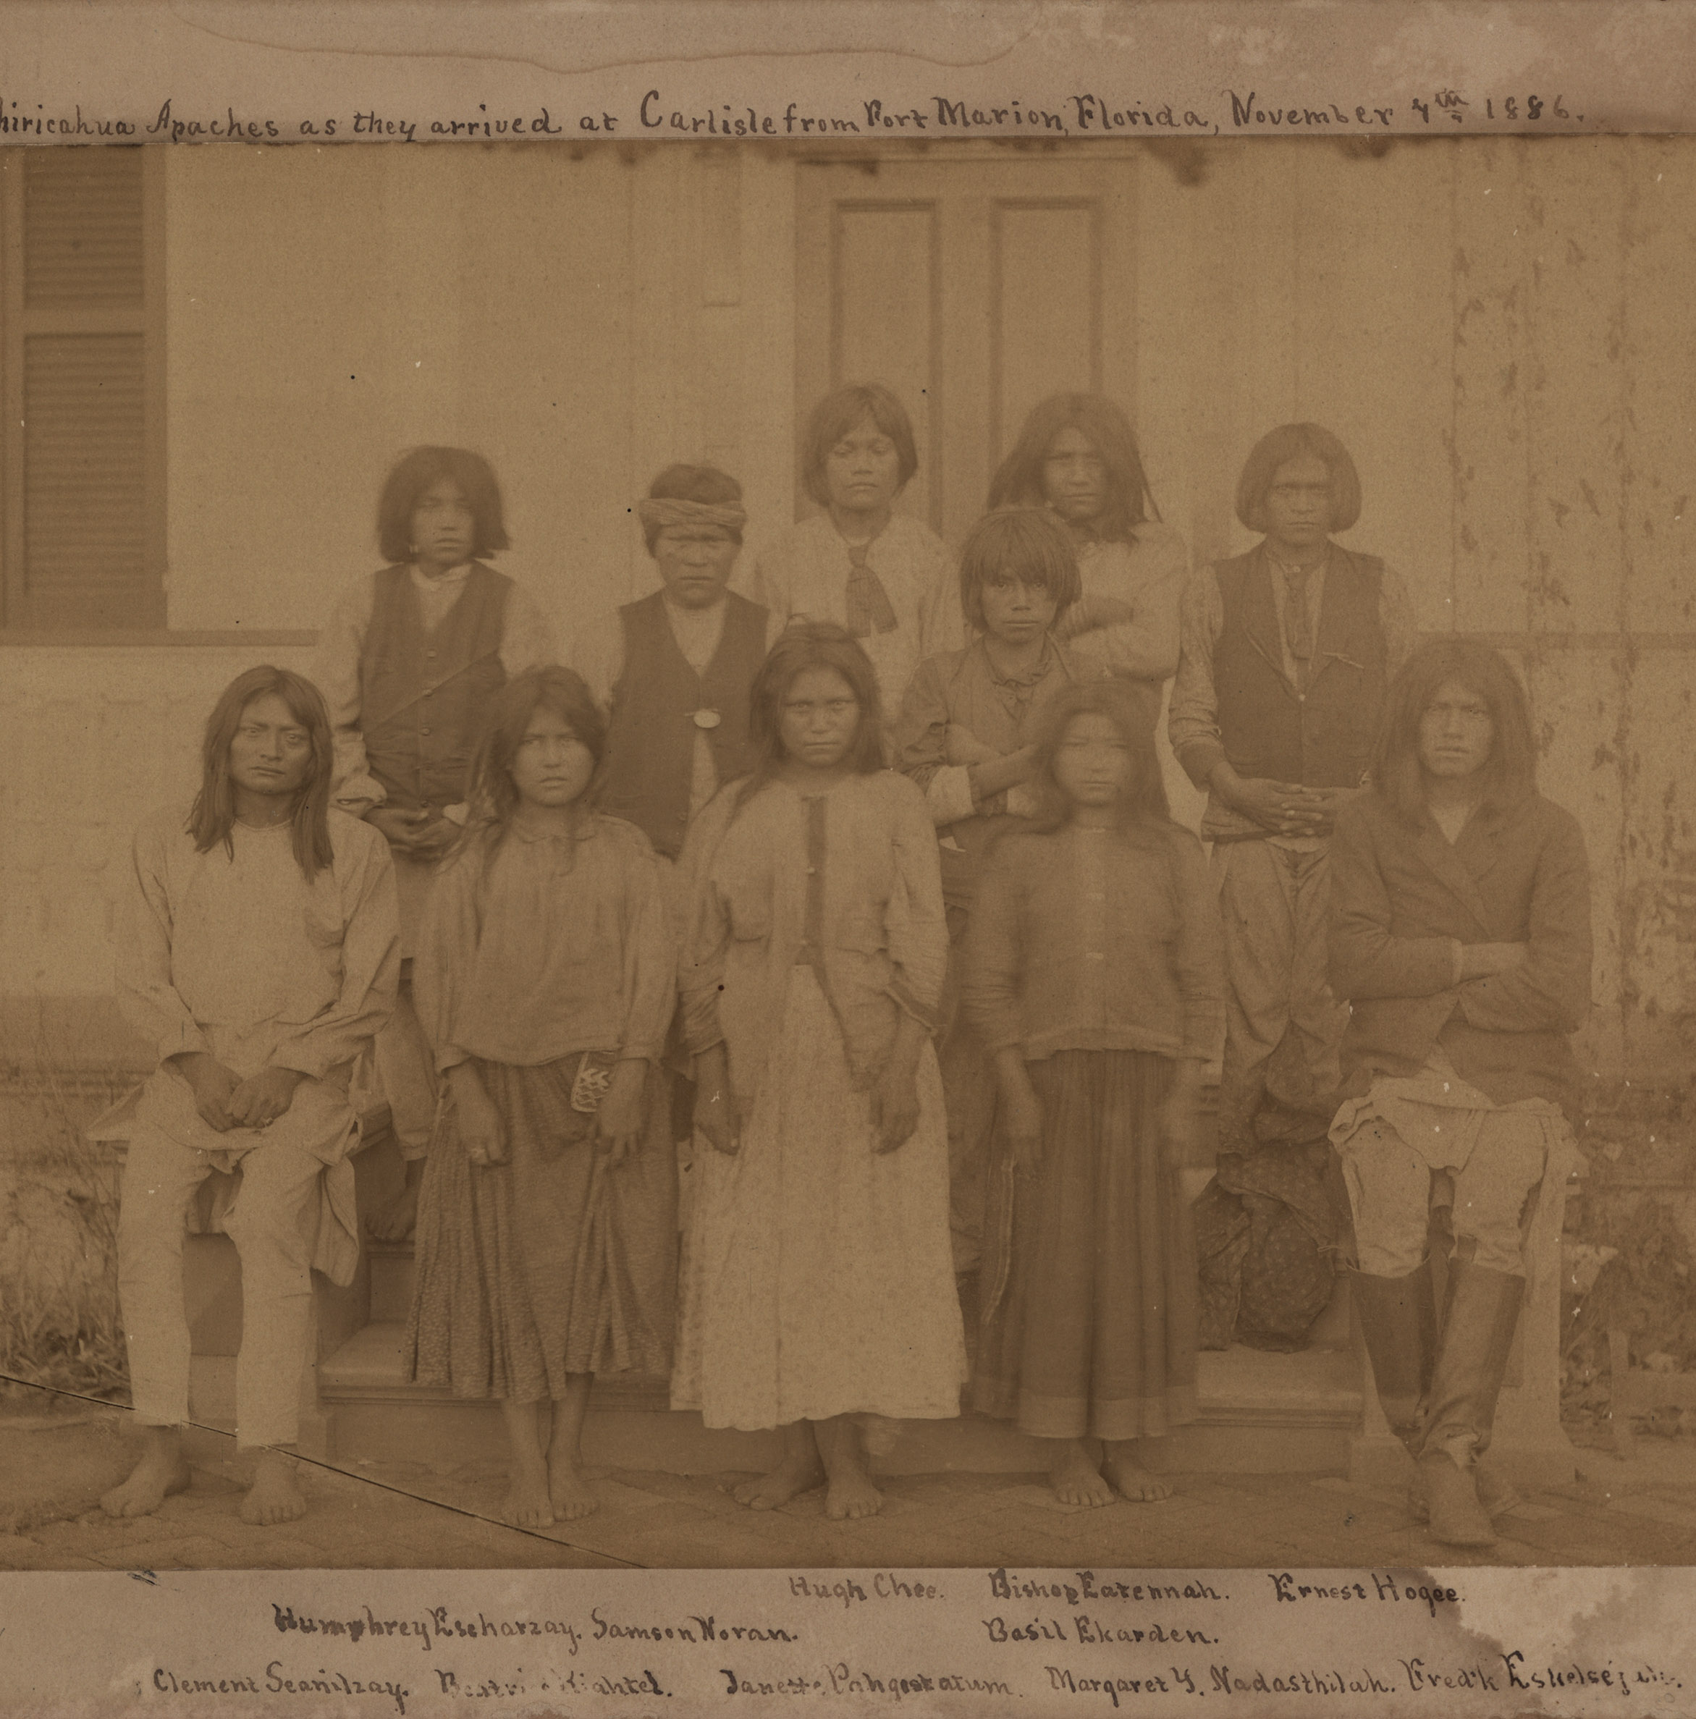
Are westward expansion and imperialism a horse of a different color?
Chiricahua Apaches from Fort Marion: Before Boarding School
These children are Chiricahua Apache, which were from South East Arizona.
Describe them:
How do they reflect their cultural heritage?

Slide 21
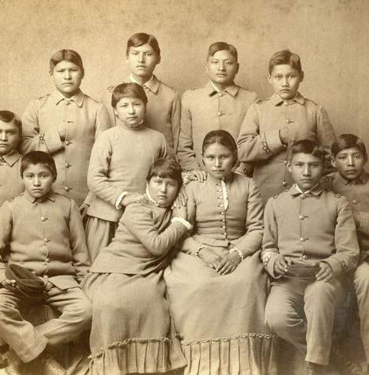
Are westward expansion and imperialism a horse of a different color?
Chiricahua Apaches from Fort Marion: After Boarding School
This picture is when the students were at Carlisle Indian school.
Often students were to wear military type uniforms
Describe them now:
How is European values being reflected?

Slide 22
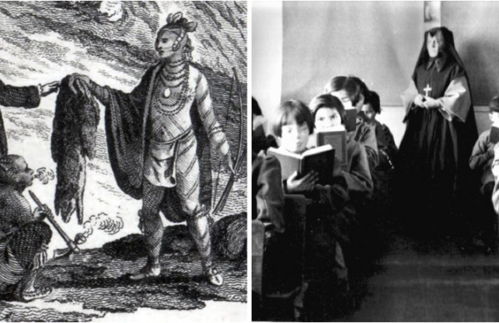
Are westward expansion and imperialism a horse of a different color?
Canadian Boarding school
How is this illustration and picture like American boarding schools?
Was cultural genocide unique to America?

Slide 23
Are westward expansion and imperialism a horse of a different color?
In your groups answer and be prepared to respond to the following:
Is Westward expansion a form of Imperialism? Why or why not?

Slide 24
Are westward expansion and imperialism a horse of a different color?
4 Corners
For the prompt: Westward Expansion is a form of Imperialism
Move to the corner of the room that best fits your opinion of the prompt (Strongly Disagree, Disagree , Agree, Strongly Agree.
Use facts and concepts from sources used in the lesson.
You can add to or counter other students’ claims, after they finish their thoughts.

Slide 25
Are westward expansion and imperialism a horse of a different color?
Exit Ticket:
Are westward expansion and imperialism simply a horse of a different color?

Slide 26
Are westward expansion and imperialism a horse of a different color?
Work Cited
Background pictures:
Home. (n.d.). Retrieved February 16, 2020, from https://www.britishbattles.com/zulu-war/battle-of-isandlwana/
(n.d.). Retrieved February 16, 2020, from https://study.com/academy/lesson/the-role-of-the-apache-the-end-of-the-indian-wars.html
Sources Analysis Sources:
(n.d.) retrieved from: https://en.wikipedia.org/wiki/History_of_South_Australia
(n.d.) Retrieved from: https://www.thoughtco.com/dawes-act-4690679
(Neylan) Retrieved from http://origins.osu.edu/article/canada-s-dark-side-indigenous-peoples-and-canada-s-150th-celebration/page/0/0
Picture analysis sources:
(n.a.) Retrieved From: http://carlisleindian.dickinson.edu/teach/analyzing-and-after-photographs-exploring-student-files
(Neylan) Retrieved from: http://origins.osu.edu/article/canada-s-dark-side-indigenous-peoples-and-canada-s-150th-celebration/page/0/0
(n.a) Retrieved from: http://www.paddletrips.net/wmb/editorial.html

