Slide 1
‘Killing the Arctic’
Human Impact on the Arctic

Slide 2
​
Today’s Agenda
Before & after picture of glaciers in Alaska
Watch interviews of Indigenous people describe how the Arctic has changed in Alaska
Partner read Killing the Arctic
Explore NASA’s Arctic Sea Ice Extent page
5. Create a PSA

Slide 3
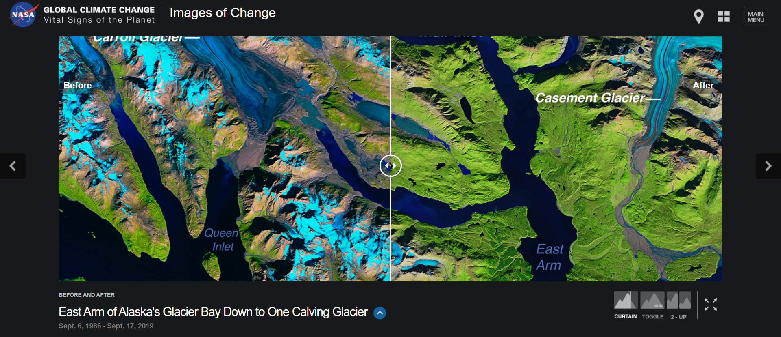
What do you notice? What do you wonder? Think-Pair-Share
NASA – Alaska’s Glacier Bay
Before After

Slide 4
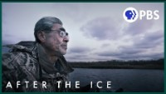
PBS – Alaskan Native Elders Tell Their Climate Change Story

Slide 5
Next Steps
Be Work with your partner to fill out the rest of the guided notes. This should take 20 minutes at most.
Then, create a public service announcement about what you have learned today. You can use a digital tool or paper. Include the following:
Images (drawn or pictures) and color
Information (by text or images) about how humans are harming the Arctic (unsustainable hunting and/or climate change)
Information explaining why people should be concerned about the health of the Arctic

