Slide 1
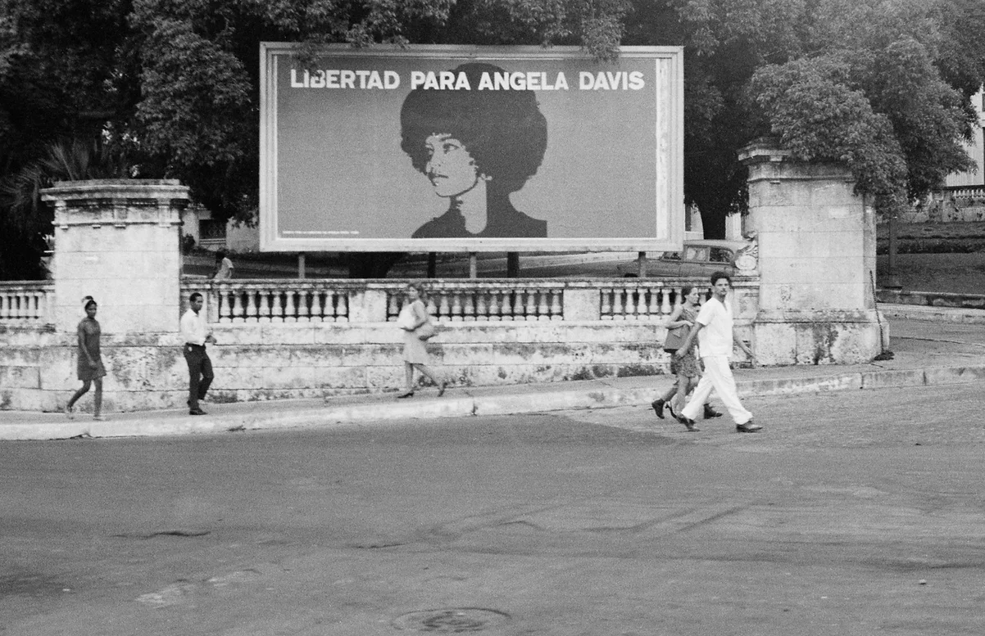
Black Activism, Cuba, and Anti-Racism

Slide 2
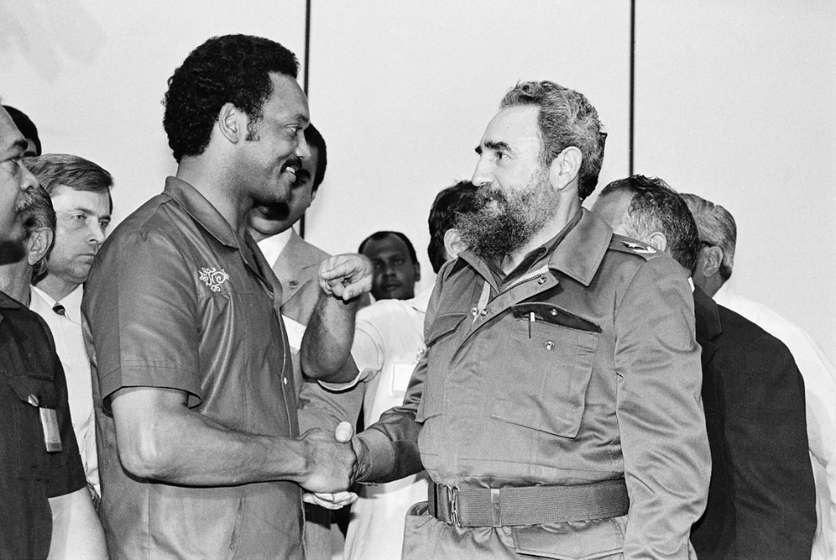
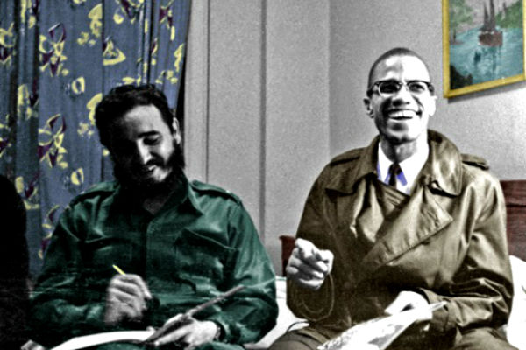
Opener: Word Wall

Slide 3
Compelling Question
Why did the Cuban government sympathize with African Americans in the mid-late 1960s?
Why did African Americans form political alliances with Fidel Castro?

Slide 4
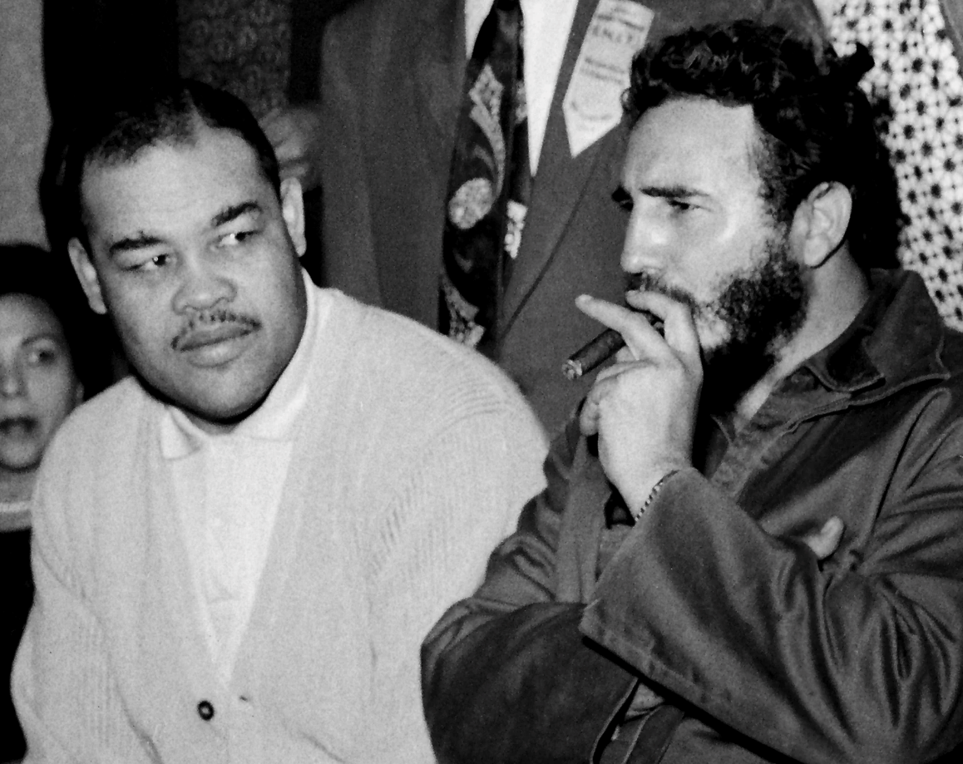
Stations Activity
There are four stations
At each station, read the primary/secondary source and answer the questions
Work with the people at the same station as you
You will have 5 minutes at each station
I will tell you when to switch

Slide 5
Venn Diagram
Compare and Contrast the Black experience and the Cuban experience found in the sources
In the middle, put things that both groups had in common
Work with one partner

Slide 6
Synthesis Questions
What points did you add to your Venn diagram?
Which sources were most helpful in giving you those points?

Slide 7
Exit Ticket
Why did the Cuban government sympathize with African Americans in the mid-late 1960s?
Why did African Americans form political alliances with Fidel Castro?

