Slide 1
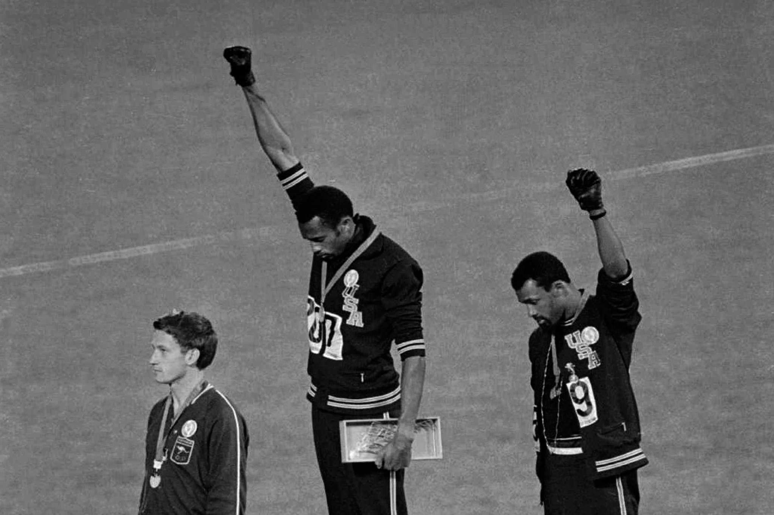
The Black Fists Protest

Slide 2
Agenda
Think-Pair-Share
Interactive Lecture
Stations
Discussion

Slide 3
Think-Pair-Share
Directions: 1) Answer the question in the first box on your sheets. 2) Then, with a partner, fill out the second box. 3) Finally, jot down some ideas that you and your partner would like to discuss with the whole class.
Do you think that athlete protests are effective at accomplishing change?

Slide 4
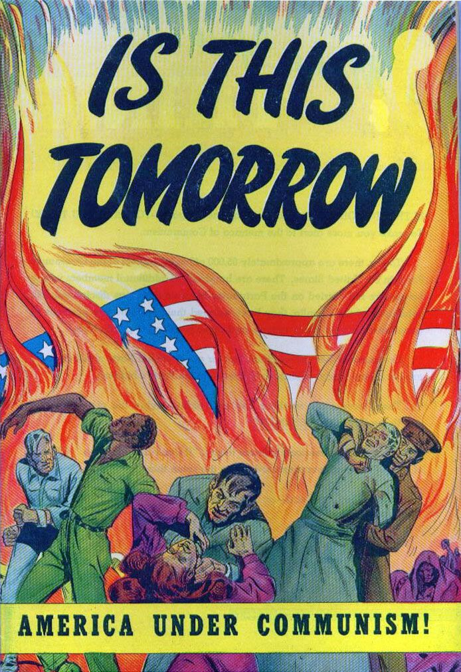
Cold War Themes so Far
United States is committed to containment
United States is trying to win over 3rd world countries
United States has beaten racism? (Civil Rights Acts, etc.)

Slide 5
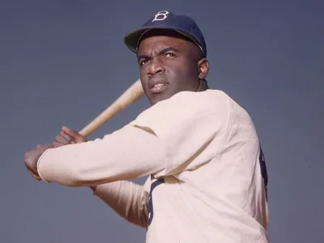
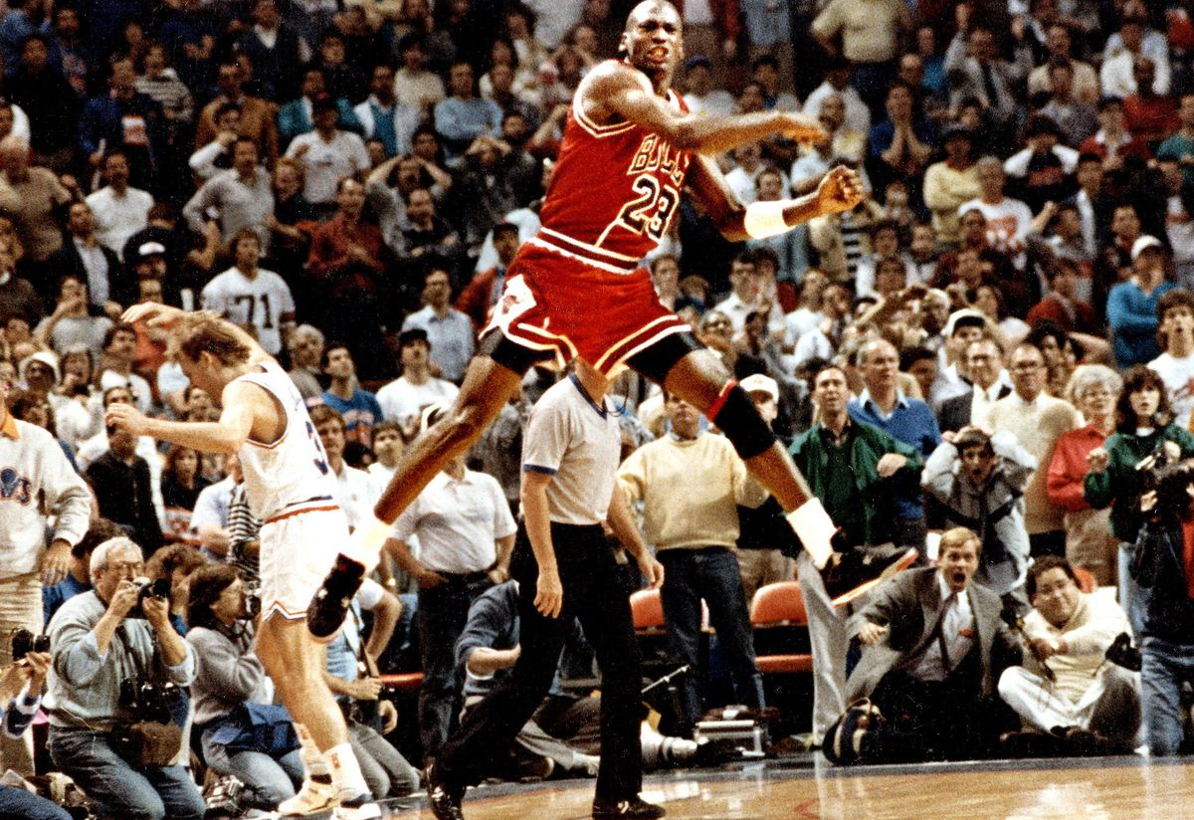
“The Myth of the Black Athlete”

Slide 6
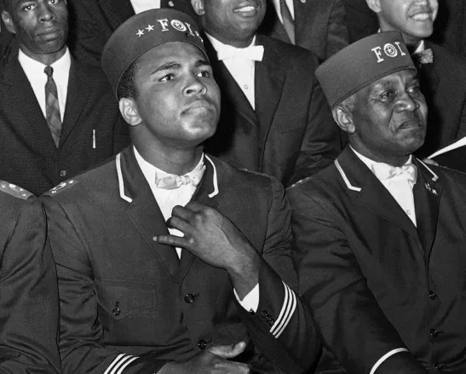
Black Athlete Protests Before 1968
Seldom overtly political statements prior to 1968
Jackie Robinson & Jim Brown were protesting simply by competing
Muhammed Ali most overtly political pre-1968

Slide 7
Stations Activity
Directions: 1) Break into groups of 3-4. 2) Together, fill out a guided worksheet for each station that you go to. 3) Be ready to discuss your findings!
Some Questions to Focus on:
“What was the Black Fists Protest? Why was it important?”
“What was the reaction immediately after the protest? How were the athletes treated?”
“What has been the Black Fists Protest over time?”

Slide 8
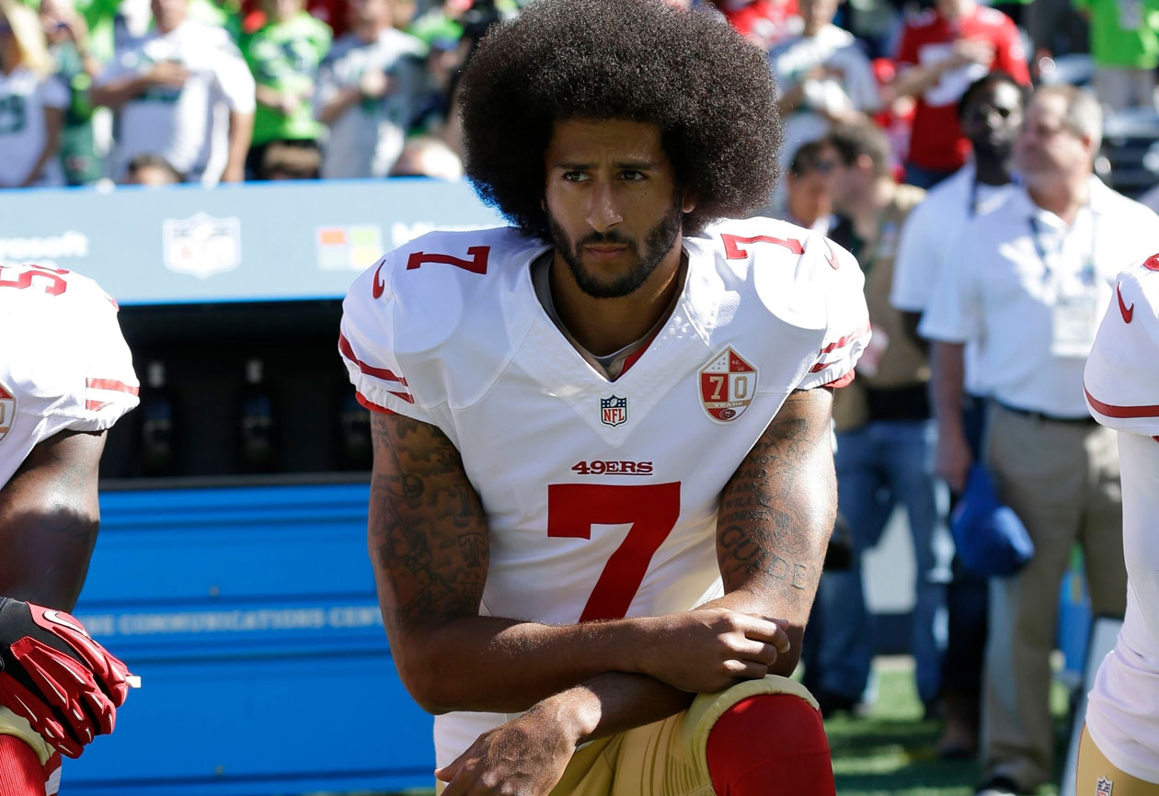
Let’s Discuss!

