Slide 1


Why are discussions centered around racism and Black history important?
Ramey, 2022.

Slide 2
Today’s Agenda
What is hard history?
Ted Talk: Hard History
Jigsaw Activity: The Father of Black History
Analyzing legislation from today
Crafting letter to Ohio Legislator
Ramey, 2022.

Slide 3
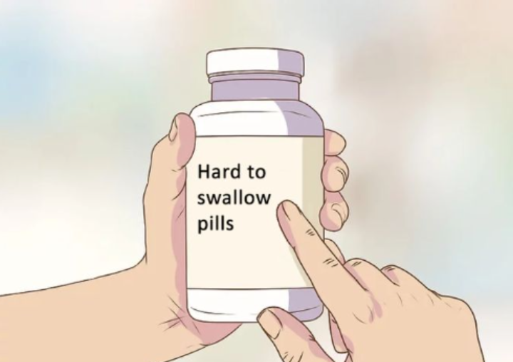
What is “hard history?”
Ramey, 2022.

Slide 4
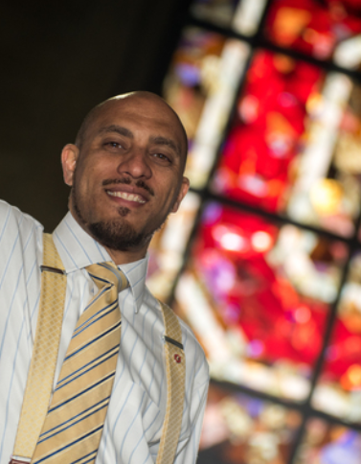
Ted Talk: Hard History
As a class, let’s watch this Ted Talk addressing the importance of hard history
While watching, fill out the graphic organizer on your guided notes
HASAN KWAME JEFFRIES is associate professor of history at The Ohio State University where he teaches courses on the Civil Rights and Black Power Movement.
Ramey, 2022.

Slide 5
Ted Talk Recap
Hard history: Aspects of the United States that portray its historically social, political, economic, and overall systemic oppressive tendencies, such as racism
Avoided through teaching lies, rationalizing oppression, or just pretending the past did not happen
Grapple with accurate complexities of the past think critically of how our present is shaped by the past
Ramey, 2022.

Slide 6
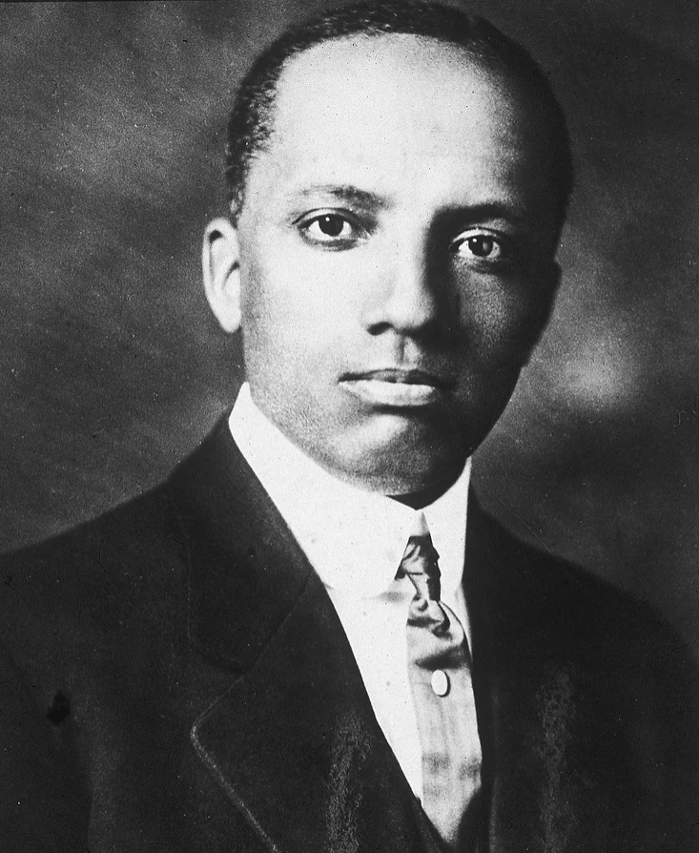
The “Father” of Black History
Carter Godwin Woodson
Ramey, 2022.

Slide 7
Jigsaw Directions: Part 1
First, you will be placed in a group of four (you and three of your peers).
You will then be assigned to read 1 of the following 4 documents. Read your assigned document and take notes on your jigsaw activity sheet.
Ramey, 2022.

Slide 8
Jigsaw Directions: Part 2
Now, as instructed, meet with other students who read the same document as you.
With your peers, you will discuss your assigned document and become an expert on the information.
Using information from your peers, add information to your notes that you did not previously have.
Ramey, 2022.

Slide 9
Jigsaw Directions: Part 3
Return to your original group and present your findings and expertise on the document you read.
While listening to your peers share their expertise, take notes on the other 3 jigsaw documents you did not read. Please ask your peers questions if you have them!
Ultimate goal – Each student will learn about all 4 jigsaw sources: the source you read AND the 3 other sources your peers presented in small groups.
Ramey, 2022.

Slide 10
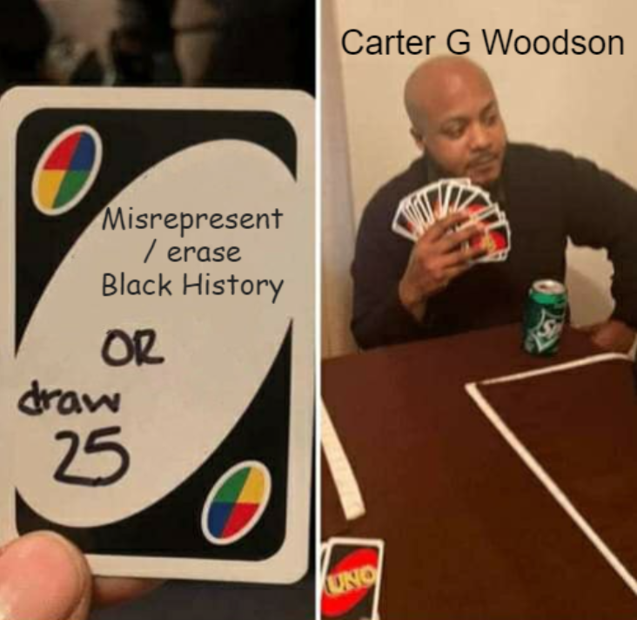
Jigsaw Conclusions
Carter G Woodson co-founded the Association for the Study of Negro Life and History in 1915 due to the lack of Black history taught in American education, ultimately dedicating his life to promoting the study of Black history.
To Woodson, celebrating Black history requires study, service, and commitment to Black societal uplift
Woodson believed it was important to recognize and honor Black historical figures and their contributions to society.
Woodson actively resisted the misrepresentation of Black history – misrepresentations Dr. Jeffries may label as “teaching lies.”
Woodson is recognized as the “founder of Black History” and creator of Black History Month
Ramey, 2022.

Slide 11
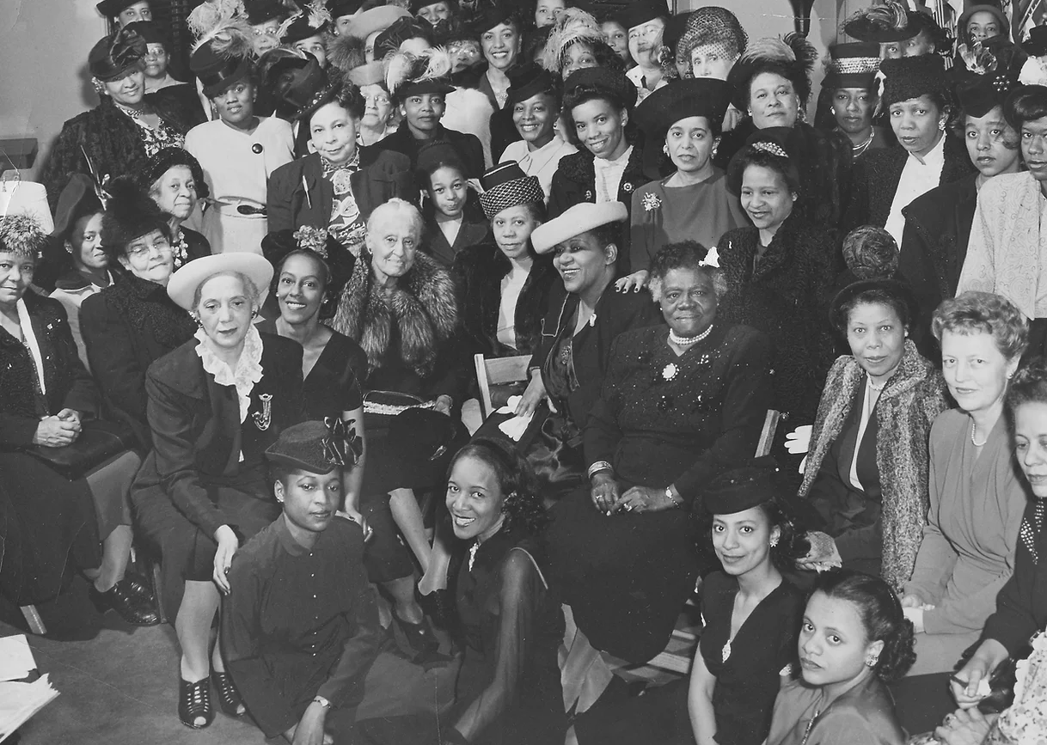
Picturing Black History:
Mary McCleod Bethune, center right, and Mary Church Terrell, center left, pictured at a gathering of Black women activists and educators, 1947
Photo by Afro Newspaper/Gado/Getty Images
Ramey, 2022.

Slide 12
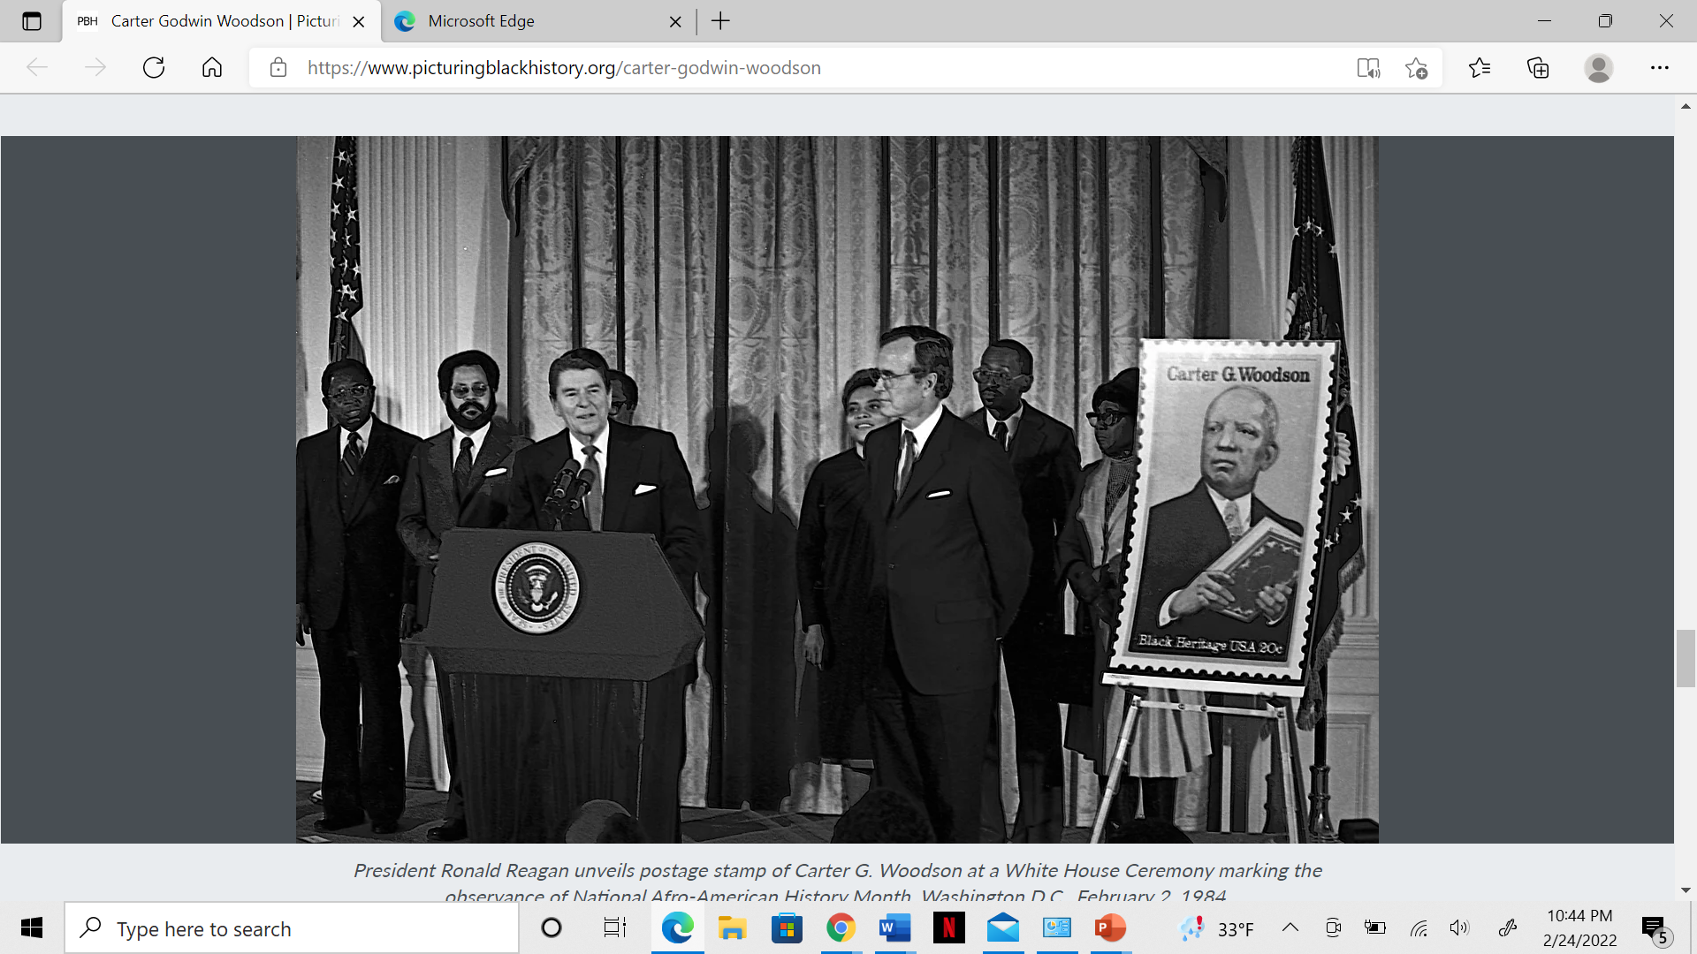
Picturing Black History:
President Ronald Reagan unveils postage stamp of Carter G. Woodson at a White House Ceremony marking the observance of National Afro-American History Month, Washington D.C., February 2, 1984.
Photo by Mark Reinstein/Corbis/Getty Images
Ramey, 2022.

Slide 13
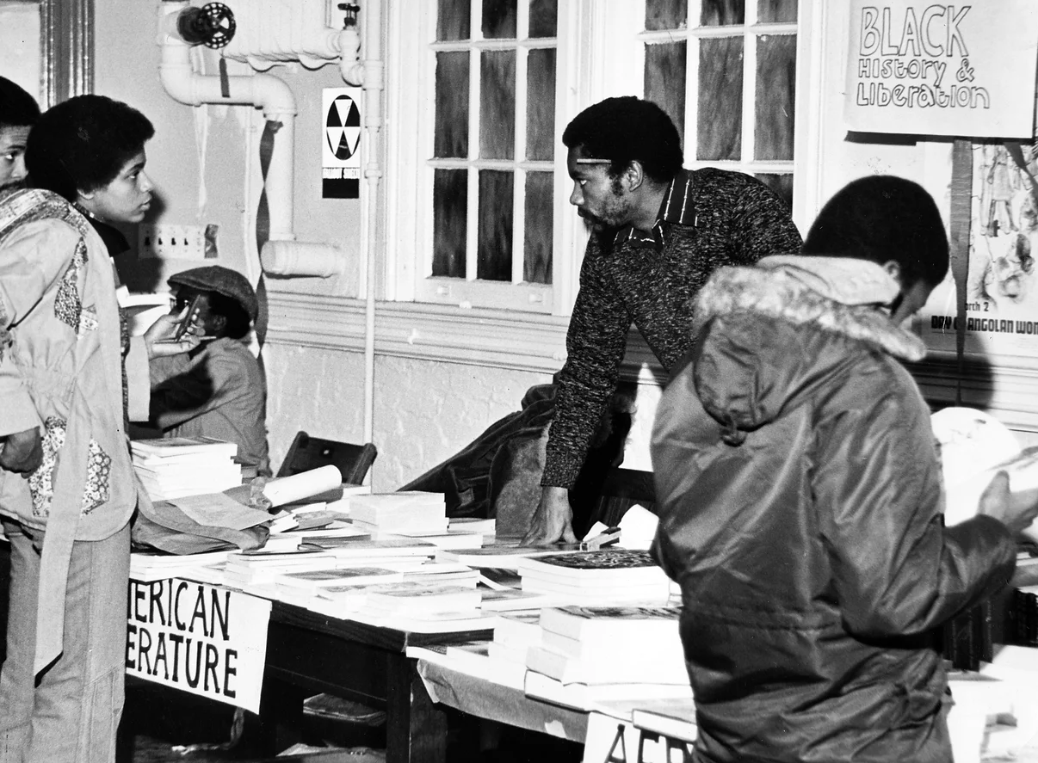
Picturing Black History:
A book vendor presents materials relevant to “Black History and Liberation” to patrons at an event in January 1980.
Photo by Afro Newspaper/Gado/Getty Images
Ramey, 2022.

Slide 14
Class Analysis Activity: Ohio House Bill 322
One at a time, 3 different sections of this Ohio house bill will be displayed
As a class, we will analyze each section of the bill
After analyzing each section, fill out the graphic organizer for each section on your guided notes
You can also find this bill in your source document
Ramey, 2022.

Slide 15
Part 1: Section. 3313. 6027.
…(B) In any course on history, civics, United States government and politics, social studies, or a similar subject area, no school district shall require, make part of such a course, or award course grading or credit for any of the following:
(1) Student work for, affiliation with, or service learning in association with any organization engaged in lobbying for legislation at the local, state, or federal level or in social or public policy advocacy;
(2) Lobbying for legislation at the local, state, or federal level;
(3) Any practicum, action project, or similar activity that involves social or public policy advocacy.
Ramey, 2022.

Slide 16
Part 2: Section. 3313. 6028.
(A) No state agency, school district , or school shall teach, instruct, or train any administrator, teacher, staff, member, or employee to adopt or believe any of the following concepts:
(10) The advent of slavery in the territory that is now the United States constituted the true founding of the United States;
(11) With respect to their relationship to American values, slavery and racism are anything other than deviations from, betrayals of, or failures to live up to the authentic founding principles of the United States, which include liberty and equality.
Ramey, 2022.

Slide 17
Part 2: Section. 3313. 6028.
(B) No teacher or school administrator employed by a school district or employee of a state agency shall approve for use, make use of, or carry out standards, curricula, lesson plans, textbooks, instructional materials, or instructional practices that serve to inculcate the concepts described in divisions (A)(1) to (11) of this section.
(C) If a student completes a course that includes any of the concepts described in divisions (A)(1) to (11) of this section, that course shall not count towards the requirements for high school graduation specified in section 3313.603 of the Revised Code.
Ramey, 2022.

Slide 18
Part 3: Section. 3313. 6029.
No teacher shall be required by a policy of any state agency, school district, or school administration to affirm a belief in the systemic nature of racism, or like ideas...”
Ramey, 2022.

Slide 19
Activity: How Would Carter G. Woodson Respond?
1.) Imagine you are Carter G Woodson and have just read OH HB 322.
What do you think? What do you feel? How would you respond to the Ohio state government?
2.) Next, writing as if you are Woodson, draft a letter to the Ohio Legislator addressing the potential problems of this bill.
Requirements for letter on next slide
Ramey, 2022.

Slide 20
Activity: How Would Carter G. Woodson Respond?
Your letter must include the following:
1.) An introduction and background information of who you are (remember, you are Carter G Woodson).
2.) Briefly describe why you are considered the “father of Black history.”
3.) Explain how this bill contradicts your beliefs about promoting and celebrating hard history.
4.) Identify potential ways this bill could limit discussions of accurate, hard history in classrooms.
5.) Identify potential ways this bill could limit other areas of Black history and celebration in classrooms.
**Reference your notes from the different aspects of today’s lesson to help you (ted talk, jigsaw activity, bill analysis, class discussions).
Ramey, 2022.

Slide 21
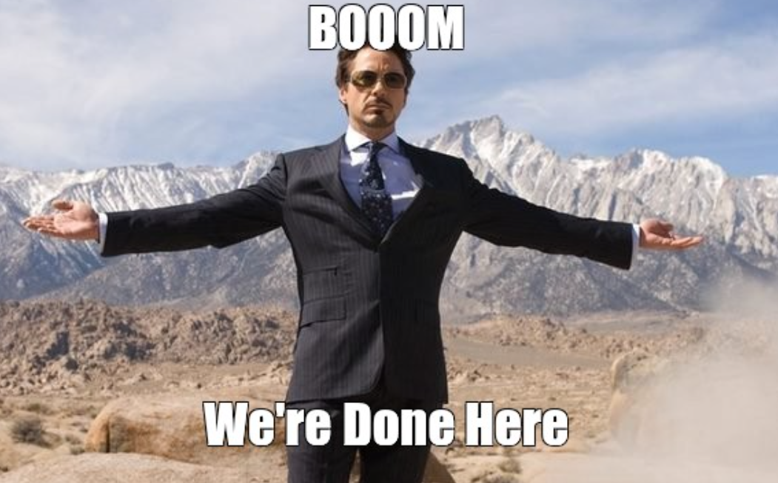
Ramey, 2022.

